Slide 1


Year 2
Meet The Team

Slide 2

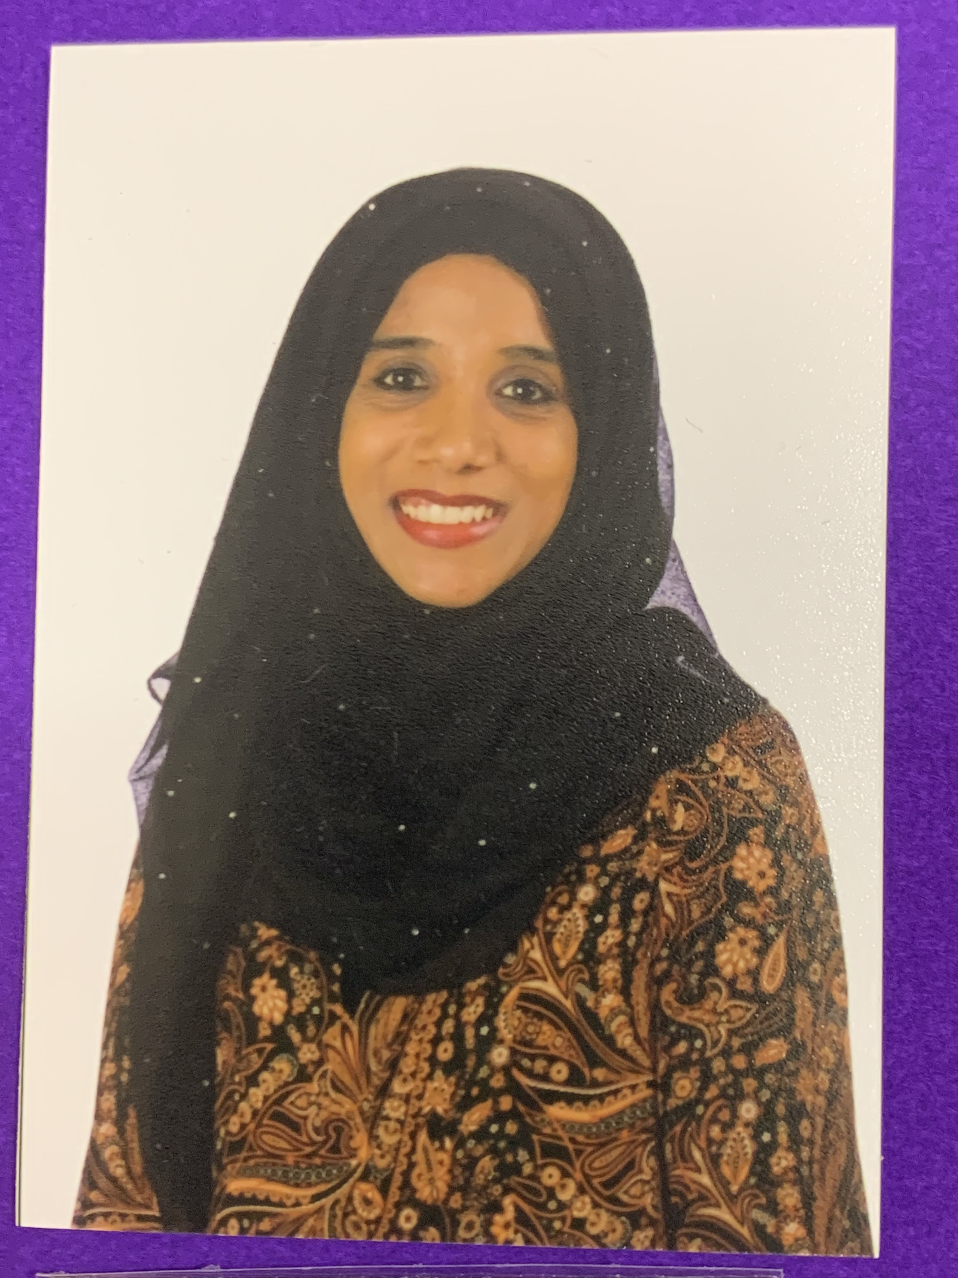
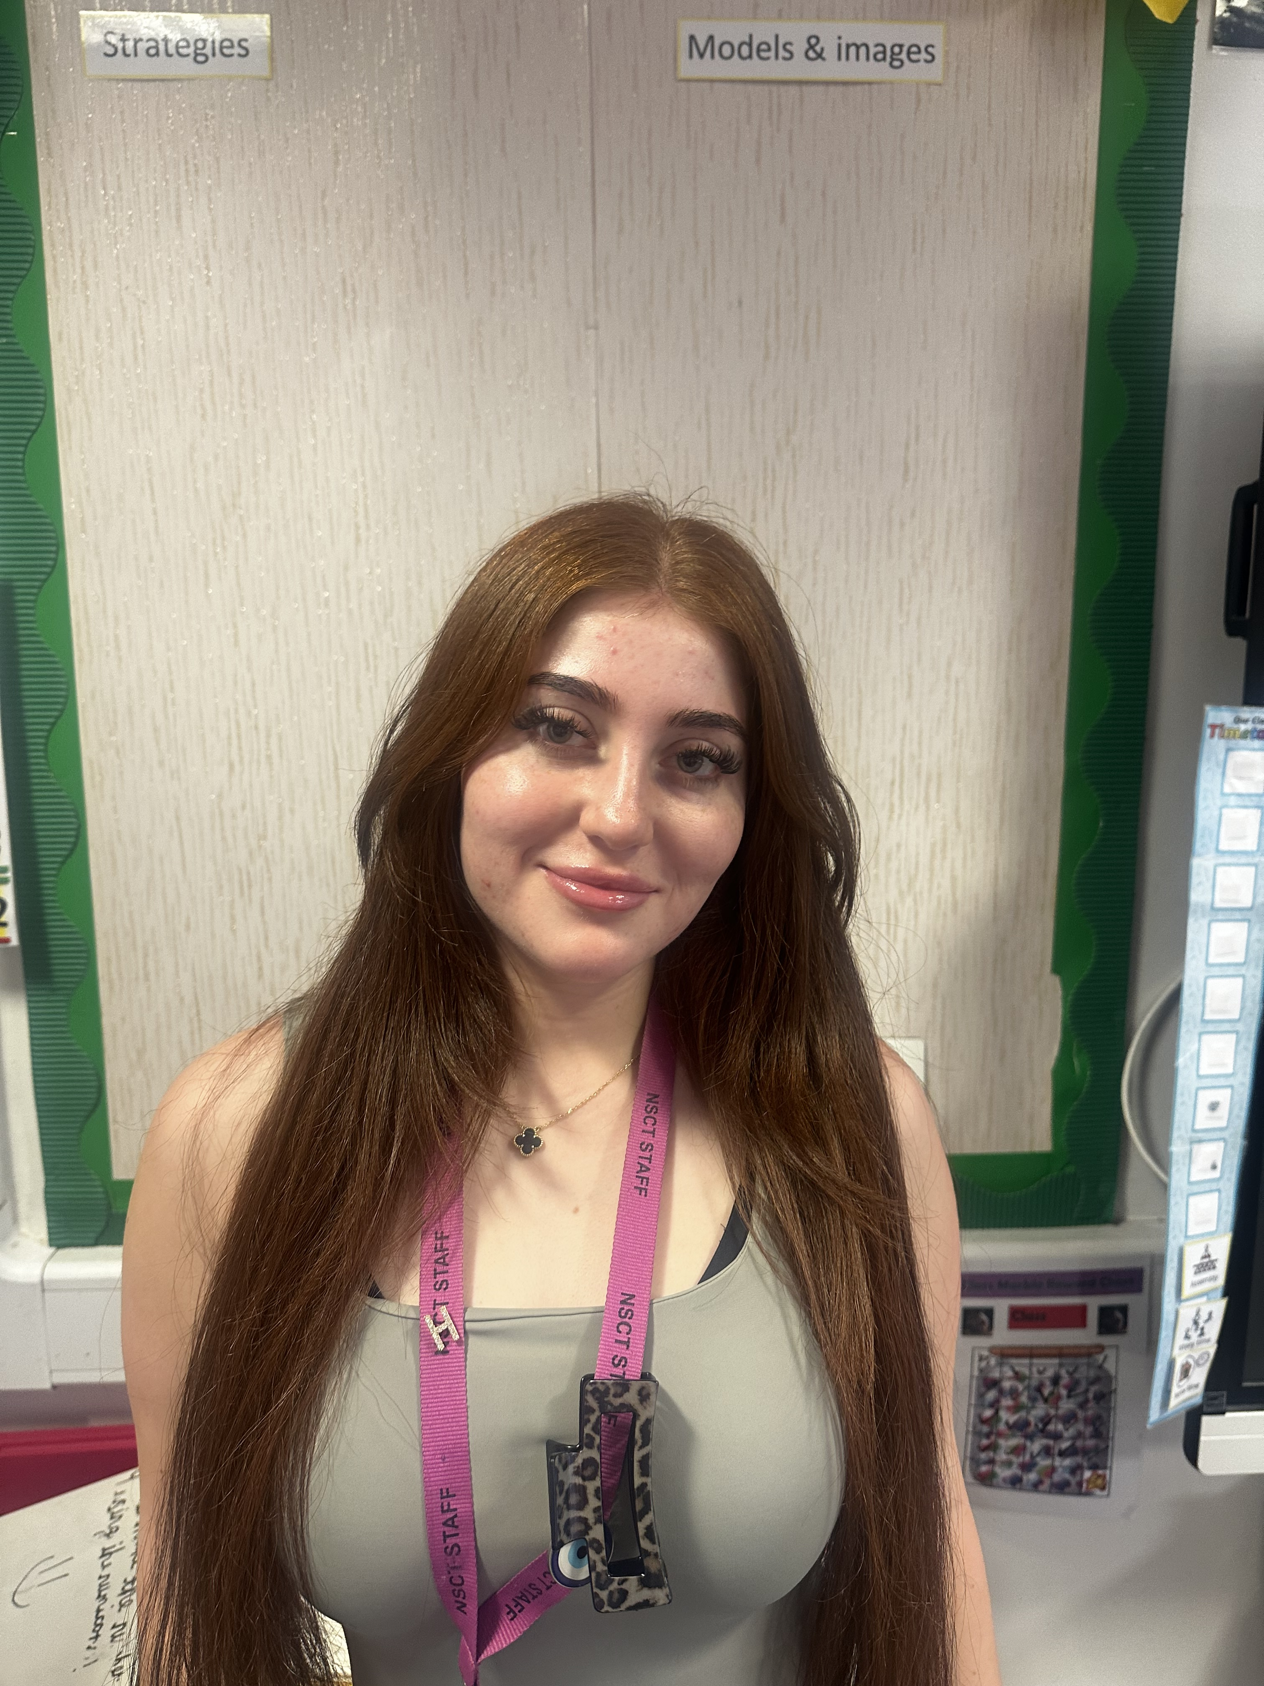
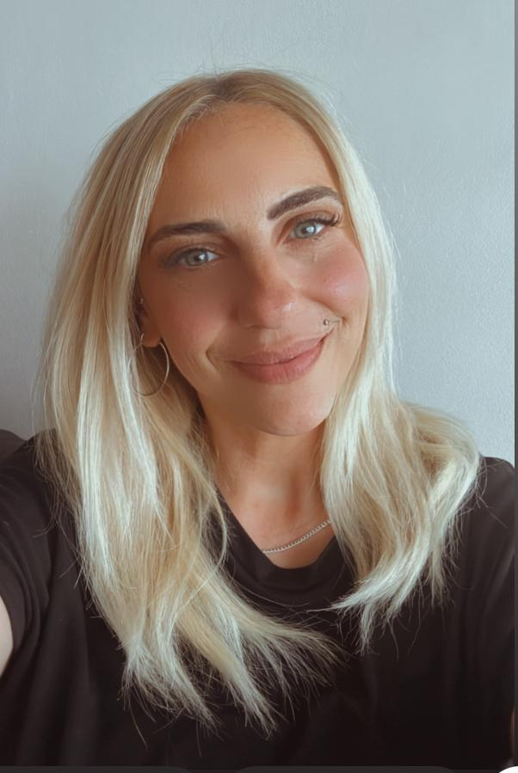
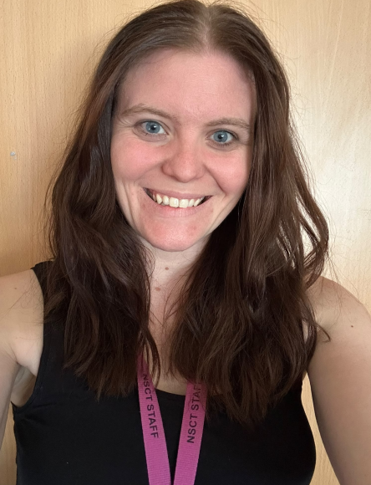
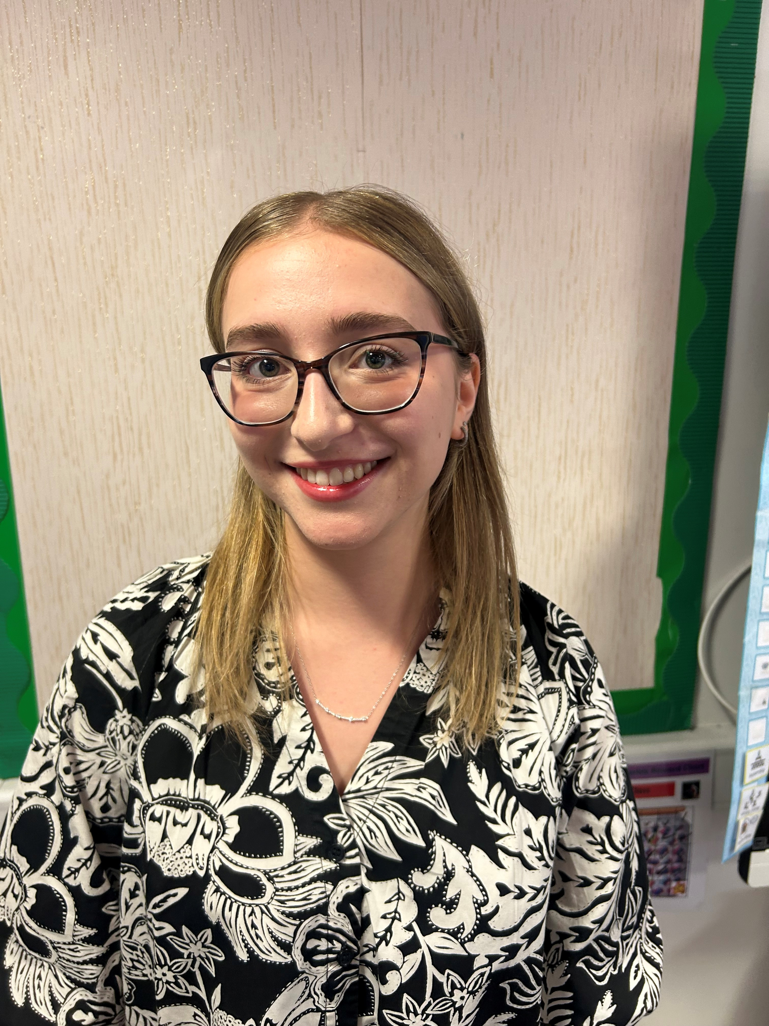
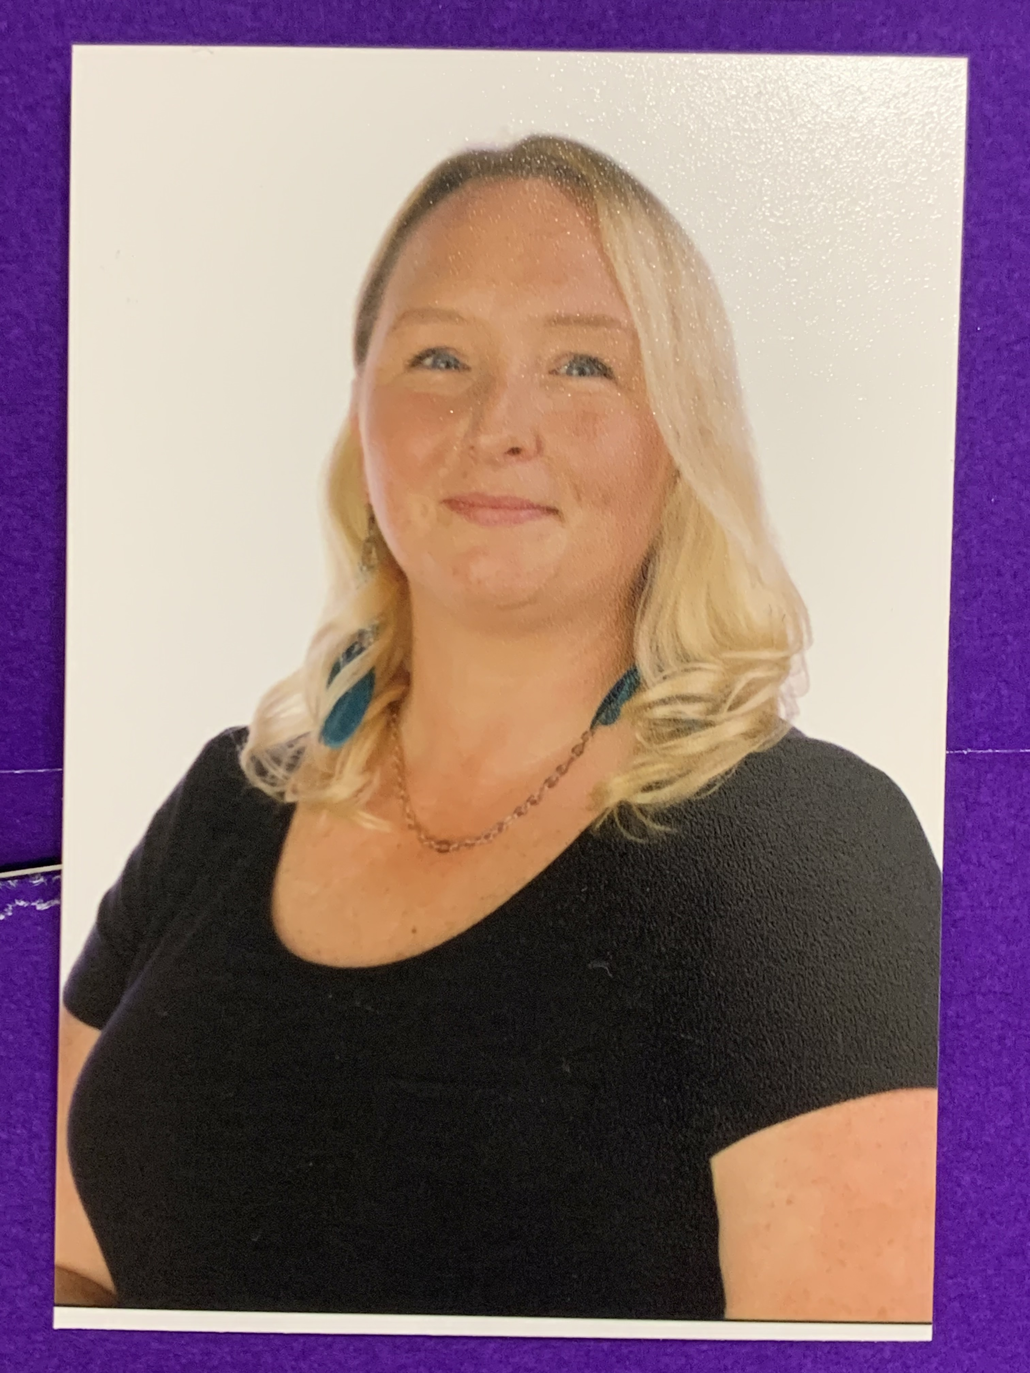
The Team
2B
2E
2O
Ms Dhuny
Class Teacher
Year Group Leader
Miss Meric
Teaching Assistant
Miss Naz
Teaching Assistant
Ms Kane
Teaching Assistant
Miss Mansur
Class Teacher
Miss Hiley
Class Teacher
Associate Assistant Headteacher
Maths Middle Leader

Slide 3

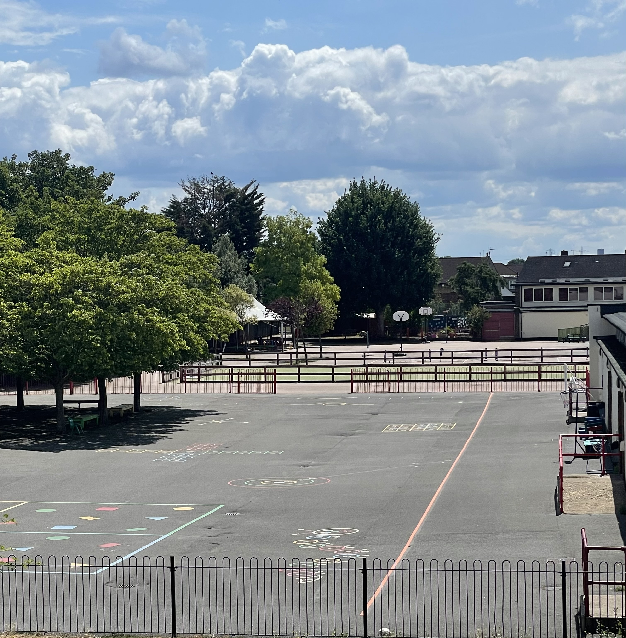
Average day at Woodpecker Hall
8.50- Registration
9.00- 9:30 Guided Reading
9:30- 10:30 English/Writing
10:30 – 10:45 Break Time
10:45 – 11:45 Maths
12:00 – 13:00 Lunch
13:00 - 13:30 phonics / spelling
13:30-14:00 handwriting
14:00 – 15:10 Learning Journey
15:10 – 15:25 Story
15:25 – Home time
Assembly on a Friday 2:45 – 3:15.

Slide 4
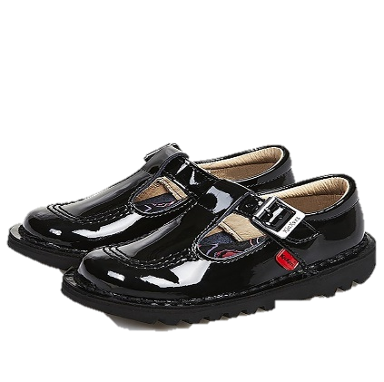
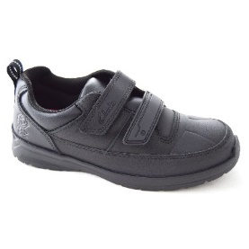


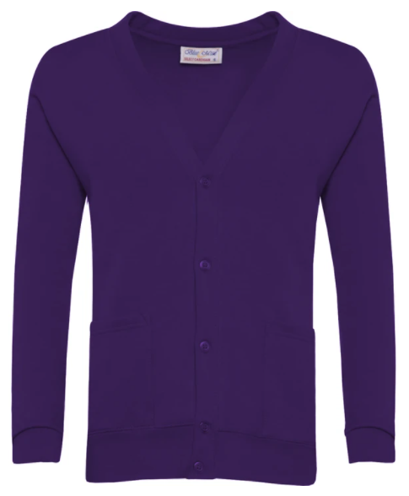

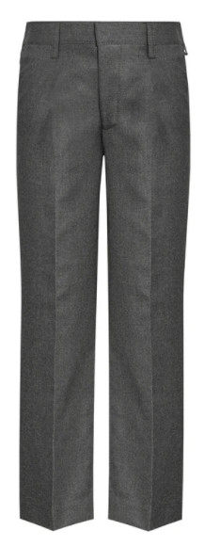

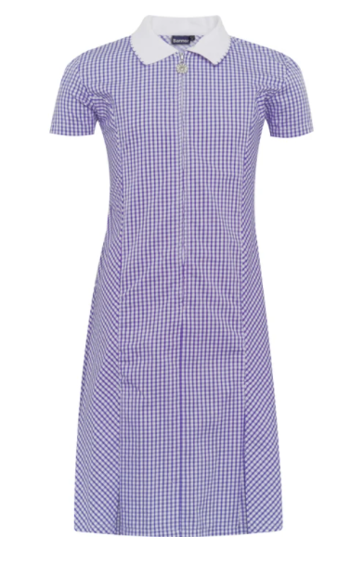



School Uniform
Children must come to school dressed in their full uniform on all days other than PE days.
School jumpers MUST have school logo.
White shirt (long or short sleeved)
School tie
V-neck purple jumper or cardigan (school logo)
Grey skirt
Grey trousers – no leggings
Grey Shorts
Grey pinafore
White socks
White, grey or black tights/ socks
Purple gingham dress (Summer)
Black shoes – no laces
NO JEWELLERY

Slide 5
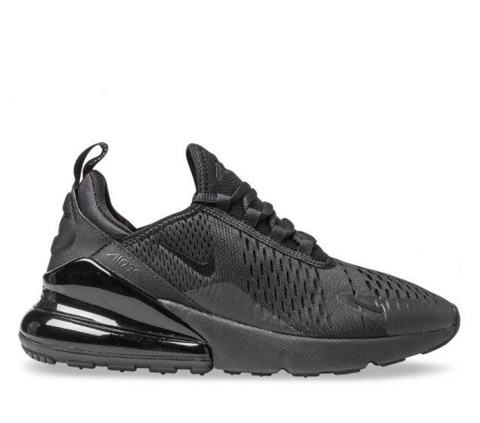
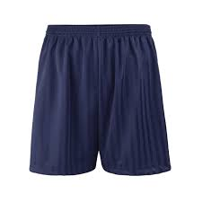
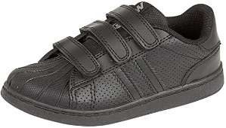
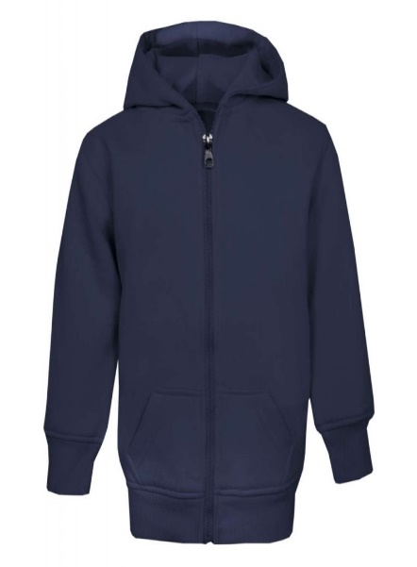


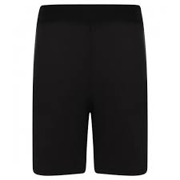
PE KIT
PE days:
Children must come to school dressed in their PE kits on their PE days.
Navy blue shorts or joggers.
No cycling shorts
White t-shirt
Navy hoodie/jumper.
Trainers – no laces
CLASS | INDOOR | OUTDOOR
2O | FRIDAY | WEDNESDAY
2B | FRIDAY | WEDNESDAY
2E | THURSDAY | WEDNESDAY

Slide 6



READING
Reading expectations:
Children must have their orange book (READING RECORD) in their bag every day & it MUST be signed daily.
Reading Record
Home Reading Book
School Library Book
Phonics book (some children)

Slide 7
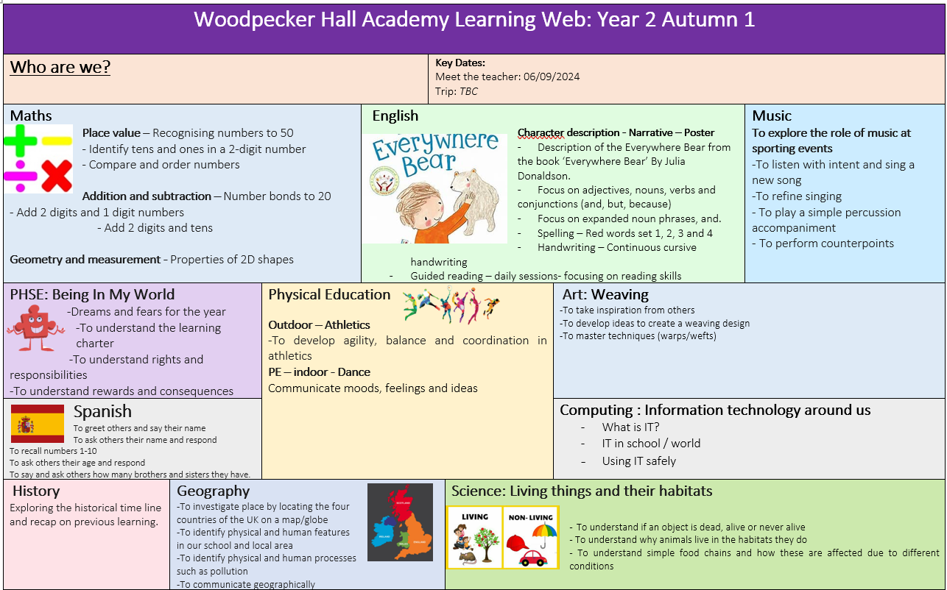
LEARNING WEB
Half termly
Overview
Outlines what the children will be learning during the half term.
If you would like to volunteer on our trips this year, please can you let your child’s class teacher know.
(Our first trip will be end of September)

Slide 8


HOME LEARNING
Expectations:
Google classroom
(Logins are stuck at the back of reading records)
Set on Fridays
Due on Tuesdays
Either Maths or English per week
Reading (every day)
Times table rock star (every day) Username password in reading records
A choice out of 3 learning journey projects to be completed by the end of the half term (show and tell).
If you don’t have access to the internet or a device for your child to do the homework, please speak to the office.

Slide 9
NO SATS
The children will no longer be sitting SATS in Year 2.
It is no longer statutory.
We will continue with our in-school assessments to ensure children are on track and making expected progress.

Slide 10


Communication is key: Arbor
-To pay for a school trip, a club or school meals, this can be done through Arbor.
-Please can you download the app as the school will be sending important messages through this.
-Check your emails for your username, this will have a link to click on.
If you need any help, please go to the office – they are the experts.

Slide 11
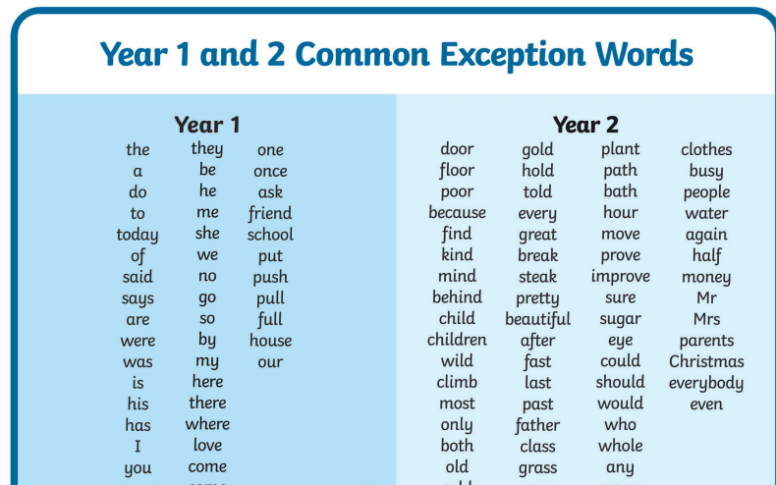
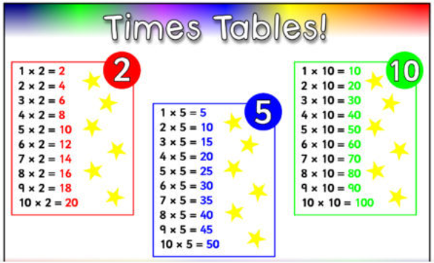
RESOURCES

Slide 12


Supporting children to feel safe, understood and ready to learn
Trauma Informed Approach
Belonging and emotional wellbeing
Healthy relationships
Notes:
Children learn best when they feel safe, valued and understood.
Our aim is to help every child:
Feel safe and secure
Build positive relationships
Understand and manage their feelings and behaviour
Feel confident and ready to learn
We use a nurturing and trauma-informed approach across our school.
We help children understand emotions, build healthy relationships and develop the skills to cope with difficult moments.
We are proud to have achieved the Nurture UK Award and TENDER Award, recognising our work to support children's wellbeing and understanding of healthy relationships.
We continue to use a trauma informed approach as a whole school approach (all staff have been trained) - This means we look beyond the behaviour and ask: “What might this child need?”
You know your child best.
By sharing information, communicating openly and working together, we can give your child the support they need to feel safe and learn.

Slide 13


FRIENDS OF
WOODPECKER
CALLING ALL PARENTS & CARERS!
WE NEED YOUR HELP!
Are you interested in becoming a Class Rep?
We need you to help spread the word and drum up support for the events run by our Parent Teacher Association throughout the year.
Let your class teacher know if you would like to volunteer!

Slide 14
Any questions

