Slide 1


Meet the Team
Year 4

Slide 2
Miss Savage (4O)
Miss Cacioppo (4E)
Mr Delfini (4B)
Miss Osman (Teaching assistant)
2

Slide 3

Average day at Woodpecker Hall
8.45-55 Registration task – linked to times tables
9.00- 9:40 Whole Class Reading
9:45 – 10:45 English
10:45 – 11:00 Break
11:00 – 12:00 Maths
12:00 – 12:15 Times Table practise
12:15 – 13:15 Lunch
13:20 – 14:00 Times table teaching/spelling/handwriting
14:00 – 15:10 Learning Journey
15:10 – 15:20 Story
15:25 – Home time
Assembly is on Friday.

Slide 4








PE Days
Class | INDOOR PE | OUTDOOR PE
4O | Friday | Tuesday
4B | Friday | Tuesday
4E | Thursday | Tuesday
Navy blue shorts or joggers.
White t-shirt
Navy hoodie/jumper.
Black trainers
4

Slide 5

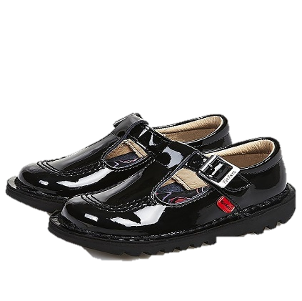







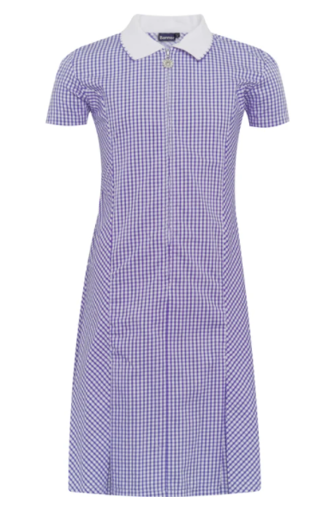



School Uniform
Children must come to school dressed in their full uniform on all days other than PE days.
School jumpers MUST have school logo.
White shirt (long or short sleeved)
School tie
V-neck purple jumper or cardigan (school logo)
Grey skirt
Grey trousers
Grey Shorts
Grey pinafore
White socks
White, grey or black tights/ socks
Grey trousers
Purple gingham dress (Summer)
Black shoes

Slide 6

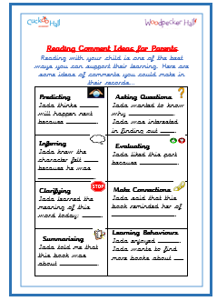
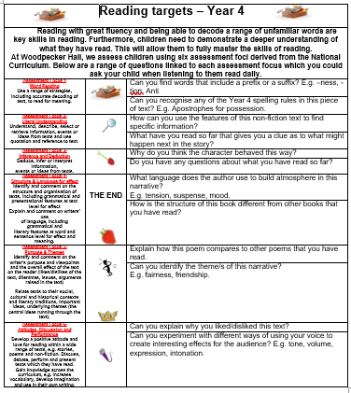
Reading Expectations
Read for 30 minutes everyday.
Bring Reading Records to school everyday.
Sign their Reading Records (see prompts)
Keep safe! It has all the passwords
you’ll need.
Children’s responsibility to change books
regularly.
6

Slide 7
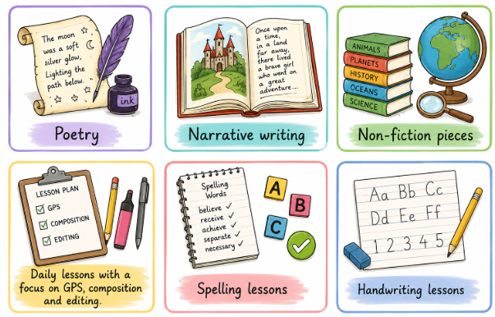
Writing
Poetry
Narrative writing
Non-fiction pieces
Daily lessons with a focus on grammar, punctuation and spelling.
Weekly spelling and handwriting lessons
7

Slide 8



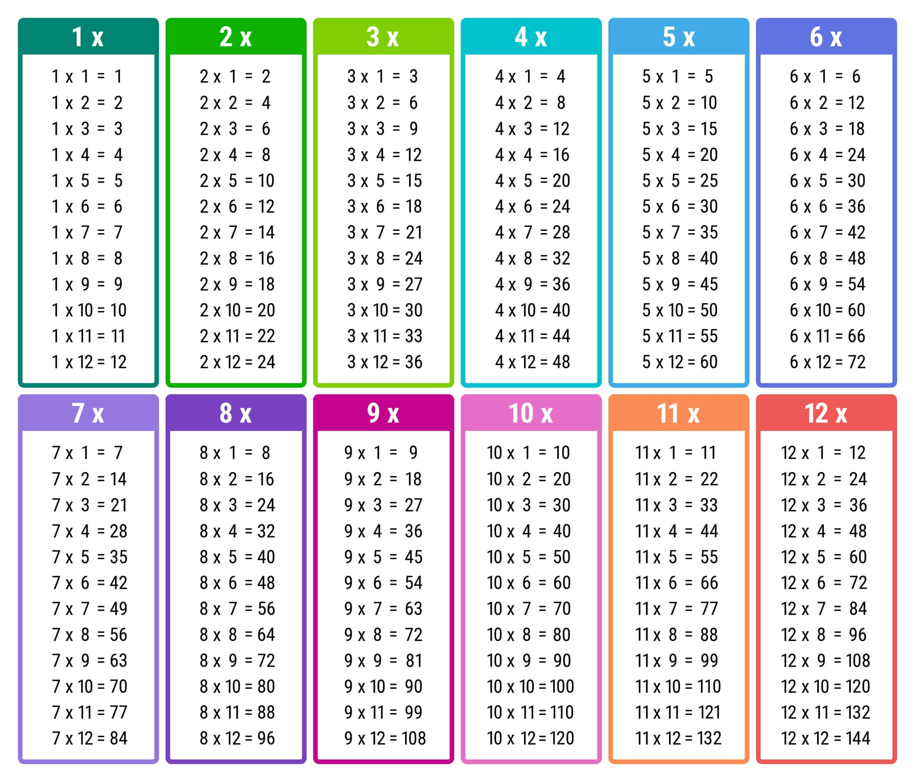
Maths
The key areas we will be covering
this year:
Number & Place Value – Foundational skills
The 4 mathematical operations
Fractions (including decimals)
Measurement
Properties of shapes
Position & Direction
Statistics
Practise books
Mr Demaio timetable songs
Hit the button
Timetables chart
TTRS- login in RR
-By the end of year 4, pupils should know their times tables up to 12 x 12.
Government Timetables test at the end of year 4- June. No pass mark
8

Slide 9
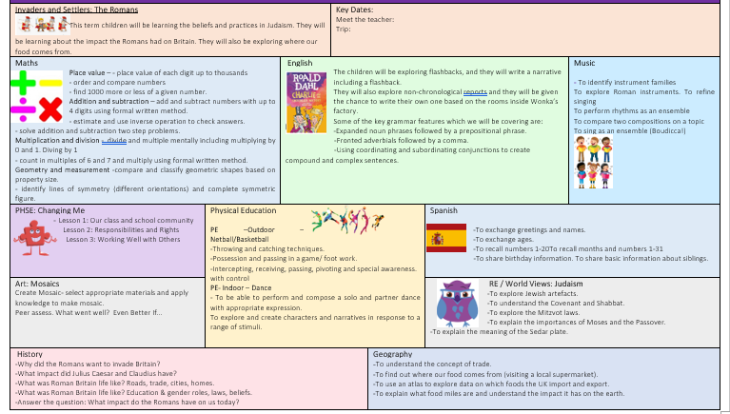
Curriculum
Autumn: Romans
- History
- Geography
- Art
- RE
Trips:
Local visit around our area
Local visit to Asda
Verulamium museum
Parent volunteers
9

Slide 10

Home Learning
Daily: Reading for at least 30 minutes. Playing times table rockstars for at least 20 minutes.
Weekly: Maths OR English will be set on a Friday and due on Tuesday.
Weekly Spellings and Timetables practice.
Half- termly: project work will be set at the beginning of every half term and due by the end of the half term.
Home learning is designed to be enjoyable, and each task should not take any longer than 30-40 minutes.
Chrome books, headphones and internet dongles are available from the school office.
No paper homework will be available.
10

Slide 11

Arbor
Download the Arbor App!
Check your emails for your username, this will have a link to click on.
Best way to receive communication from the school.
Trips, Clubs, Closures etc.
11

Slide 12
Attendance
Good attendance is essential for your child’s success .
Regular attendance helps children keep up with learning, build confidence and stay connected with their class.
Even missing a day or two can mean gaps in understanding, especially in subjects like maths and English where lessons build on previous learning.
We encourage all families to aim for excellent attendance so that every child can reach their full potential.
Attendance is also incentivised through half termly attendance prizes and trips.
12

Slide 13

Swimming
Year 4 will take part in the London Borough of Enfield Swimming Programme as part of their Physical Education entitlement.
Location: TBC
Date: TBC
Duration: 12 weeks
A letter will be sent when it is your child’s class's turn (on the website)
Goggles may be worn only if a letter has been sent by parent/guardian
Children will be split into differentiated groups and are taught by trained members of staff
13

Slide 14


Supporting children to feel safe, understood and ready to learn
Trauma Informed Approach
Belonging and emotional wellbeing
Healthy relationships
Notes:
Children learn best when they feel safe, valued and understood.
Our aim is to help every child:
Feel safe and secure
Build positive relationships
Understand and manage their feelings and behaviour
Feel confident and ready to learn
We use a nurturing and trauma-informed approach across our school.
We help children understand emotions, build healthy relationships and develop the skills to cope with difficult moments.
We are proud to have achieved the Nurture UK Award and TENDER Award, recognising our work to support children's wellbeing and understanding of healthy relationships.
We continue to use a trauma informed approach as a whole school approach (all staff have been trained) - This means we look beyond the behaviour and ask: “What might this child need?”
You know your child best.
By sharing information, communicating openly and working together, we can give your child the support they need to feel safe and learn.

Slide 15


