Slide 1


Welcome to
Kingfisher Hall Academy Reception
2026/27

Slide 2

Aims of this session:
Meet the team
Explain the next steps in the induction process (dates, arrangements, classes)
Explain how best to best prepare your child for Reception
Explain what to expect when children start and introduce school systems in place
What to expect during the Stay and Play
Answer questions
2

Slide 3
Staff Overview
Senior Team Head Teacher Gemma Vincent Deputy Head Havva Ayer Assistant Head Olivia Stuart Associate Assistant Head Nicola Barlow | Reception Team EYFS Lead Miss Demetriou Garnet Class Teachers Miss Jackson/ Mrs Harris Teaching Assistant TBC Ruby Class Teachers Mrs Smith / Mrs Harris Teaching Assistant TBC | SEND Team SENDCo Andrea Sofroniou SEND Admin Faye Woodward
3

Slide 4
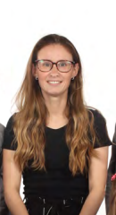

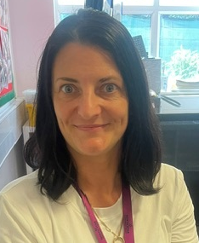
Staff Overview
Garnet Class
Ruby and Garnet
Ruby Class
Teacher
Miss Harris
Teacher ​
Mrs Smith
Teacher ​
Miss Jackson
4

Slide 5
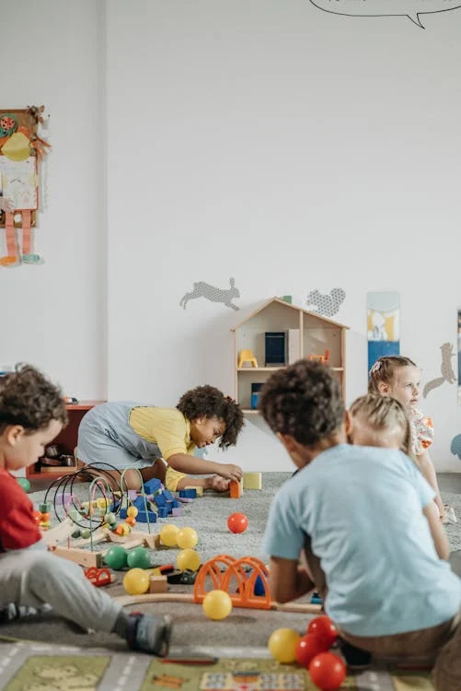
Induction Process:
Stay and play SAVE THE DATE
Tuesday the 7th of July 9.30- 11.15
Current children's parents do not need to attend
Only one parent to attend for new joiners.
This will be a great opportunity for you and your child to familiarise yourselves with the setting, get to know the teachers and for your child to make some friends ahead of the September start.
5

Slide 6
Induction Process:
Group A
Date | Time | Information
Monday 7th September 2026 | 8:30-11:15am | Frist day- no lunch Parents/carers are NOT expected to attend this session. Children are not staying for lunch.
Tuesday 8th September 2026 | 8:30-12:30pm | Second day- with lunch Parents/carers are NOT expected to attend this session. Children are staying for lunch. If your child will NOT be having school dinners, please provide them with a healthy packed lunch.
Wednesday 9th September 2026 | 8:30-3:10pm | Full day Your child will be in school full time. Please ensure your child is in school from 8.30am. Pick-up time is at 3.00pm; please don’t be late.
6

Slide 7
Induction Process:
Group B
Date | Time | Information
Monday 7th September 2026 | 12:30-3:10pm | Frist day- no lunch Parents/carers are NOT expected to attend this session. Children are not staying for lunch.
Tuesday 8th September 2026 | 11:00-3:10pm | Second day- with lunch Parents/carers are NOT expected to attend this session. Children are staying for lunch. If your child will NOT be having school dinners, please provide them with a healthy packed lunch.
Wednesday 9th September 2026 | 8:30-3:10pm | Full day Your child will be in school full time. Please ensure your child is in school from 8.30am. Pick-up time is at 3.00pm; please don’t be late.
7

Slide 8
All children will be full-time on the third day unless we feel that they need longer to settle.
Your child may need a personalised introduction to school that will help them to settle more easily.
8

Slide 9
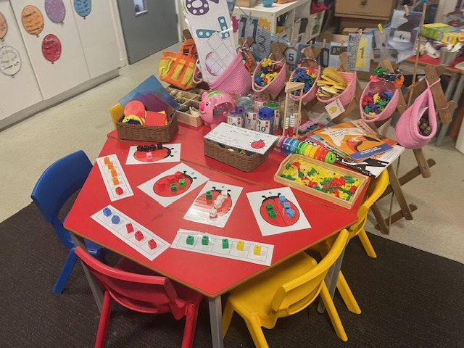
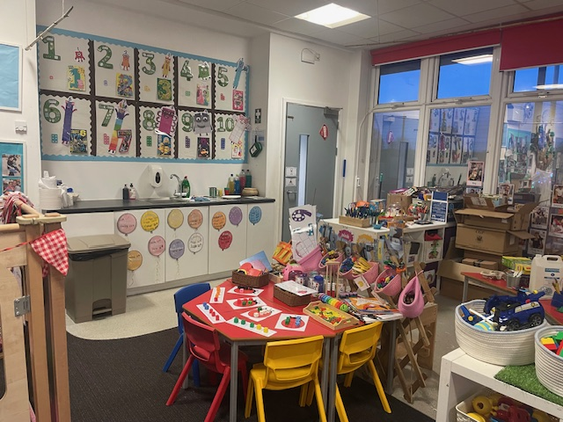
Outline of the day 8.30am to come into class; children start learning at 8.40am 11.30-12.30pm Lunch time 3.10pm end of day Drop off and pick up is at your child’s class door via the playground. 2 PE sessions per week –days TBC 1 music session per week 1 Spanish session per week Our day consists of learning indoor and outdoors. If you would like to speak to the teacher please arrange a time for the end of the day.
Keeping Healthy and independent Healthy diet. Oral health very important; brushing teeth with an adult twice a day. 10-13 hours sleep every night; early bedtime is very important. No screen time 1 hour before bedtime to help them sleep. Independence dressing/undressing and eating. Following instructions. Express emotions clearly.
9

Slide 10
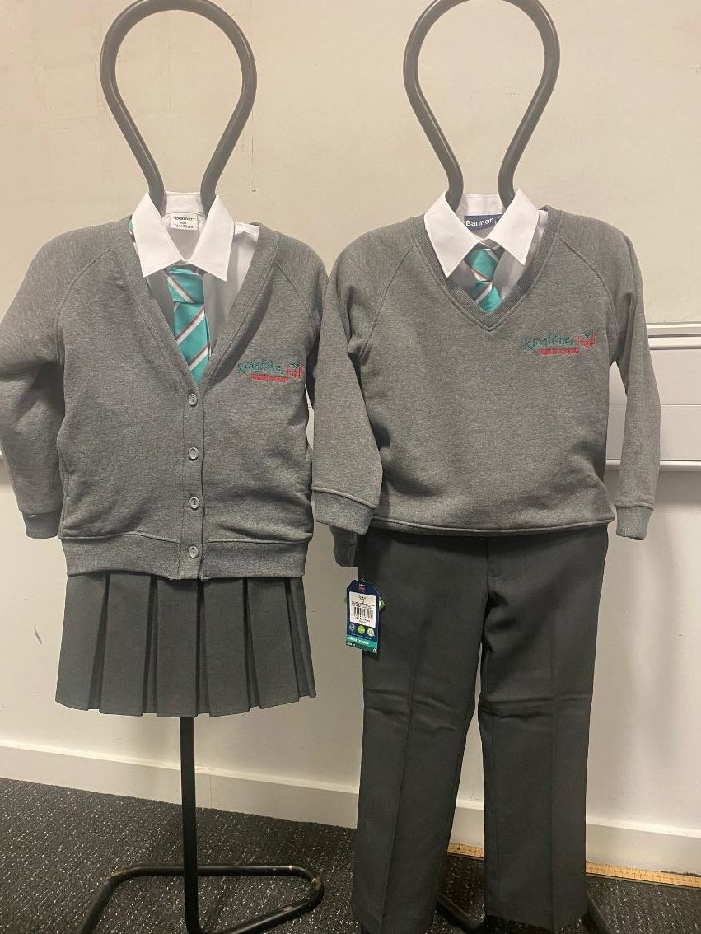





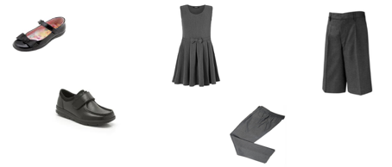



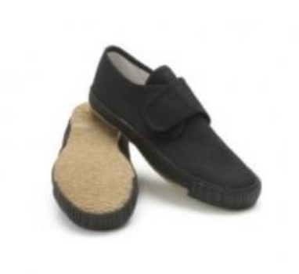
School Uniform
Uniform is compulsory
School uniform can be bought during the summer holidays, from Smiths School wear on Baker Street near Enfield Town.
Come to school in PE kit on PE days-TBC
The school uniform
Reception P.E Kit
ALL UNIFORM MUST BE LABELLED!
For health and safety reasons children are not allowed to wear jewellery to school other than small, stud earrings.
Please take the time over the holidays to encourage your child to get dressed/undressed independently, as this will prepare them for the beginning of term in September.
10
Notes:
Book bag

Slide 11
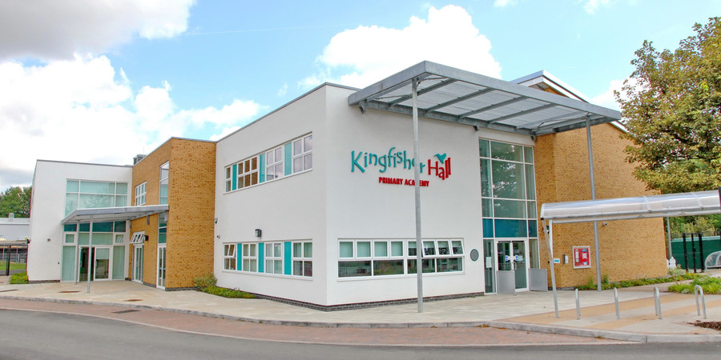
School Day on Arrival
Please keep to the dropping off and collecting times. Children arriving late or being collected late can become distressed. Always phone us if you are running late so that we are able to reassure your child that you are on your way.
Children must be collected by a known adult or senior school age child, not a primary aged child. If for any reason a different person is collecting your child, please let the class teacher or a member of the office staff know.
11

Slide 12


Fruit / Water
Children are provided with a piece of fruit or vegetable every morning as part of the National Fruit Scheme, to support healthy eating.
We actively encourage children to drink water throughout the day to keep them hydrated. Please send your child in with their own water bottle every day and make sure it is labelled with their name.
12

Slide 13

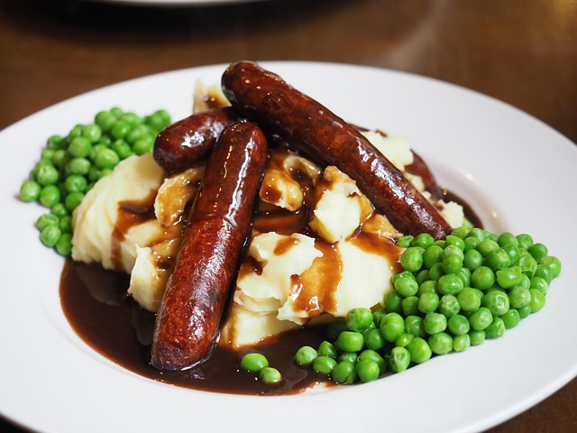
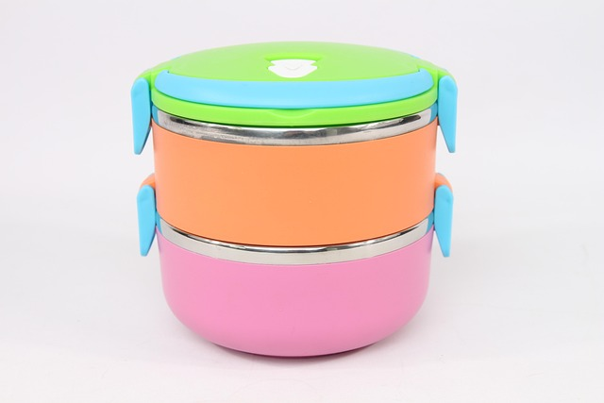
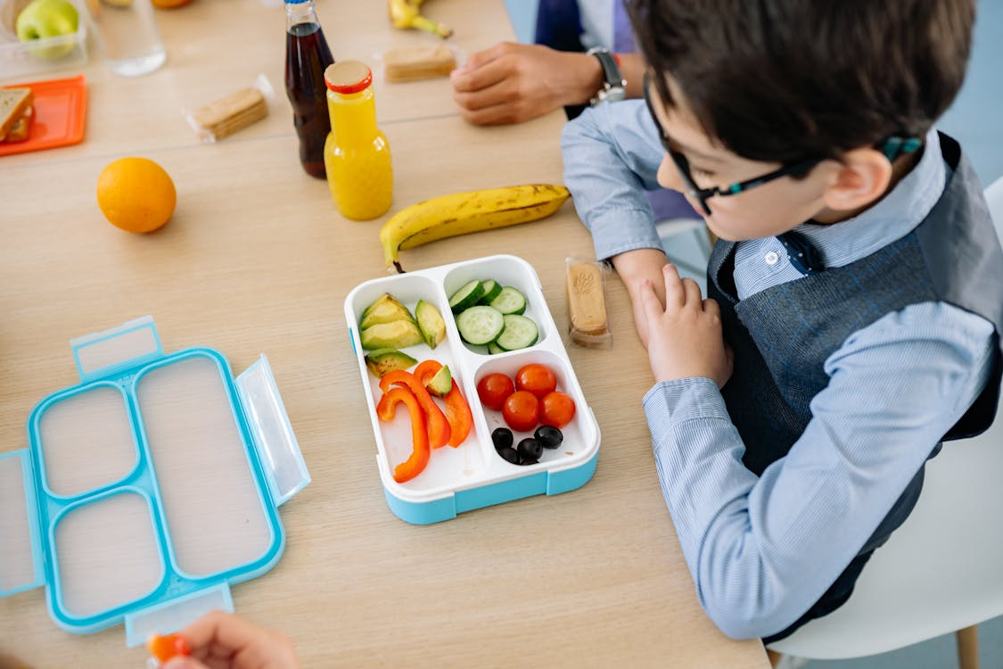
Lunchtimes
Your child can either have a school dinner or bring in a packed lunch. All children in Reception are entitled to a Universal Free School Meal and no payment is required.
Please note
Fizzy drinks and sweets/chocolates are not allowed to be brought in children’s lunch boxes. Kingfisher Hall Primary Academy is a NUT FREE school. Please do not include any items in lunch boxes that contain nuts, such as ‘Nutella’, peanut butter sandwiches or other nut items.
13
Notes:
Cut grapes in half

Slide 14

TAPESTRY Learning Journal
Online Learning Journal system where staff record your child’s progress and activities using tablet devices (iPads) and PCs.
Parents and carers can view their own child’s journal on mobile devices and on their home computers and can make observations of their own using a secure login system.
It creates a two-way communication between us (the EYFS team), and you (the parents and carers).
14

Slide 15
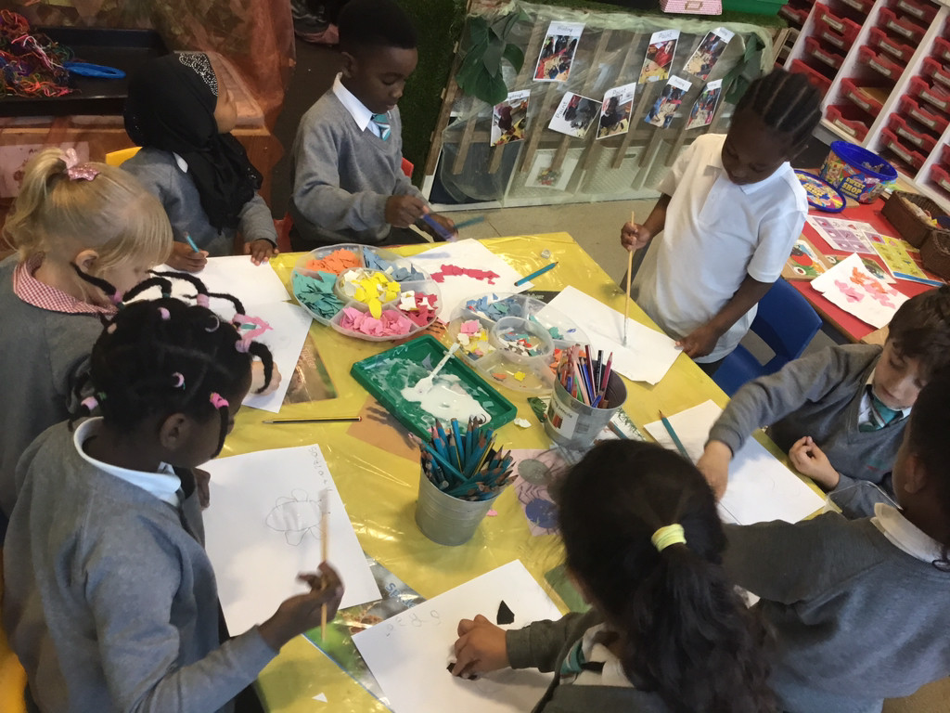
Curriculum
The Foundation Stage curriculum is play-orientated and based on the premise that children learn from quality first hand experiences-Indoors and Outdoors
Three Prime Areas of learning & development: | Four Specific Areas of learning and development:
Communication & Language - Listening, Attention and Understanding - Speaking Physical Development - Gross Motor Skills - Fine Motor Skills Personal, Social & Emotional Development - Self-Regulation - Managing Self - Building Relationship | Literacy - Comprehension - Word Reading - Writing Mathematics - Number - Numerical patterns Understanding of the World - Past and Present - People, Culture and Communities - The Natural World Expressive Arts & Design - Creating with Materials - Being Imaginative and Expressive
Learning is further enhanced through ‘Focus Group’ work with Class Teachers and Teaching Assistants.
Kingfisher Hall Academy follows the Read Write Inc. scheme of work to teach phonics.
​
Useful website for parents & carers: www.ruthmiskin.com​
15

Slide 16

Phonics
Kingfisher Hall Academy follows the Read Write Inc. scheme of work to teach phonics.
Children develop their phonic knowledge by working through the programme in groups, learning to blend and segment simple words and moving on to sentences as their confidence grows. We will be assessing them regularly to ensure that they are always being taught at their correct levels.
As well as encouraging fluency and pace, Read, Write Inc. also encourages and develops children’s comprehension skills which will make them confident and competent readers.
Useful website for parents- www.ruthmiskin.com
16

Slide 17



Medical needs
If your child has a medical problem or allergies which might affect them in school, we need to know. It will help us ensure, for example, that any cooking ingredients used are suitable for all the children.
If your child uses an inhaler, we will need one that can be kept in school.
Inhalers are kept securely in the medical room and children use them under the supervision of the school staff. We must have a letter from GP giving precise instructions of dosage.
Please note that medication is not administered by staff, unless it is part of an emergency care plan which has been agreed by the headteacher.
Please make sure that we have an up to date contact number in case we need to get hold of you.
17
Notes:
Two inhalers, one in the classroom and one in the office
It must be in date.

Slide 18

First Aid
Whilst we do everything we can to make sure that they are safe, children do fall over and getting the occasional bruise is part of growing up!
Our staff are trained to attend to the children and will treat all bumps and bruises.
If a child has bumped their head, you will receive a call from a member of staff to make you aware.
18

Slide 19
How to support?
Read with or to your child every day and complete the orange reading record.
Talk to your child about their school day. Discuss things that they see around them and extend their vocabulary.
Make a commitment to attend Parents’ Evenings and Open Days, coffee mornings and workshops.
If there are concerns over your child’s behaviour or how they settle in, work with the school and support class teacher by providing consistent messages between school and home.
Make sure your child has good attendance and punctuality by establishing good routines at home e.g. bedtimes.
Homework: Weekly homework will be sent home to be completed: either literacy or maths based. Each half term a project homework will be sent home to be completed.
Please see the Reception Information Booklet for a more detailed list of things you can do to support your child’s learning.
19

Slide 20
If you have a concern about your child
Please speak to the Class Teacher or Teaching Assistant first for day-to-day communication.
For the most serious and pressing issues, please arrange a meeting to speak to your child’s class teacher or a member of the senior team.
20

Slide 21

Website
You will find all the relevant information about Reception Curriculum on our website
https://www.kingfisherhallacademy.org.uk/
21

Slide 22

Save the Date
Wednesday 23rd September 2026 at 8:40am
Parent Workshop for Literacy and Maths

Slide 23
Any Questions?
23

Slide 24
Thank you and if you have any further questions, please see the Reception Information Booklet or email the school:
kingfisher@northstartrust.org.uk
We look forward to seeing you all in September!

