Slide 1

Welcome to
Woodpecker Hall Academy Nursery
2026/27

Slide 2
Aims of this session:
Meet the team
Key information
Next steps in the induction process
(Dates, arrangements, classes)
How best to prepare your child for Nursery
What to expect when children start
Answer questions
2

Slide 3
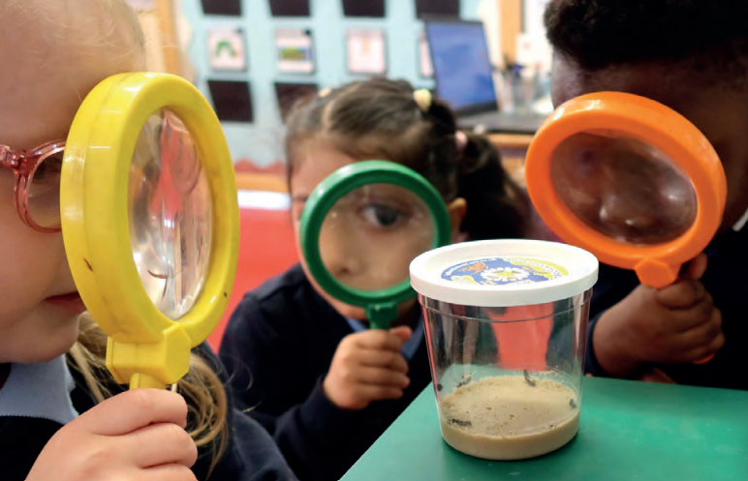
Who is who?
Headteacher: Nicky Ross
Deputy Headteacher & SENCO : Hatice Mehmet
Associate Assistant Headteacher for Early Years: Kayley Putz & Yasmine Jerome
Year group Lead:
Selma Hassan
Full Time Class Teacher: Kayley Putz
Nursery Part Time Class Teachers: Selma Hassan & Sabrina Salkey
3

Slide 4
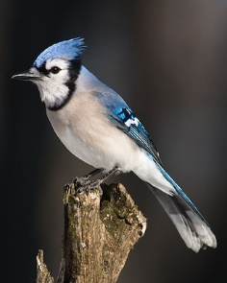
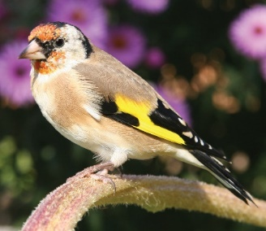
Nursery Classes
Finches
3 year old class
*Morning class
8.30-11.30am
*Afternoon class
12.15-3.15pm
Blue Jays
3 year olds class
* Full Time
8.30-3.15pm
4

Slide 5
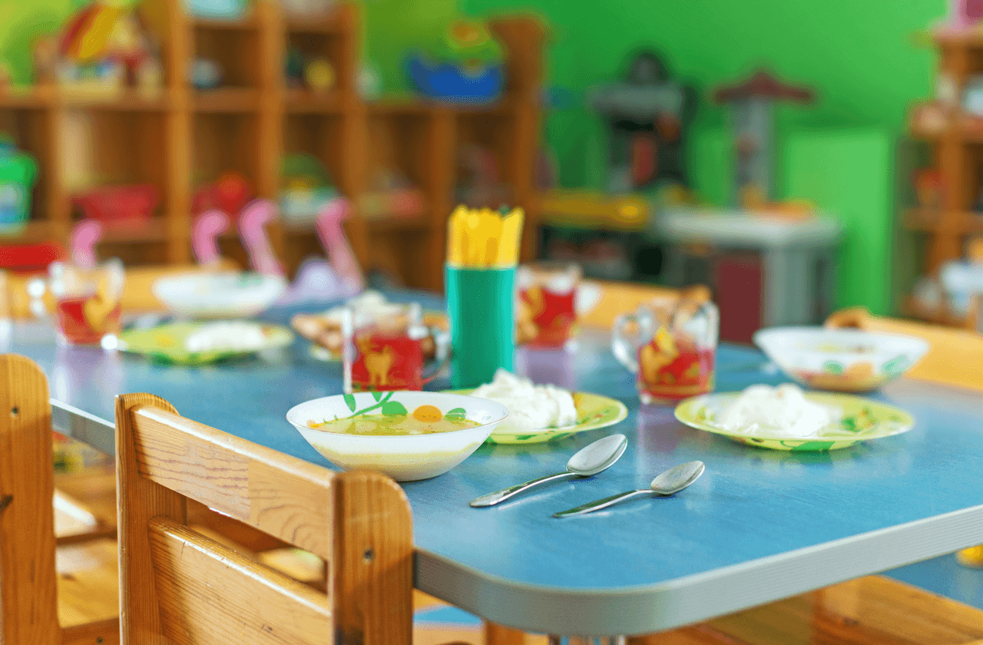
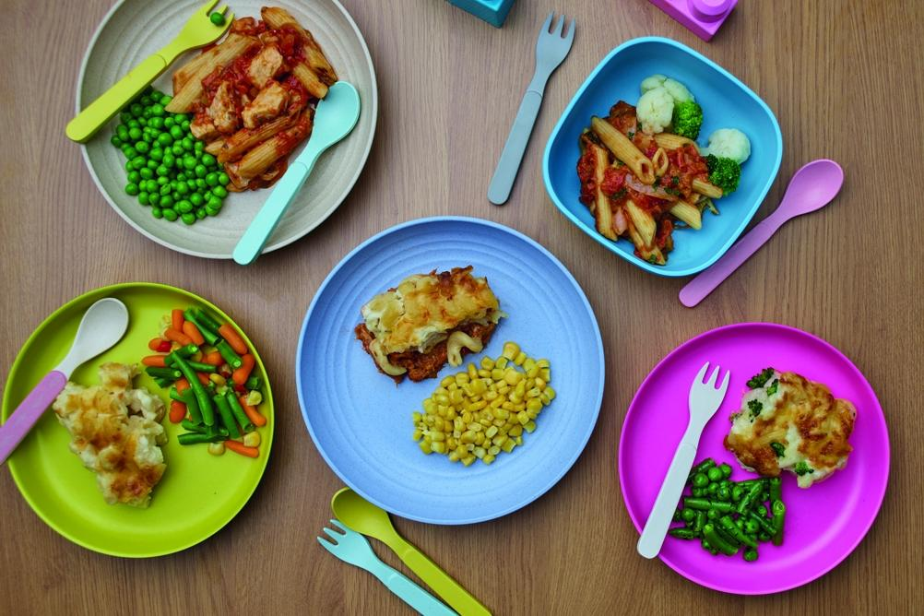
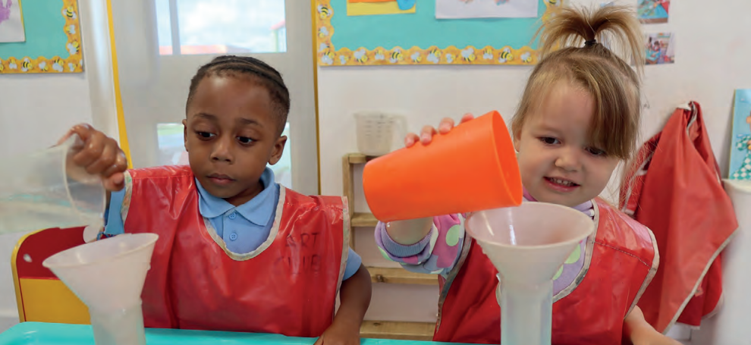
Wraparound Care
Breakfast Club
8:00-8:30pm
We offer the children cereal, toast, fruit and water.
After Nursery Care
3.15-6.15pm
Children staying in After Nursery Care will be provided with a light meal.
(See the Wrap Around Care menu)
5

Slide 6

Food
Fruit and Milk -Children are provided with a piece of fruit/vegetable and a carton of milk each day. We require the children to bring their own named water bottle.
Blue Jays – Bring packed lunch from home. (NO NUTS & FISH)
Lunch time is at 11.30am.
6

Slide 7


Packed Lunches
If your child is staying with us full time, please ensure they bring in a packed lunch. Please note that fizzy drinks, chocolate spreads and sweets/chocolates are not allowed to be brought in children’s lunch boxes.
Woodpecker Hall Academy is NUT and FISH FREE at all times. Please do not include any items in lunch boxes that contain fish/seafood, such as tuna and nuts, such as ‘Nutella’ and other chocolate spreads, peanut butter sandwiches or other nut items.
Children are encouraged to eat as much as they can. If your child experiences problems at lunchtime, we will let you know.
Anything not eaten will be left in the lunchbox.

Slide 8

Medical Needs
We need to know if your child has a medical need or any allergies which might affect them in school. Please inform the class teacher/school office.
If your child uses an inhaler, we can supervise its use during the school day.
Please note that medication is not administered by staff unless it is part of an emergency care plan which has been agreed by the Headteacher/Medical Team.
Please make sure that we have an up-to-date contact number in case we need to get hold of you.

Slide 9
Induction
Key dates and Information for Nursery 3-4 2026
Tuesday 30th June 2026 9.30 am/Upper school Hall WHA | Information Meeting for parents and careers Letter about stay & play, staggered starts and home visits to be given with the information pack
Wednesday 1st July 2026 | Home visits This is for children who are new to our school and have not attended our Nursery provision before.
Tuesday 7th July 2026 | Stay & Play session for Nursery children who are new to our school and have not attended our Nursery. (Parents are required to stay on site for this visit).
9

Slide 10
Induction
Key dates and Information for Nursery 3-4 2026
Friday 4th- 7th September 2026 | All information is in your letter. *Please note that if your child is unsettled, we will work with you to set up personalised settling-in process and times to support your child.
Current Nursery Children -
No settling in period required - Monday 7th September - Return to Nursery
Finches -
Monday 7th September 2026
8.30am - 9.30am or 12.15pm – 1.15pm
Parent/carers must attend this session.
Tuesday 8th September 2026
8.30am - 10.30am or 12.15pm – 2.15pm
Parents/carers are NOT expected to attend this session.
Wednesday 9th September 2026
8.30am - 11.30am or 12.15pm – 3.15pm
Your child will be in nursery for their full allocated hours.
Blue Jays - New Starters
Monday 7th September 2026
8.30am - 9.30am
Parent/carers must attend this session.
Tuesday 8th September 2026
8.30am – 10.30am
Parents/carers are NOT expected to attend this session.
Wednesday 9th September 2026
8.30am - 12.30pm with Lunch
Thursday 10th September 2026
8.30am – 3.15pm
Full-time Session
10

Slide 11
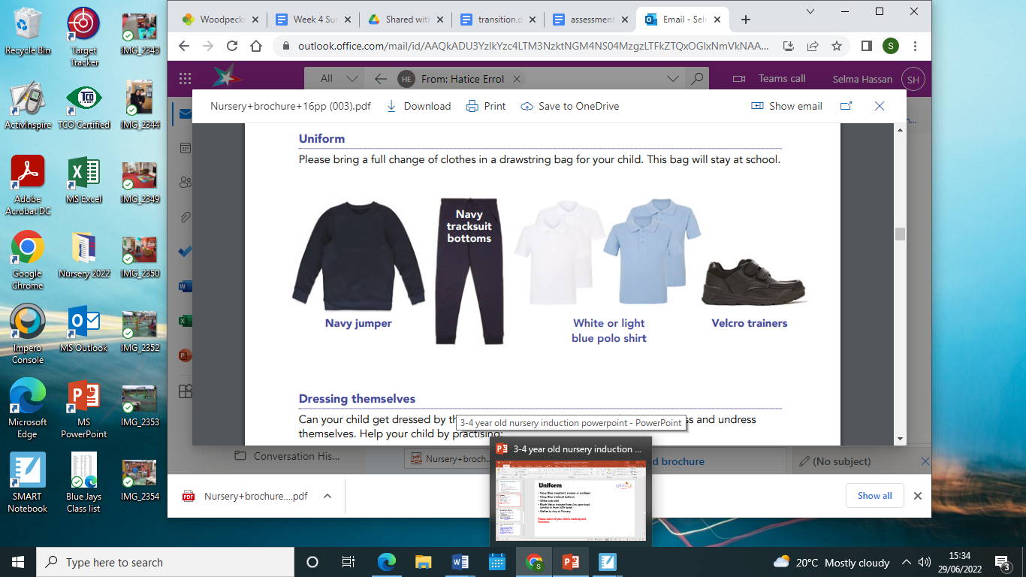
Uniform
Navy Blue sweatshirt, jumper or cardigan
Navy Blue tracksuit bottoms
White or light blue polo shirt
Black velcro trainers/shoes (no open-toed sandals or shoes with laces)
Wellies to stay at Nursery for Forest Garden.
Please label all your child’s clothing and footwear.
11
Notes:
Coat
Sun hat depending on weather

Slide 12

EYFS Curriculum…What we do?
Using the Early Years Foundation Stage Curriculum -
Focus upon Prime Areas - Personal Social Emotional Development, Physical Development, Communication & Language.
Specific Areas - Literacy, Maths, Expressive Art & Design, Understanding the World
Our Learning Journeys
Autumn 1 - All about me!
Autumn 2 - In the Woods.
Spring 1 - People who help us
Spring 2 - On the farm
Summer 1 - In the Garden
Summer 2 – Journeys and Transport
Parents will receive a learning web with further details each half term.
Class Trip opportunities will be organised and parents informed via Arbor. Consent will be required.

Slide 13


Bookbags
Reading is one of the most important things you can do to support your child’s education.
Each nursery child will be given a zippy wallet with a book and a reading record.
Please return this by WEDNESDAY so we can change the book.
13
Notes:
Coat
Sun hat depending on weather

Slide 14
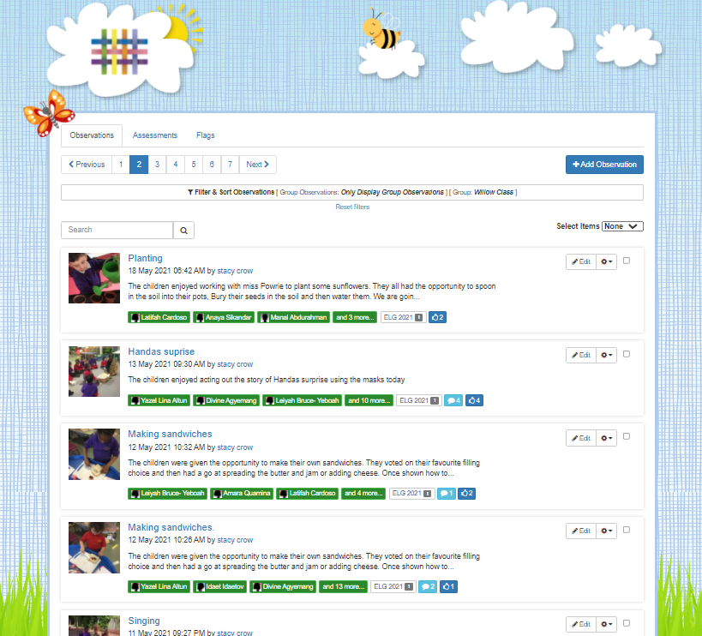
Tapestry
An Online Learning Journal system where staff record children's progress and activities, using tablet devices (iPads) and PCs.
Parents can view their child’s journal on mobile devices and on their home computers and can make observations of their own using a secure login system.
It creates a two-way communication between home and school.
We ask parents to upload 1 observation every 2 weeks from home. Home activity tasks will also be set to support this.
In September, you will be set up on Arbor (key information/messages/trips etc).
We will also hold an information meeting dedicated to Tapestry by the end of September (Date tbc).
14

Slide 15
Be Ready for Nursery
It would really help your child to settle into Nursery if they can:
Dress and undress themselves (Coats and trousers when using the toilet)
Put on own shoes using two hands.
Use a cup to drink from/ be independent to eat a snack.
Sit down to listen to a story (concentration).
Have a regular and early bedtime routine.
Talk is key to learning (daily experiences).
Use the toilet by themselves (See next slide).
It is also important that you talk to your child about their day at Nursery and encourage them to talk to us about their needs.
15

Slide 16

Toileting
We encourage children to use the toilet independently and ask that families support this at home.
• Accidents are a normal part of learning and development.
• Staff can support children with changing when necessary.
• Please provide a set of spare clothes in your child's bag every day.
• If your child is currently in nappies, we can support their toilet training journey but this needs to start at home before they join us in September.
• Our Outreach Team offers advice, guidance, and toilet training workshops for families.

Slide 17
Settling in expectations…
-Even if your child has had a previous experience of nursery or playgroups, starting in a new environment might be unsettling (separation anxiety, tears, clinginess).
-Some children might be more tearful than others which unsettles those around them.
-We will encourage you to leave after a while, so that we can settle them in but we will always call you if needed.
17

Slide 18
Woodpecker Hall Academy Website- Nursery
https://www.woodpeckerhallacademy.org.uk
You will find all the relevant information about our Nursery Curriculum on our website.
All other information is in your information pack.
18

Slide 19


Friends of Woody
All parents are part of the Parent Teacher Association (PTA).
Friends of Woody.
Each class has x2 representatives (encourage parents to get involved).
All ideas welcome.
No organising of events just helping get things set up/helping at events.
Events only happen with your support.
19

Slide 20

Any questions?
20

