Slide 1

Welcome to
Woodpecker Nursery
2026/2027

Slide 2

Aims of this session:
Meet the team
Explain the induction process
Explain how best to prepare your child for Nursery
Explain what to expect when children start
Answer questions
2

Slide 3

Meet the team…
Puffins (2-year-old room) Team:
Staff:
Wahida Rahman
Sharon Johnson
Victoria Vaughan
Bikash Kanti Nath
Head Teacher: Nicky Ross
Deputy Headteacher/SENCO:
Hati Mehmet
Associate Assistant Head Teacher: Kayley Putz
Nursery Year Group Lead: Selma Hassan
3

Slide 4

Timetable
Breakfast Club
8:00am-8:30am
Morning class
8:30am-11:30am
Afternoon class
12:15pm-3:15pm
Full time
8:30am-3:15pm
Wrap Around Care
3:30pm-6:15pm
4

Slide 5
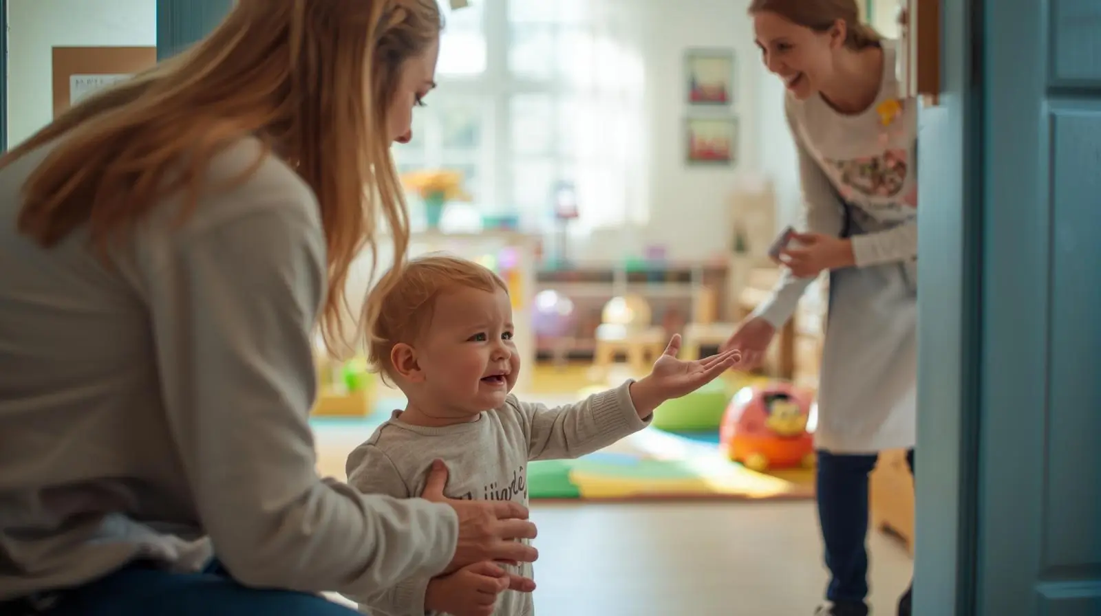
Settling in…
Your child may have had a previous experience of nursery or playgroups, but starting in a new environment and leaving their main carer might be unsettling (separation anxiety, tears, clinginess).
-Some children might be more tearful than others which unsettles those around them.
-We will encourage you to leave after a while, so that we can settle them in but we will always call you if needed.

Slide 6
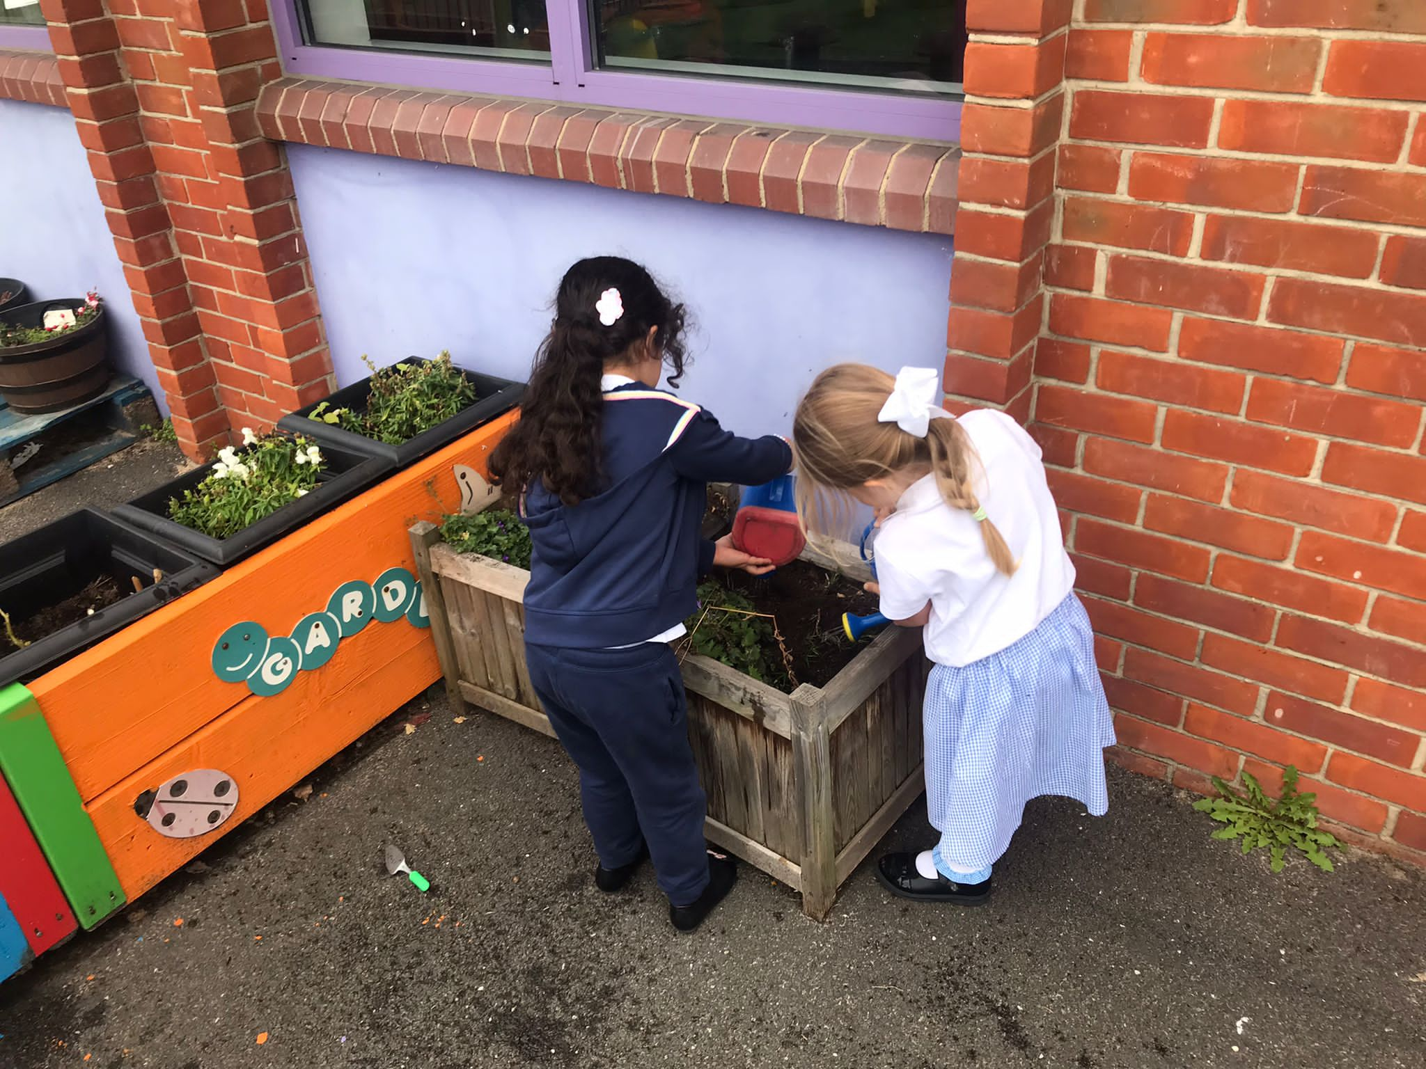
Curriculum
In the Early Years, the curriculum for children under 3 focuses on developing the prime areas:
    Personal social emotional development
    Communication and language
    Physical development
One indoor and one outdoor focus activity will be
planned for the children to take part in each day.
The activities planned will be influenced by the
children’s interests and observations made by
the practitioners.
Children are taught a broad range of knowledge and skills that provide the right foundation for good progress through school and in life.

Slide 7
Two-year-old Report
Staff will review the progress of all the children and provide parents and/or carers with a short summary of their child’s development within the prime areas.
This will include; Communication and Language, Physical Development and Personal, Social and Emotional Development.
It will take place when the child is aged between 24-36 months. These checks identify the child’s strengths and any areas where progress is less than expected.
Parents/Carers will receive a copy of this report and can discuss this with staff.

Slide 8



Food
Fruit and Milk Children are provided with a piece of fruit or vegetable every morning as part of the National Fruit Scheme, to support healthy eating.
Water bottles - We require the children to bring their own named water bottle.
Full time Puffins– Bring packed lunch from home. Lunch time is at 11.30am.
Fizzy drinks and sweets/chocolates are not allowed in packed lunch boxes.
Woodpecker Hall Academy is a NUT & FISH FREE school. Please do not include any items in lunch boxes that contain nuts or fish , such as ‘Nutella’, peanut butter sandwiches, tuna sandwiches or other nut/fish items.
8

Slide 9

Sleep
Children are entitled to sleep during the day. Please speak to staff to discuss your child’s routine.
Sleep mats and blankets will be provided; there will be a quiet space in the Nursery.
The children will be regularly checked to ensure they are safe whilst sleeping.
9

Slide 10
Toileting
We aim to work in partnership with parents towards toilet training children.
Parents/Carers need to provide their own nappies and creams which will be placed in their child’s individual box. Unless your child is in the process of toilet training, please provide regular nappies, not pull-ups. Parents/carers also need to provide at least 2 changes of clothing (all items labelled with your child’s name).
Any soiled clothes will be returned home at the end of the session to be washed.
When your child is ready, we will discuss this with you and support with potty training.

Slide 11
Induction: AM Sessions
Date | Time | Information
Wednesday 2nd September 2026 | 9:45am - 10:15am | Home Visit A member of the nursery team will be visiting you and your child at your home.
Thursday 3rd September 2026 | 9.00-10.00 | Meat the Team This is an opportunity to meet the team and get the information regarding the two year old room.
Monday 7th September 2026 | 8:30am - 9:30am | First day- 1 hour This is a settling in session to help your child in their transition. Parent/carers must attend this session.
Tuesday 8th September 2026 | 8:30am - 9:30am | Second day- 1 hour This is a settling in session to help your child in their transition. Parent/carers must NOT attend this session.
Wednesday 9th September 2026 | 8:30am - 10:30am | Third day – 2 hour Parents/carers are NOT expected to attend this session.
Thursday 10th September 2026 | 8:30am - 11:30am | Full-time Session Your child will be in nursery for the full allocated hours. Please be on time to pick your child up as children can easily become distressed.
11

Slide 12
Induction: PM Sessions
Date | Time | Information
Wednesday 2nd September 2026 | 11:15am - 11:45am | Home Visit A member of the nursery team will be visiting you and your child at your home.
Thursday 3rd September 2026 | 9.00-10.00 | Meat the Team This is an opportunity to meet the team and get the information regarding the two year old room.
Monday 7th September 2026 | 12:15pm - 1:15pm | First day- 1 hour This is a settling in session to help your child in their transition. Parent/carers must attend this session.
Tuesday 8th September 2032 | 12:15pm - 1:15pm | Second day- 1 hour This is a settling in session to help your child in their transition. Parent/carers must NOT attend this session.
Wednesday 9th September 2026 | 12:15pm - 2:15pm | Third day – 2 hour Parents/carers are NOT expected to attend this session.
Thursday 10th September 2027 | 12:15pm - 3:15pm | Full-time Session Your child will be in nursery for the full allocated hours. Please be on time to pick your child up as children can easily become distressed.
12

Slide 13
Induction: FT Sessions
Date | Time | Information
Wednesday 2nd September 2026 | 3:15pm - 3:45pm | Home Visit A member of the nursery team will be visiting you and your child at your home.
Thursday 3rd September 2026 | 9.00-10.00 | Meat the Team This is an opportunity to meet the team and get the information regarding the two-year-old room.
Monday 7th September 2026 | 8:30am - 9:30am | First day- 1 hour This is a settling in session to help your child in their transition. Parent/carers must attend this session.
Tuesday 8th September 2031 | 8:30am - 9:30am | Second day – 1 hour Parents/carers are NOT expected to attend this session.
Wednesday 9th September 2026 | 8:30am - 11:30am | Third day- no lunch Half a day. Parents/carers are NOT expected to attend this session.
Thursday 10th September 2026 | 8:30am - 12:15am | Fourth day- with lunch Parents must provide a healthy packed lunch for their children to enjoy. No nuts of fish products are allowed due to allergies.
Friday 11th September 2026 | 8:30am - 3:15pm | Full-time Session Your child will be in nursery for the full allocated hours. Please be on time to pick your child up as children can easily become distressed.
13

Slide 14
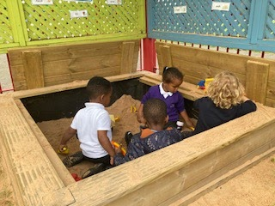
Support your child in getting ready for Nursery
It would really help your child to settle into Nursery if they can:
Help themselves with dressing and undressing.
Say when they have had a wee or poo in their nappy. (In English or in home language)
Use a cup to drink from/ be independent to eat a snack.
Have a regular and early bedtime routine.
Follow simple instructions.
Talk is key to learning (daily experiences), it is important that you talk to your child about the world around them.

Slide 15
Clothes
Children should wear comfortable clothes in Puffins room (no uniform) and have at least two changes of clothing. To help identify clothes, we request all garments, particularly outdoor garments, such as, sun hats and wellies are labelled or marked with the child’s name. Footwear should be Velcro and no shoelaces.

Slide 16
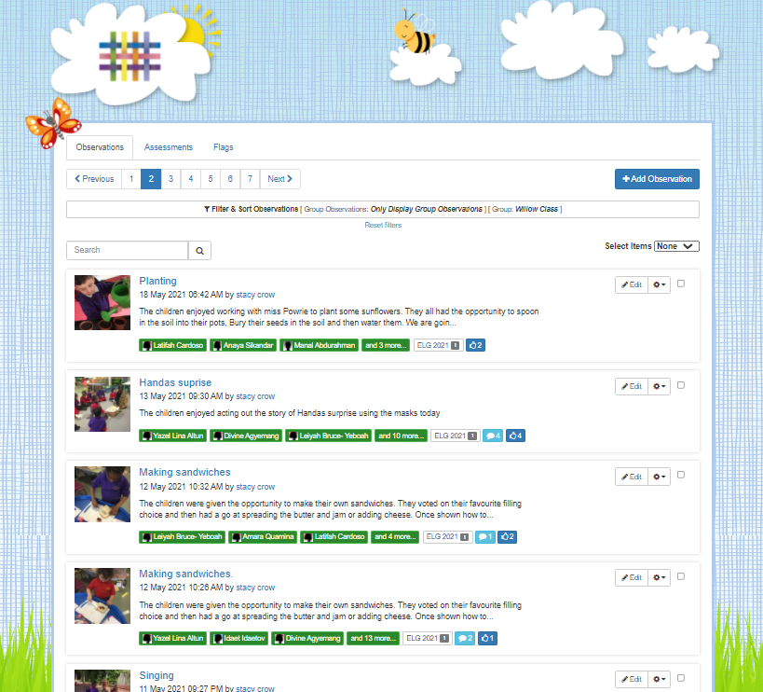
Tapestry
An Online Learning Journal system where staff record children's progress and activities using tablet devices (iPads) and PCs.
Parents can view their child’s journal on mobile devices and on their home computers and can make observations of their own using a secure login system.
It creates a two-way communication between us (the EYFS team), and you (the parents and carers).
We ask parents to upload 1 observation every 2 weeks from home. Home activity tasks will also be set to support this.
You will receive an information letter and consent form to fill in alongside other consent forms that we need parents/carers to sign before you child starts school.
We will also hold information meeting dedicated to Tapestry and working with your child at home once they have started.
16

Slide 17

Any questions?
17

