Slide 1


Welcome
Year 1 Meet the Team
Notes:
Polly

Slide 2
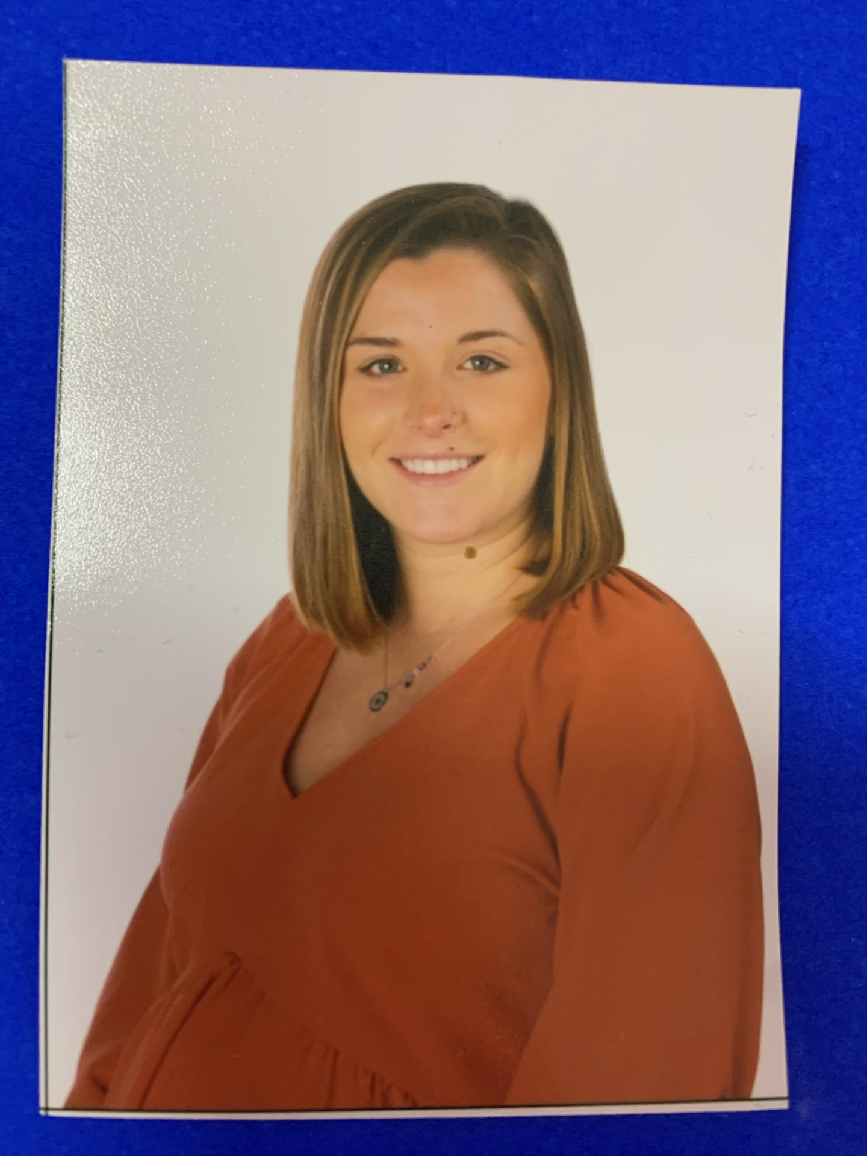
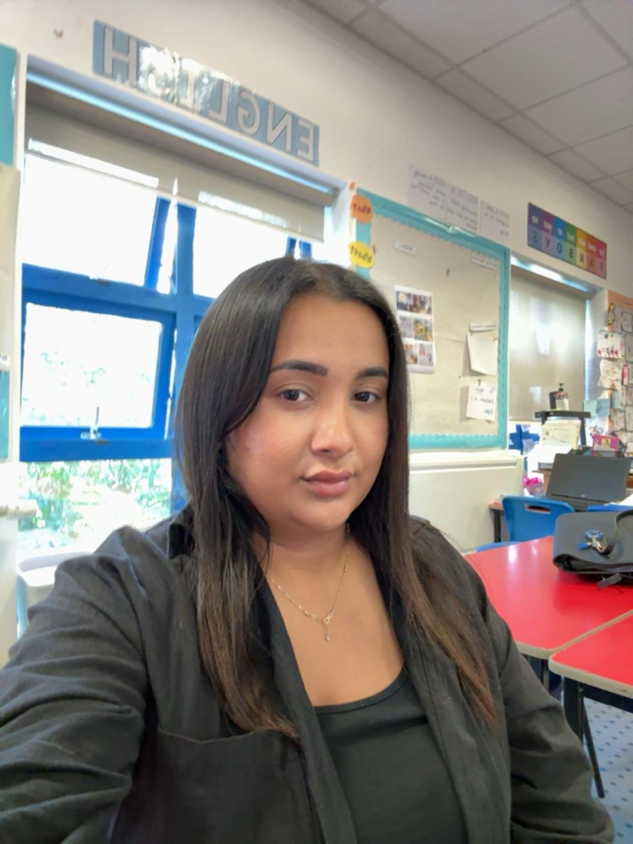
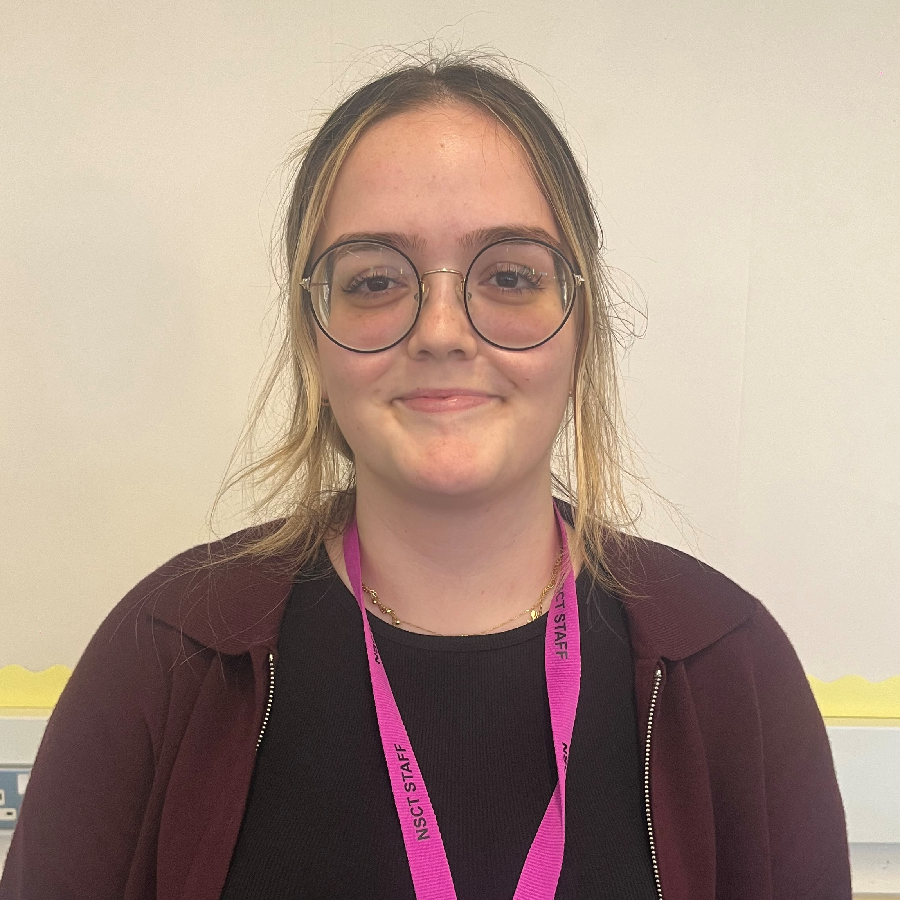
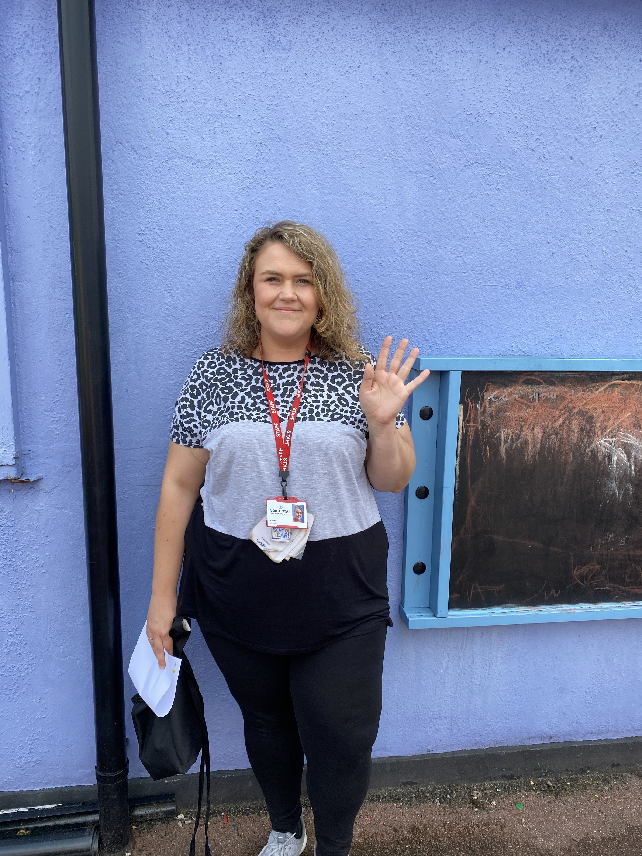
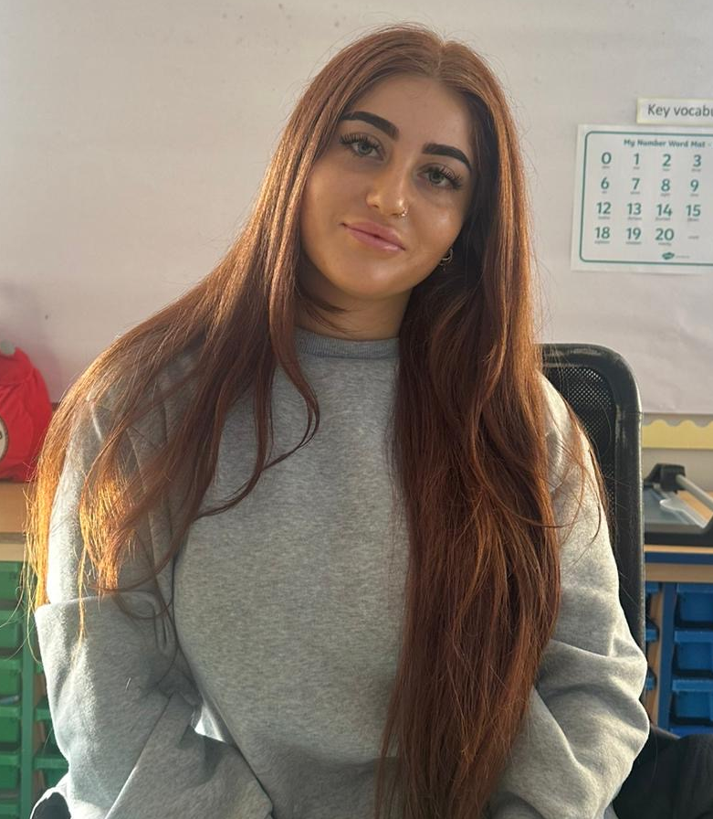
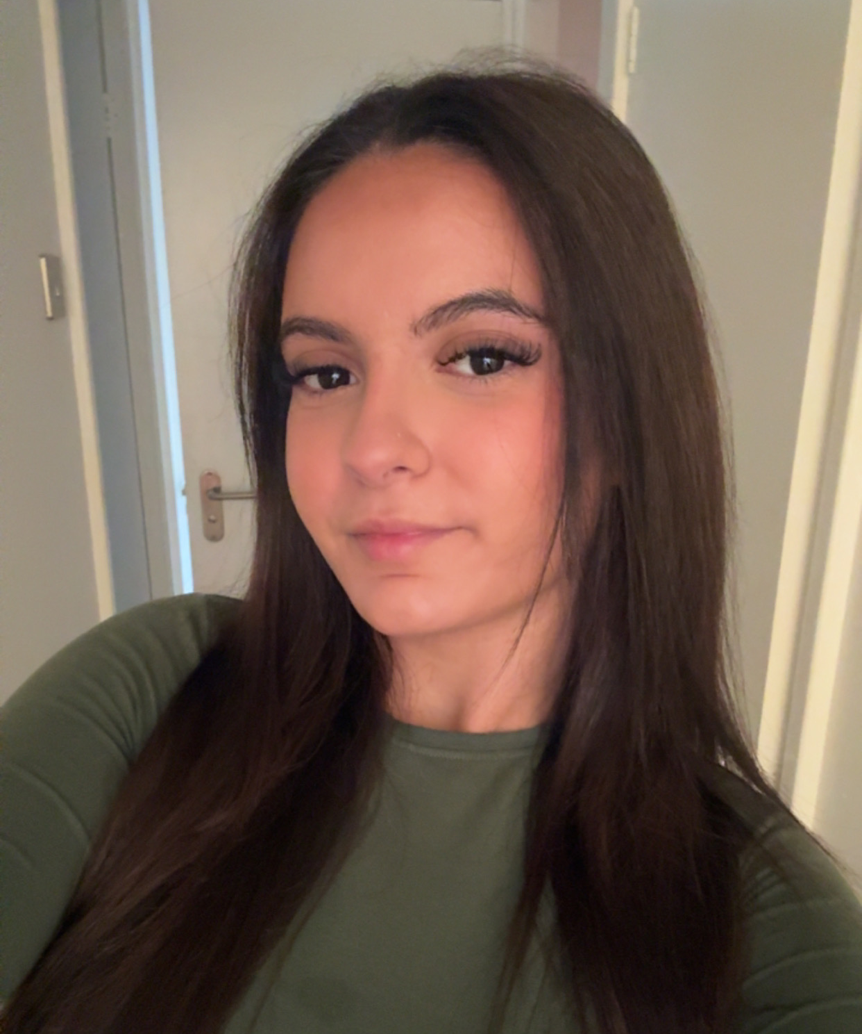
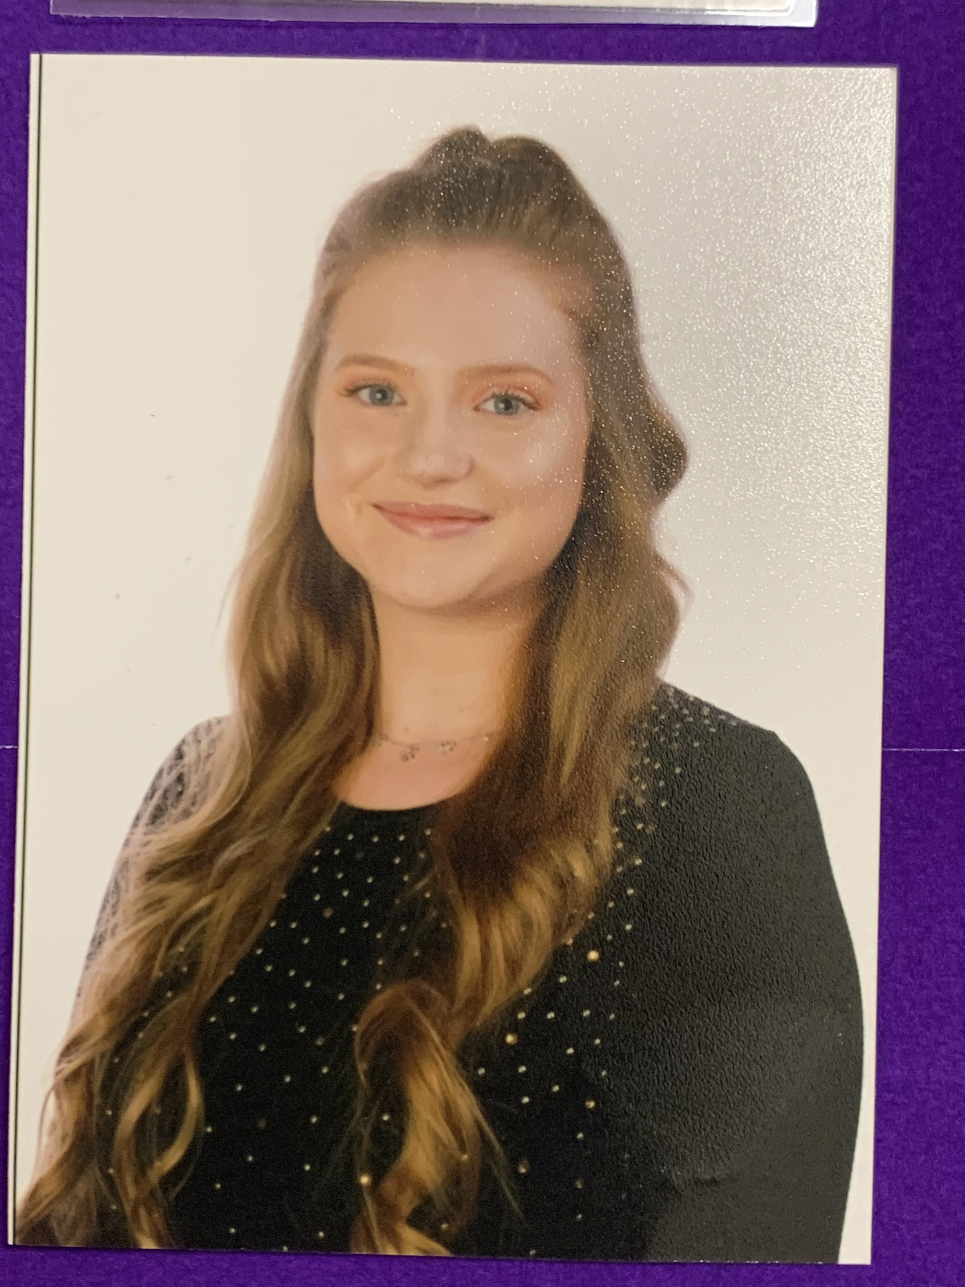
The Team
1O 1B 1E
Mrs Hacet Miss Celik Miss Ertogrul Miss Putz
Ms Meric Miss Venis Miss Ozay
Notes:
Polly

Slide 3

A typical day in Year 1
8.45 – 8:55 - Registration
9:00 - 9:30 - Guided Reading
9:30 - 10:30 – English (Writing)
10:30 – 10:45 - Break time with snack
10:45 – 11:50 - Maths
11:50 – 12:50 - Lunch
13:00 – 13:30 - Phonics
13:30 – 14:00 – Handwriting
14:00 – 15:10 – Learning Journey
15:10 – 15:20 – Story time
15:25 – Home time
Assembly on a Friday 2:45 – 3:15.
3
Notes:
Sarah
No Jewellery & Hair tied back

Slide 4
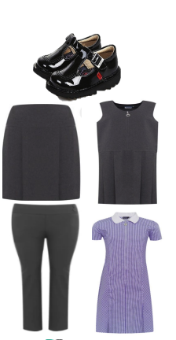
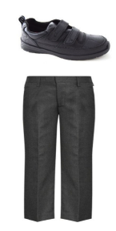
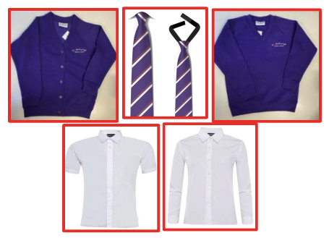
School Uniform
Children must come to school dressed in their full uniform on all days other than PE days.
School jumpers MUST have the school logo.
Please write your child’s name in EVERYTHING!
4
Notes:
Oyku

Slide 5
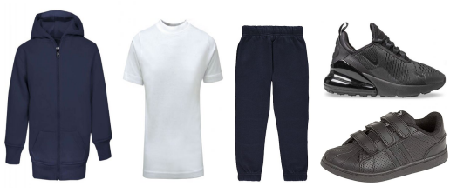
PE Kits
PE Days
1O – Wednesday & Friday
1B – Wednesday & Thursday
1E – Tuesday & Wednesday
Children must come to school dressed in their PE kits on their PE days.
5
Notes:
Sarah
No Jewellery & Hair tied back

Slide 6
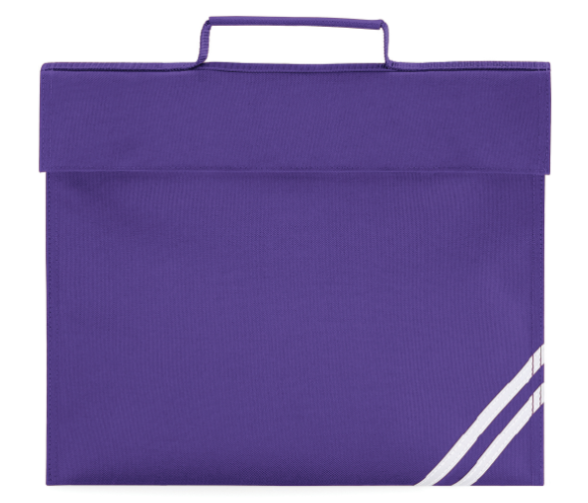

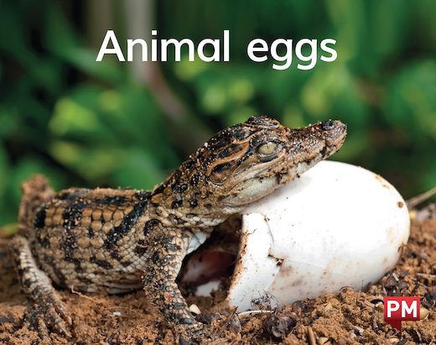

Expectations
Children MUST come to school with a book bag, a water bottle, reading book and reading record DAILY.
Reading records (orange book) must be in their bag every day and it MUST be signed daily.
Phonics books will be brought home every Friday
and must be returned on a Wednesday.
6
Notes:
Polly

Slide 7
Phonics Screening
Children in Year 1 throughout the country will all be taking part in a phonics screening check during the same week in June.
The phonics screening check is designed to confirm whether individual children know their sounds and can use their phonic decoding and blending skills to an appropriate standard.
The test contains 40 words. Each child will sit one-to-one and read each word aloud to a teacher. The test will take approximately 10 minutes per child.
The list of words the children read is a combination of 20 real words and 20 pseudo words (nonsense words).
You will receive your child's result by the end of the summer term.
7
Notes:
Polly
The pseudo words will be shown to your child with a picture of an alien. This provides the children with a context for the pseudo word which is independent from any existing vocabulary they may have. Pseudo words are included because they will be new to all pupils; they do not favour children with a good vocabulary knowledge or visual memory of words.

Slide 8


What Can You Do?
Play lots of sound and listening games with your child.
Read as much as possible- to and with your child.
Encourage and praise - get them to have a ‘good guess’.
If your child is struggling to decode a word, help them by encouraging them to say each sound in the word from left to right, e.g. c/a/t
Discuss the meaning of words if your child does not know what they have read.
Visit www.ruthmiskin.com for videos on how we teach
phonics at school.
8
Notes:
Polly

Slide 9

Home Learning
Read daily for 10 minutes.
Complete weekly homework on Google Classroom. This will be set every Friday and due by Tuesday.
Daily spelling and number bonds.
Half termly projects.
If you do not have access to the internet or need help using Google Classroom, we can support you at the end.
9
Notes:
Sarah

Slide 10
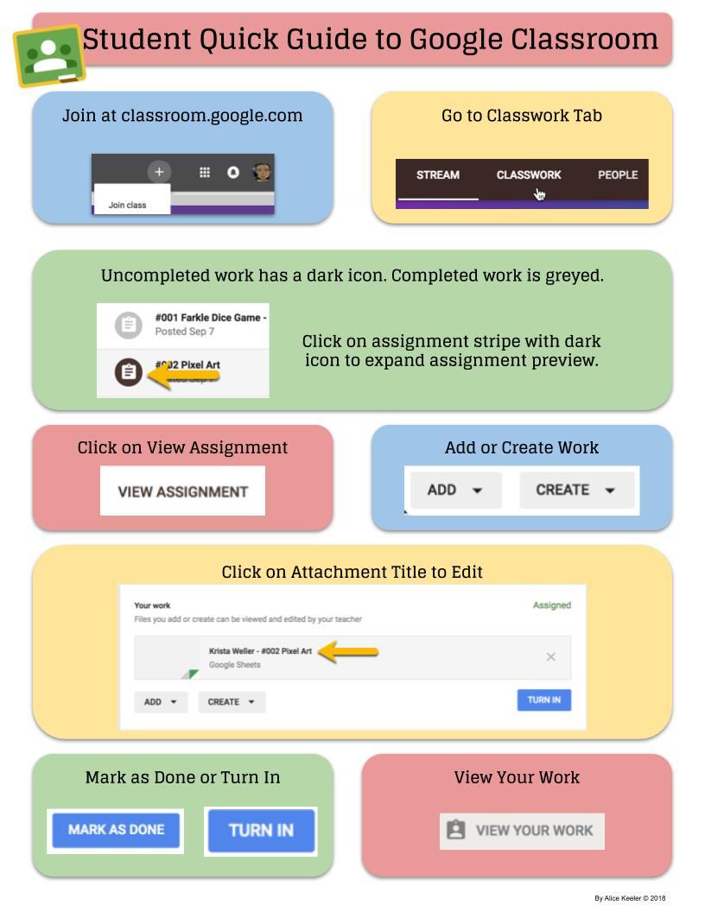
Google Classroom
10
Notes:
Oyku

Slide 11
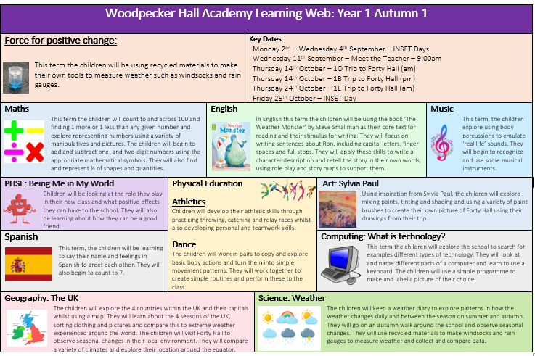
Learning Web
You can find our Learning Webs on our website. These change each half term and explain what your children will be learning.
This half term: What's the Weather?
Autumn 2: To Infinity and Beyond
Spring 1: London's Burning
Spring 2: Animal Kingdom
Summer 1: Secret Garden
Summer 2: There's No Place Like Home
11
Notes:
Polly

Slide 12


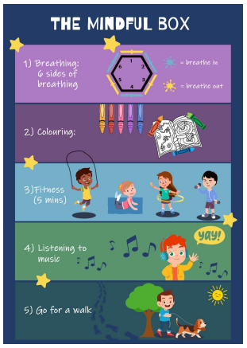

Promoting Healthy Relationships with Tender
Tender:
A charity that supports children in understanding what healthy, respectful relationships look like.
September 2020: Statutory for all schools to teach relationships education.
Links with Relationships and Sex Education (RSE) & PSHE curriculum
Provides children with the skills to identify and maintain healthy relationships.
Skills learnt can support children in transitioning into adulthood.
How you can help:
Talk about their friendships
Talk about their emotions (recognise what makes them feel good and bad in their friendships at school and in life).
Encourage the use of the ‘Healthy Relationships Toolkit’ created by our school council.
“Stop it, I don’t like it,” ‘ Breathing exercises’ ‘ Top tips from children’

Slide 13

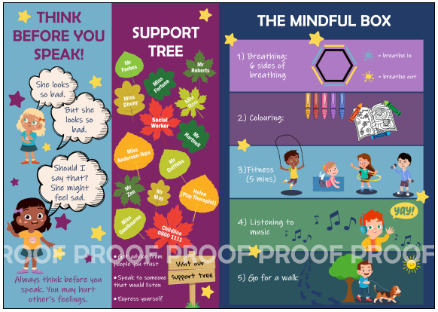

Slide 14

Trips
You will be informed of planned trips via emails and Arbor.
You will need to give permission for your child to attend each trip via the Arbor app.
If you would like to attend the trip to support as a parent volunteer, please speak to your class teacher. We try to accommodate as many parents as we can and will try our best to ensure this remains fair for all.
14
Notes:
Polly

Slide 15



Staying Up to Date
The best way to stay updated with school news in through social media.
You can also download the Arbor app on your phone which enables you to receive information from your school about your child. You can also use this app to pay for trips, clubs and lunch meals. Check your emails for your username, this will have a link to click on.
If you need help with this, we can support you at the end of the meeting.
Notes:
Sarah

Slide 16




FRIENDS OF
WOODPECKER
CALLING ALL PARENTS & CARERS!
WE NEED YOUR HELP!
Are you interested in becoming a Class Rep?
We need you to help spread the word and drum up support for the events run by our Parent Teacher Association throughout the year.
Let your class teacher know if you would like to volunteer!

Slide 17

Notes:
Sarah

