Slide 1


Year 2
Meet The Team

Slide 2

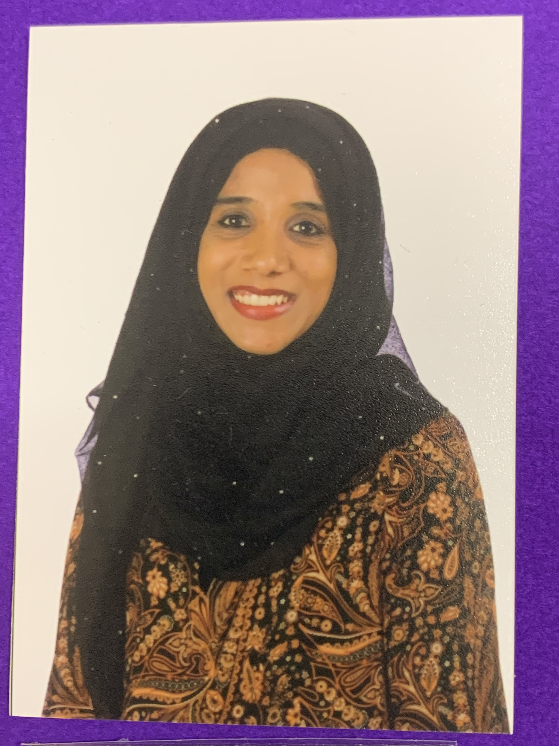
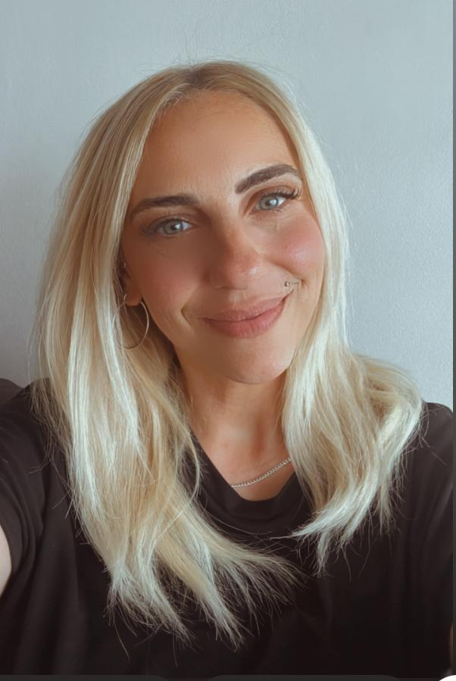
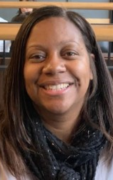
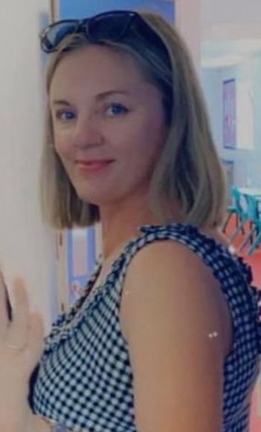
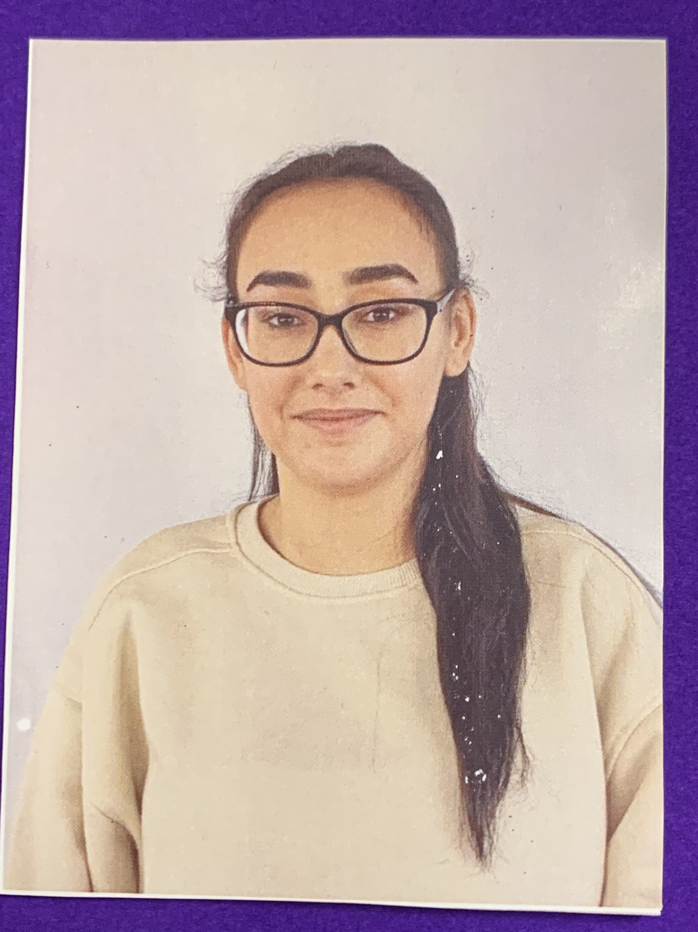
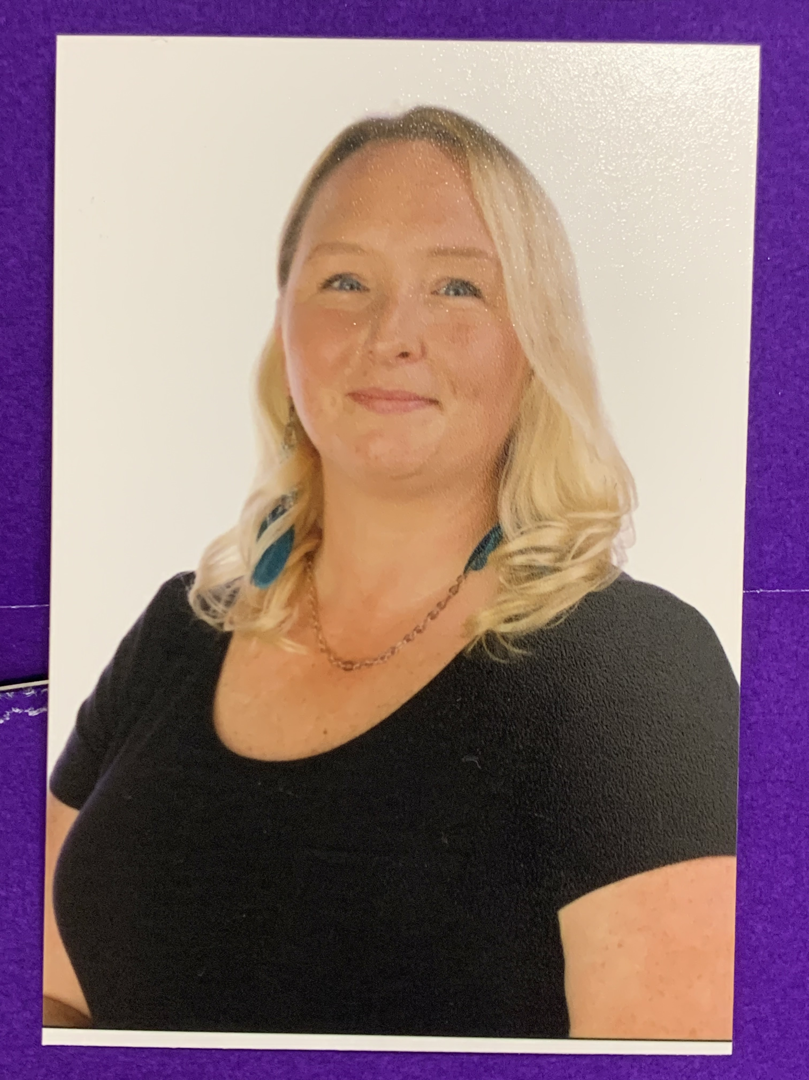
The Team
2B
2E
2O
Mrs Naz
Teaching Assistant
Ms Dhuny
Class Teacher
Ms Kane
Teaching Assistant
Mrs Woolmer Teaching Assistant
Miss Bulbul
Class Teacher
Year Group Leader
Mrs Salkey
Class Teacher

Slide 3

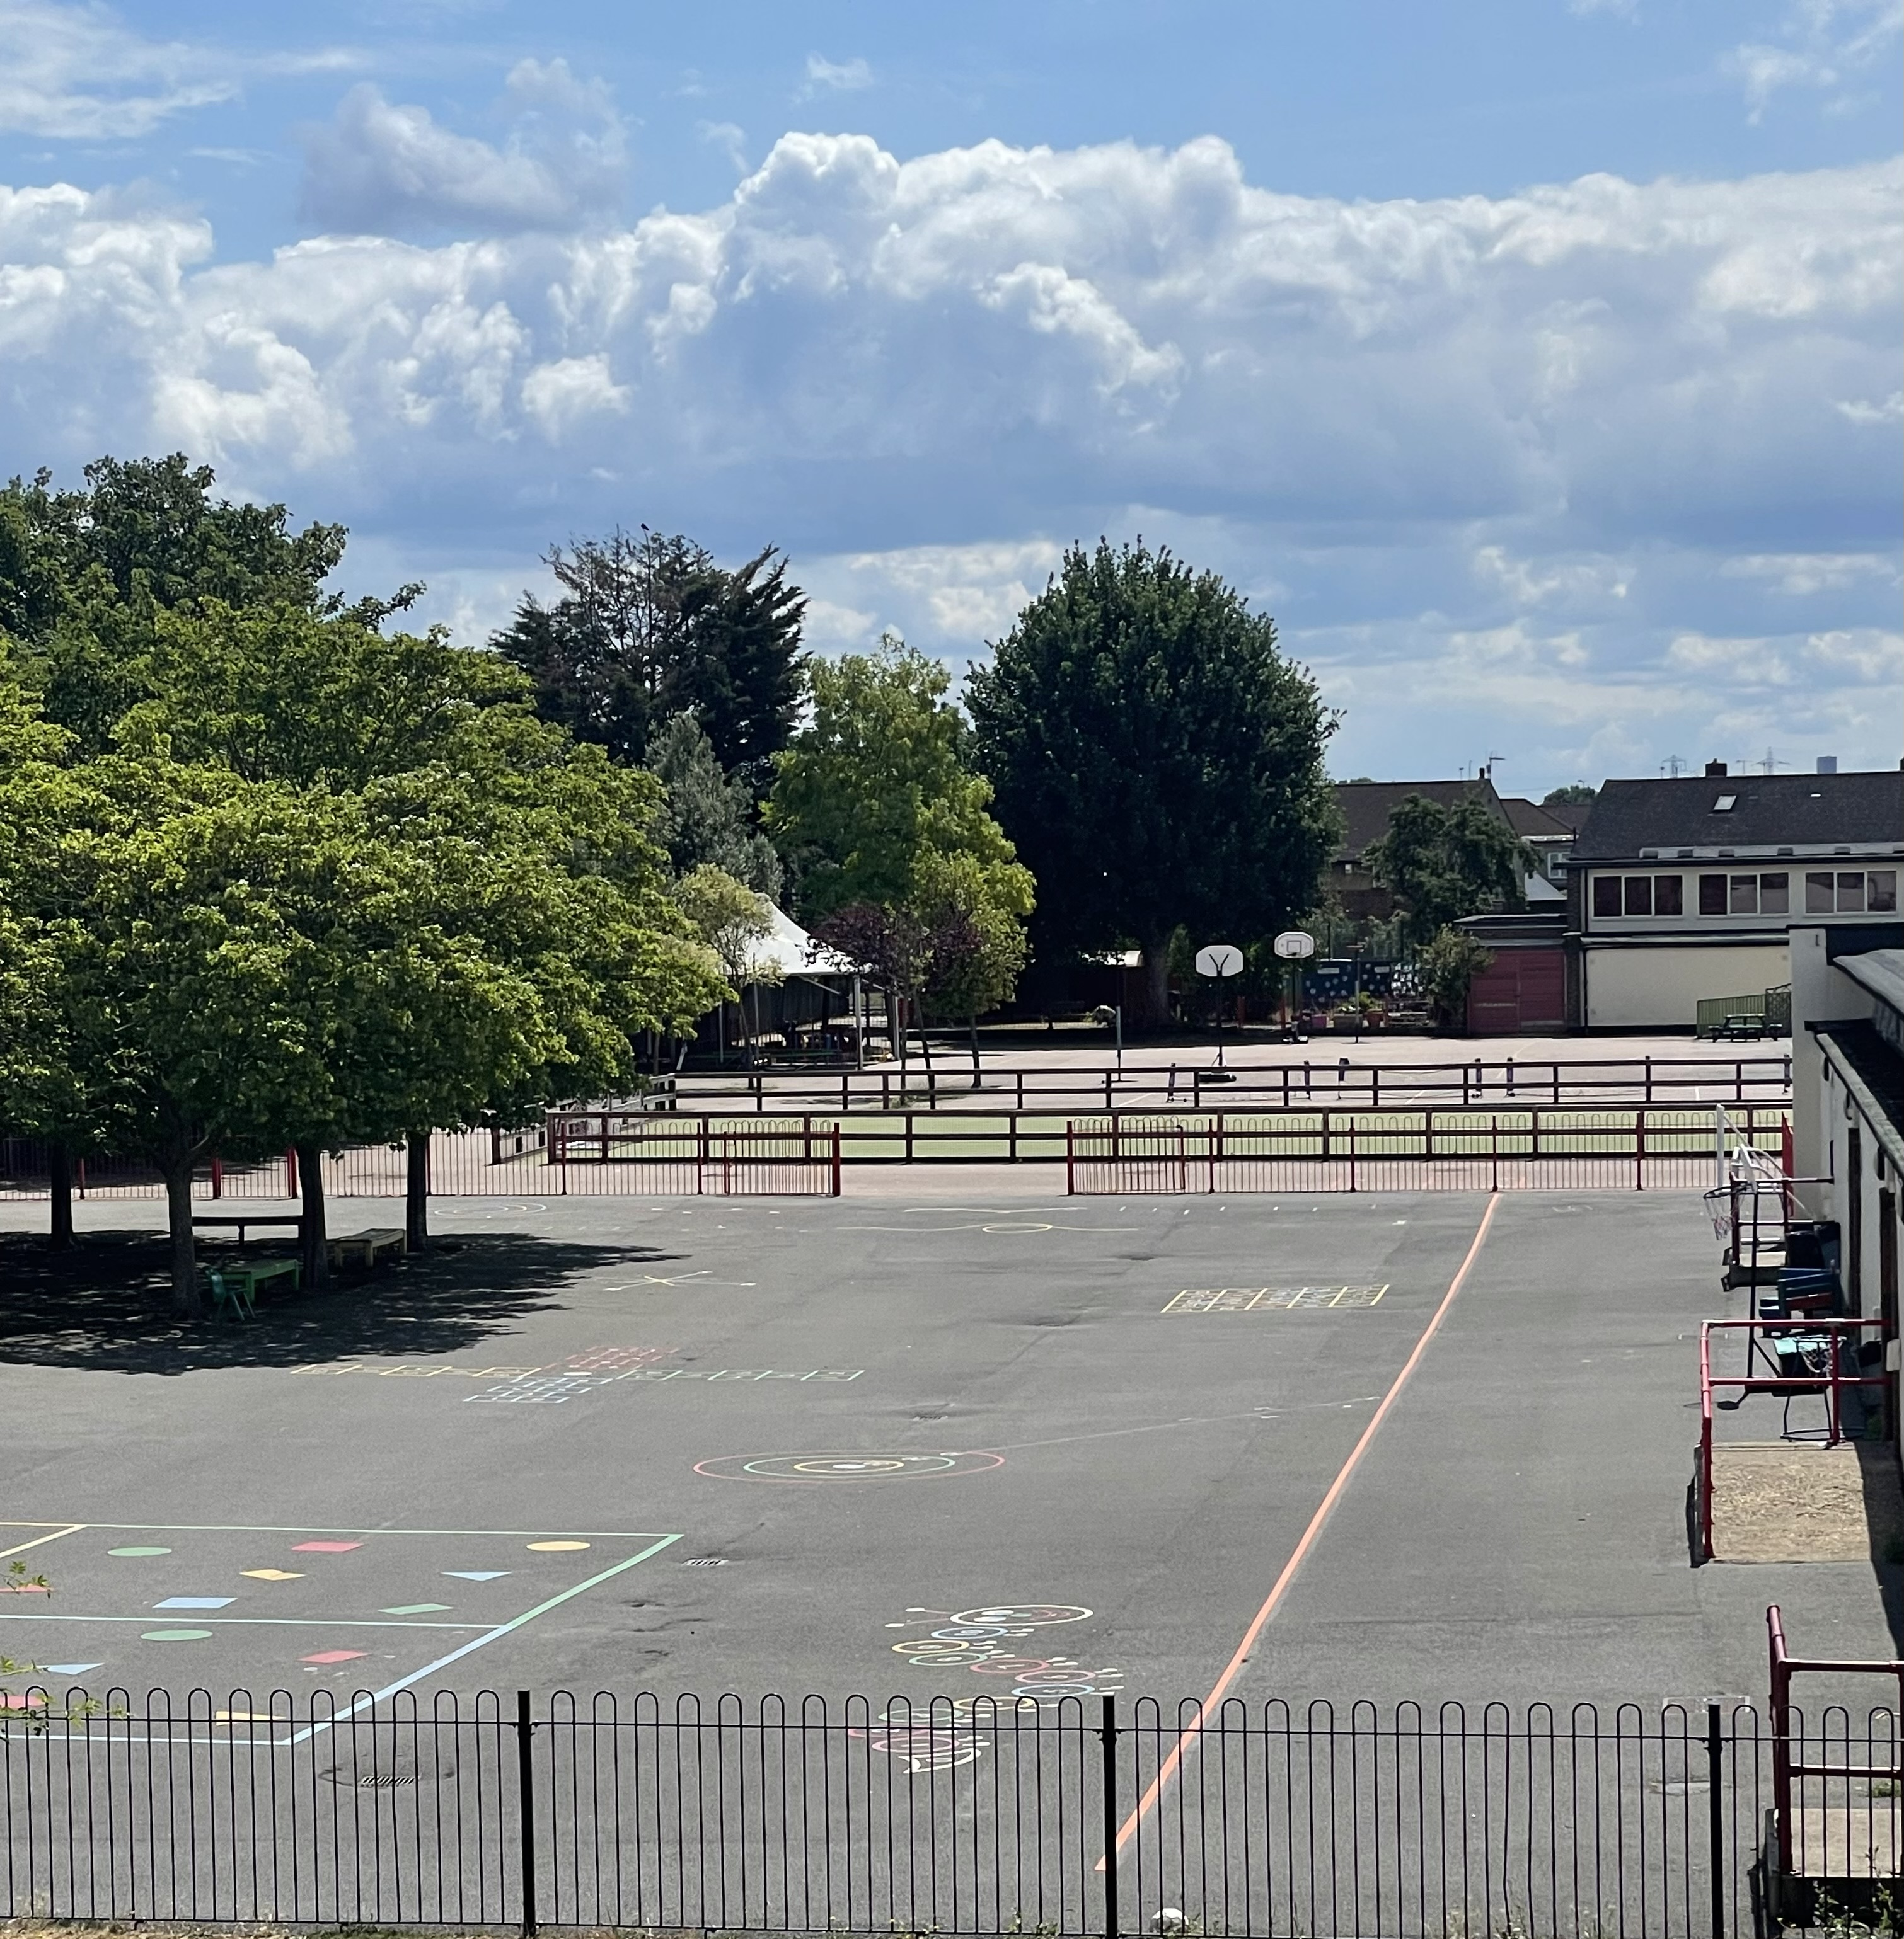
Average day at Woodpecker Hall
8.50- Registration
9.00- 9:30 Guided Reading
9:30- 10:30 English/Writing
10:30 – 10:45 Break Time
10:45 – 11:45 Maths
11:45 – 11:55 Phonics Blast
12:00 – 13:00 Lunch
13:00 - 13:30 Times tables
13:30 – 15:10 Learning Journey
15:10 – 15:25 Story
15:25 – Home time
Assembly on a Friday 2:45 – 3:15.

Slide 4
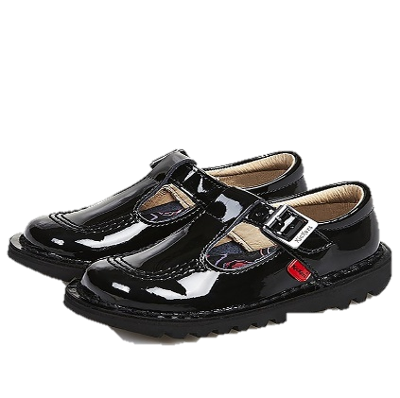
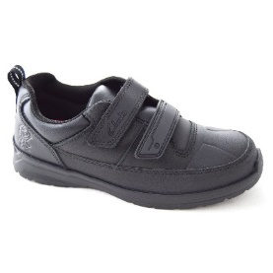


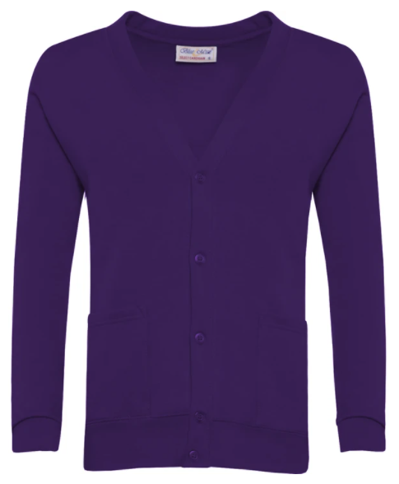

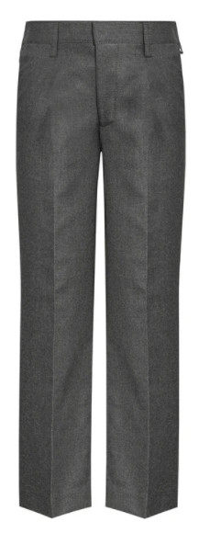

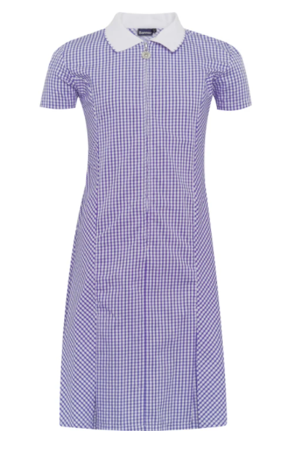



School Uniform
Children must come to school dressed in their full uniform on all days other than PE days.
School jumpers MUST have school logo.
White shirt (long or short sleeved)
School tie
V-neck purple jumper or cardigan (school logo)
Grey skirt
Grey trousers – no leggings
Grey Shorts
Grey pinafore
White socks
White, grey or black tights/ socks
Purple gingham dress (Summer)
Black shoes – no laces
NO JEWELLERY

Slide 5
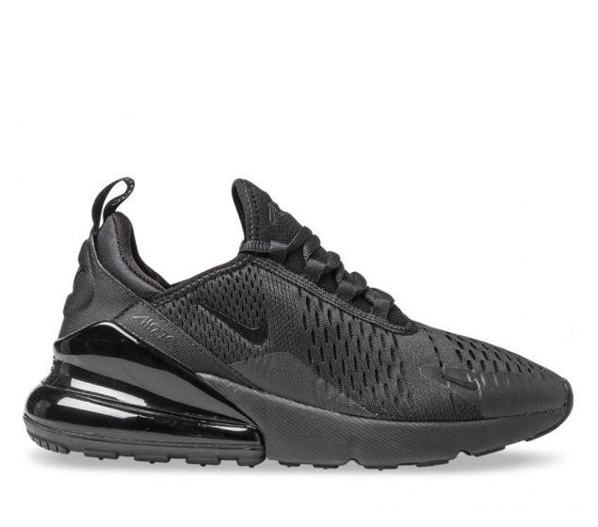
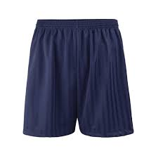
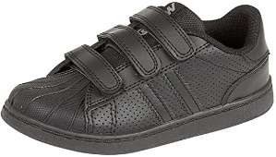
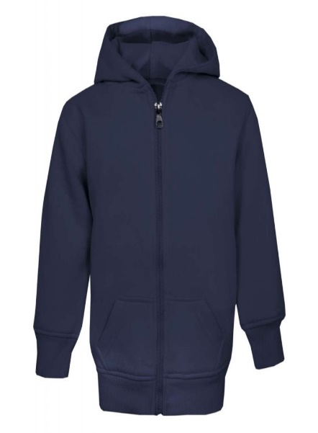



PE KIT
PE days:
Children must come to school dressed in their PE kits on their PE days.
Navy blue shorts or joggers.
No cycling shorts
White t-shirt
Navy hoodie/jumper.
Trainers – no laces
CLASS | INDOOR | OUTDOOR
2O | FRIDAY | WEDNESDAY
2B | FRIDAY | WEDNESDAY
2E | THURSDAY | WEDNESDAY

Slide 6



READING
Reading expectations:
Children must have their orange book (READING RECORD) in their bag every day & it MUST be signed daily.
Reading Record
Home Reading Book
School Library Book
Phonics book (some children)

Slide 7
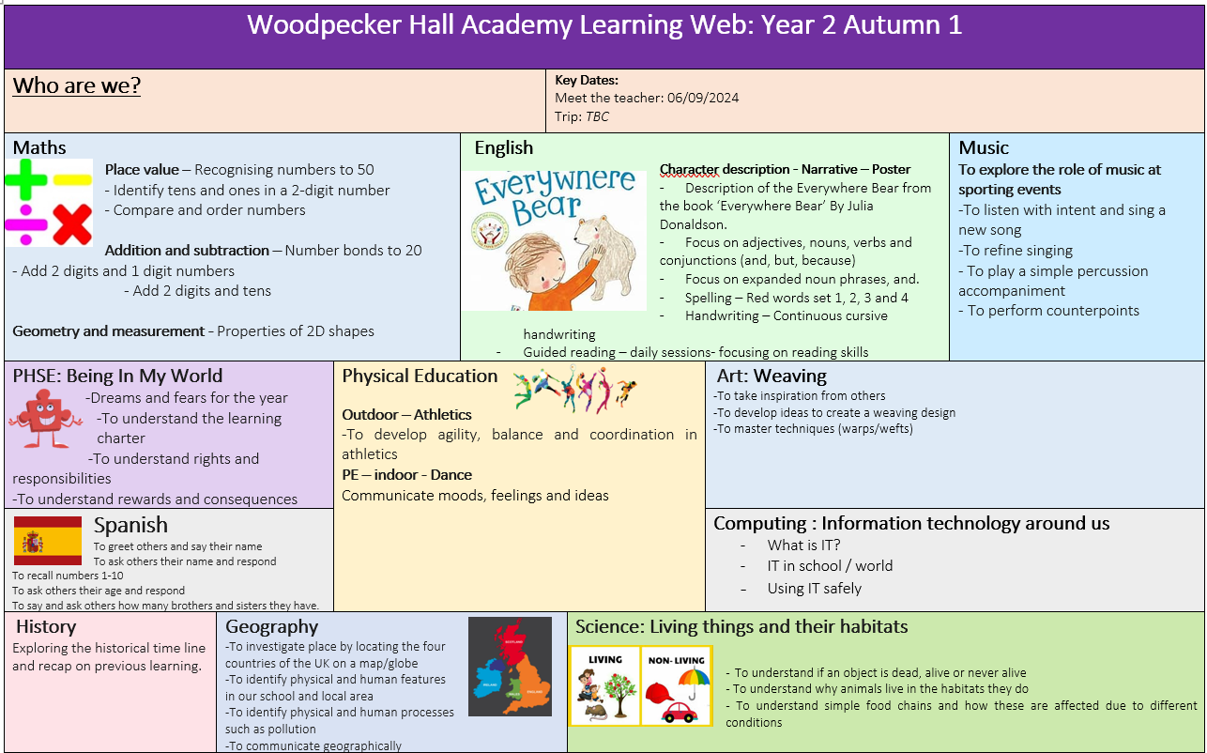
LEARNING WEB
Half termly
Overview
Outlines what the children will be learning during the half term.
If you would like to volunteer on our trips this year, please can you let your child’s class teacher know.
(Our first trip will be at the start of October)

Slide 8

HOME LEARNING
Expectations:
Google classroom
(Logins are stuck at the back of reading records)
Set on Fridays
Due on Tuesdays
Either Maths or English per week
Reading (every day)
Times table rock star (every day)
A choice out of 3 learning journey projects to be completed by the end of the half term (show and tell).
If you don’t have access to the internet or a device for your child to do the homework, please speak to the office.

Slide 9
NO SATS
The children will no longer be sitting SATS in Year 2.
It is no longer statutory.
We will continue with our in-school assessments to ensure children are on track and making expected progress.

Slide 10


Communication is key: Arbor
-To pay for a school trip, a club or school meals, this can be done through Arbor.
-Please can you download the app as the school will be sending important messages through this.
-Check your emails for your username, this will have a link to click on.
If you need any help, please go to the office – they are the experts.

Slide 11
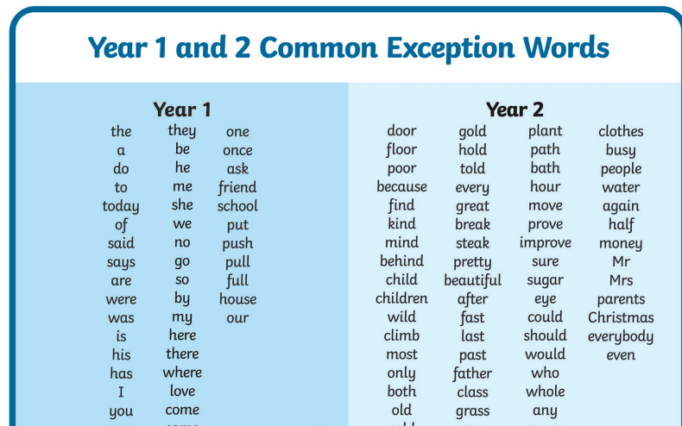
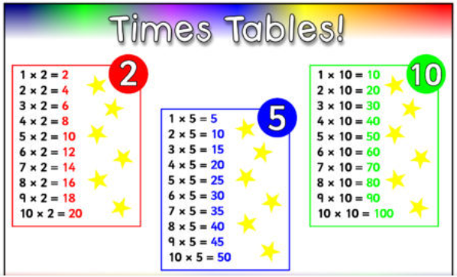
RESOURCES

Slide 12


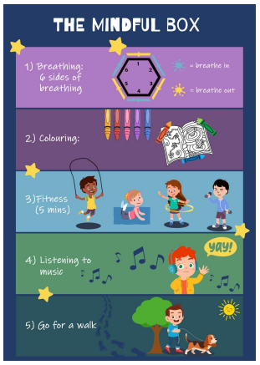

Promoting Healthy Relationships with Tender
Tender:
A charity that supports children in understanding what healthy, respectful relationships look like.
September 2020: Statutory for all schools to teach relationships education.
Links with Relationships and Sex Education (RSE) & PSHE curriculum
Provides children with the skills to identify and maintain healthy relationships.
Skills learnt can support children in transitioning into adulthood.
How you can help:
Talk about their friendships
Talk about their emotions (recognise what makes them feel good and bad in their friendships at school and in life).
Encourage the use of the ‘Healthy Relationships Toolkit’ created by our school council.
“Stop it, I don’t like it,” ‘ Breathing exercises’ ‘ Top tips from children’

Slide 13




FRIENDS OF
WOODPECKER
CALLING ALL PARENTS & CARERS!
WE NEED YOUR HELP!
Are you interested in becoming a Class Rep?
We need you to help spread the word and drum up support for the events run by our Parent Teacher Association throughout the year.
Let your class teacher know if you would like to volunteer!

Slide 14

Any questions

