Slide 1


Year 5
Meet The Team

Slide 2

Meet The Team
Miss Jerome Art and DT Curriculum lead (5B)
Miss Ioannou (Friday) (5B)
Miss McCartney (5O)
Miss Ellis Year group lead (5E)
Teaching Assistant – Mr Hartnell

Slide 3

Year 5 - Our aims
Preparation year for S ATs
Building independence
Developing a love for learning
Creating exciting opportunities
Planning fun, educational trips
Deliver high quality lessons
Having fun!

Slide 4

Average day at Woodpecker Hall
8.45am – Gates Open
8.50 – Timetable practise
8.55- Registration
9.00- Whole class reading
9.45 – Writing
10.45 – Break time
11.00 – Maths
12.00- Times tables
12.15 – Lunchtime
1.15 – Learning Journey sessions
3.15 – Class story
3.25 – Home time
Headteacher’s assembly/Singing assembly – Friday 2.45-3.15
ME

Slide 5
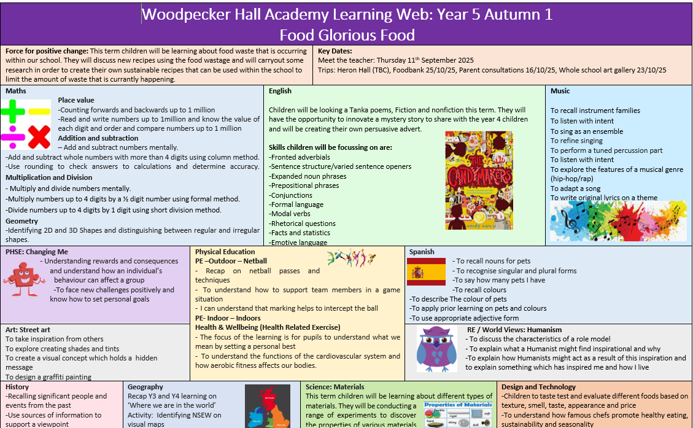


Curriculum
Science
Art
RE
DT
PSHE/P4C
ME

Slide 6


Reading
Big focus of ours this year
Underpins all other subjects
Daily reading lessons to focus on reading skills (predicting, questioning, summarising, inferring, retrieval, visualising, and vocabulary)
Encourage your child to read daily (30 minutes at least!)
Reading for pleasure (home reading books)
Check your child has recorded daily what they have read in their reading records (see back of reading record for suggested comments)
Sooper books
How you can help at home:​
ME

Slide 7

Writing
An area of development across the year group
Poetry
Narrative writing (stories)
Non-fiction (persuasive, informative, explanation, instructions)
Daily writing lessons with focus on - spelling, punctuation, grammar and
composition.
How you can help at home:
Weekly Practice spelling with your child (Year 5/6 spelling lists and rules)
Weekly Handwriting practice – Fully cursive
ME

Slide 8

Maths
Number
Place value
Four operations (+, -, x, /)
Measure, statistics and geometry
Arithmetic
Reasoning/ word problems
Times tables
Division facts
How you can help at home:
Daily practise on TT Rockstars for timetables and division facts
ME

Slide 9


Home Learning
In preparation for Year 6 and beyond, it is essential that your child has a positive
home learning attitude.
This will include:
English/Maths weekly homework set online
Learning Journey project set each half term
Daily expectations
Reading
Homework is set every Friday and due in every Tuesday
Times tables
Handwriting
Spellings
YJ

Slide 10
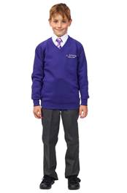
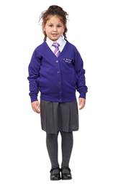

Uniform
Purple V neck jumper/cardigan (with
school logo)
Grey trousers/skirt/pinafore/shorts
◆
White shirt
◆ Tie
Purple summer dress
Black, grey or white socks/tights
NO leggings please!
IM

Slide 11

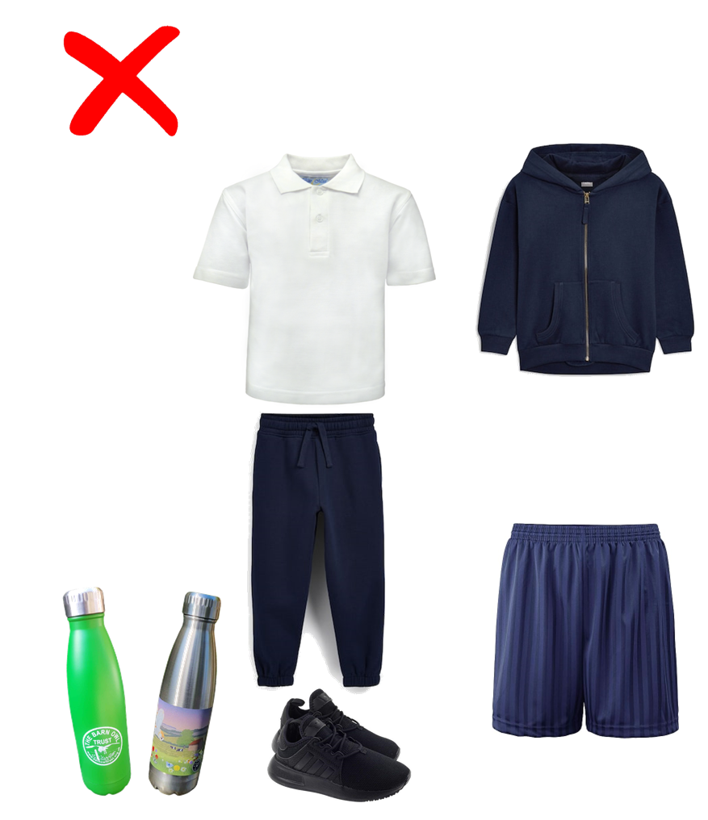
PE kit
Navy blue shorts or joggers.
White t-shirt
Navy hoodie/jumper.
Trainers
PE Days
◆ 5O – Tuesday (outdoor) and Monday (indoor)
◆ 5B – Tuesday (outdoor) and Monday (indoor)
◆ 5E – Tuesday (outdoor) and Friday (indoor)
◆
◆ Children will be coming into school in their PE kit on their allocated PE day.
IM

Slide 12

Swimming – Watch this space!
Year 5 will take part in the London Borough of Enfield Swimming Programme as part of their Physical Education entitlement.
Location: Waverly School (Travel by minibus)
Date: TBC (5O and 5E Autumn term)
Duration: TBC
A letter will be sent when it is your child’s class's turn (on the website)
Goggles may be worn only if a letter has been sent by parent/guardian
Children will be split into differentiated groups and are taught by trained members of staff
IM
12

Slide 13
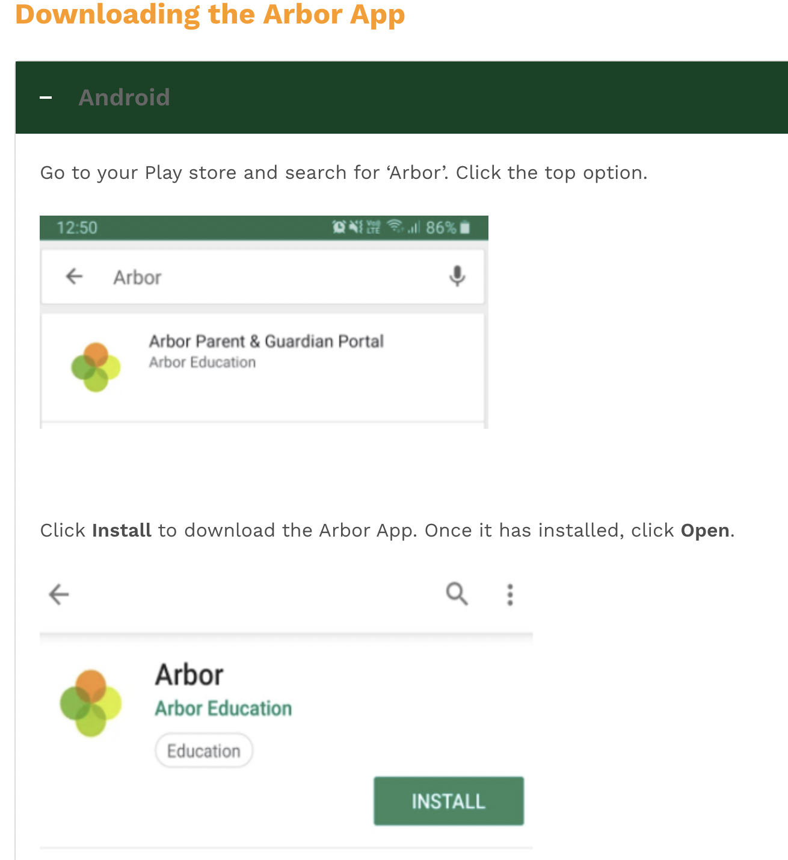
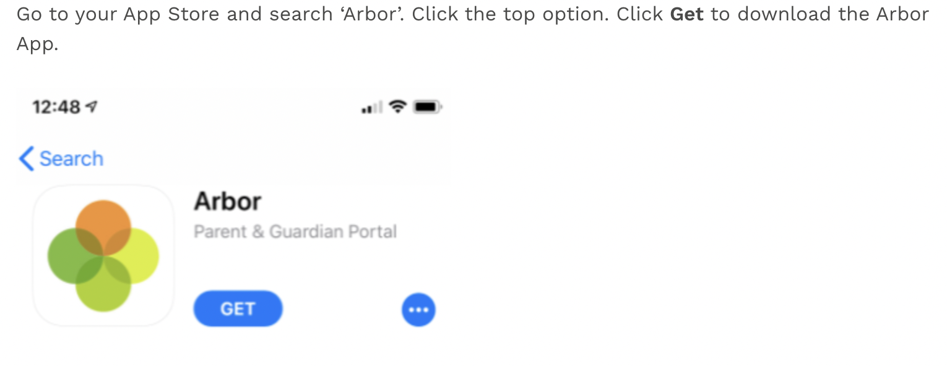
Communication is Key
Information on your child
Important messages from the school
Easier way to pay for trips, clubs, meals
IM
13

Slide 14




FRIENDS OF
WOODPECKER
CALLING ALL PARENTS & CARERS!
WE NEED YOUR HELP!
Are you interested in becoming a Class Rep?
We need you to help spread the word and drum up support for the events run by our Parent Teacher Association throughout the year.
Let your class teacher know if you would like to volunteer!
YJ

Slide 15


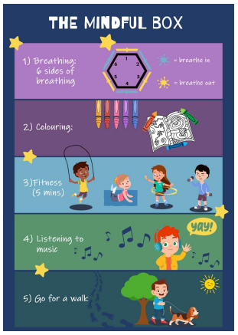

Promoting Healthy Relationships with Tender
Tender:
A charity that supports children in understanding what healthy, respectful relationships look like.
September 2020: Statutory for all schools to teach relationships education.
Links with Relationships and Sex Education (RSE) & PSHE curriculum
Provides children with the skills to identify and maintain healthy relationships.
Skills learnt can support children in transitioning into adulthood.
How you can help:
Talk about their friendships
Talk about their emotions (recognise what makes them feel good and bad in their friendships at school and in life).
Encourage the use of the ‘Healthy Relationships Toolkit’ created by our school council.
“Stop it, I don’t like it,” ‘ Breathing exercises’ ‘ Top tips from children’

Slide 16



Slide 17

Wednesday 21st January 2025!!
More details to come…
17

Slide 18
Thank you!

