Slide 1


Meet the Team
Year 4

Slide 2
Miss Hawthorne (4O)
Miss Cacioppo (4E)
Mr Delfini (4B)
Miss Osman (Teaching assistant)
2

Slide 3

Average day at Woodpecker Hall
8.45-55 Registration task
9.00- 9:40 Whole Class Reading
9:45 – 10:45 English
10:45 – 11:00 Break
11:00 – 12:00 Maths
12:00 – 12:15 Times Tables practise
12:15 – 13:15 Lunch
13:15 – 15:10 Learning Journey x 2
15:10 – 15:20 Story
15:25 – Home time
Assembly is on Friday.

Slide 4





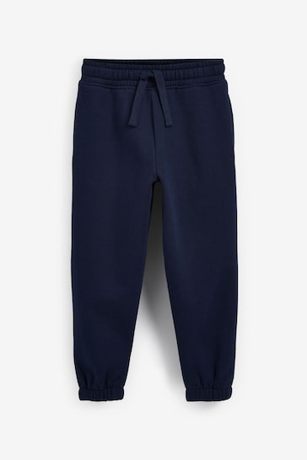


PE Days
Class | INDOOR PE | OUTDOOR PE
4O | Friday | Tuesday
4B | Friday | Tuesday
4E | Thursday | Tuesday
Navy blue shorts or joggers.
White t-shirt
Navy hoodie/jumper.
Trainers
4

Slide 5

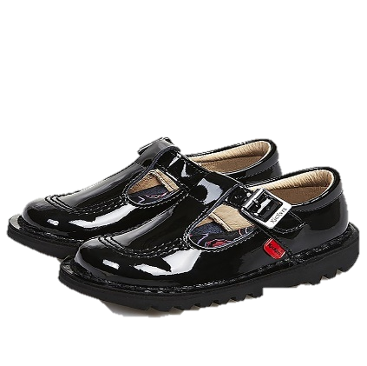
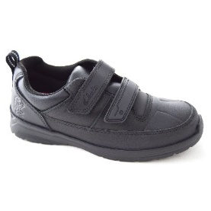




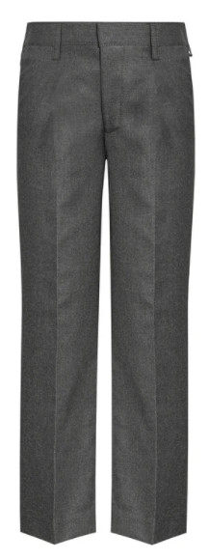

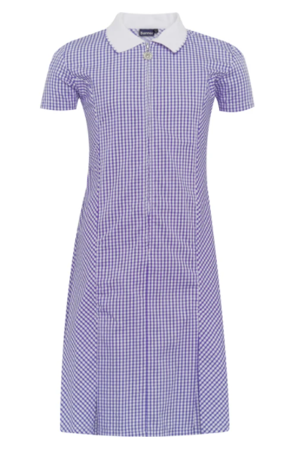



School Uniform
Children must come to school dressed in their full uniform on all days other than PE days.
School jumpers MUST have school logo.
White shirt (long or short sleeved)
School tie
V-neck purple jumper or cardigan (school logo)
Grey skirt
Grey trousers
Grey Shorts
Grey pinafore
White socks
White, grey or black tights/ socks
Grey trousers
Purple gingham dress (Summer)
Black shoes

Slide 6

Swimming
Year 4 will take part in the London Borough of Enfield Swimming Programme as part of their Physical Education entitlement.
Location: Waverly School (Travel by minibus)
Date: TBC
Duration: 12 weeks
A letter will be sent when it is your child’s class's turn (on the website)
Goggles may be worn only if a letter has been sent by parent/guardian
Children will be split into differentiated groups and are taught by trained members of staff
6

Slide 7

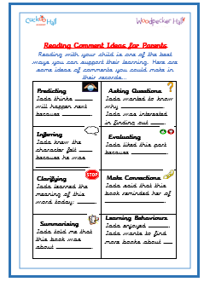
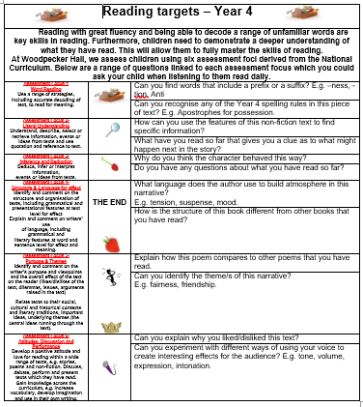
Reading Expectations
Read for 30 minutes everyday.
Bring Reading Records to school everyday.
Sign their Reading Records (see prompts)
Keep safe! It has all the passwords
you’ll need.
Children’s responsibility to change books
regularly.
7

Slide 8



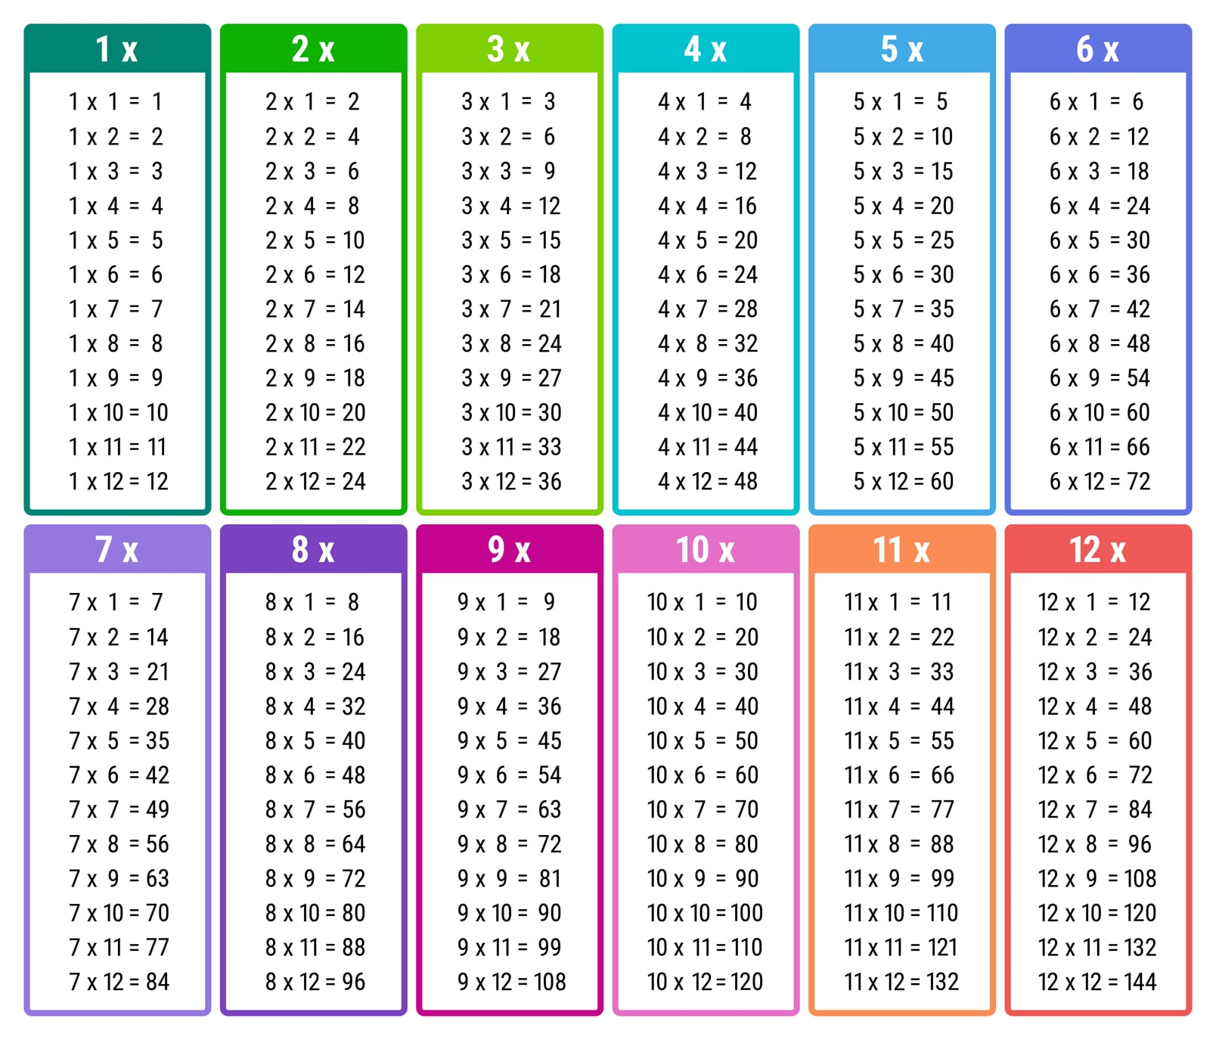
Maths
The key areas we will be covering this year:
Number & Place Value
The 4 mathematical operations
Fractions (including decimals)
Measurement
Properties of shapes
Position & Direction
Statistics
Practise books
Mr Demaio timetable songs
Hit the button
Timetables chart
TTRS- login in RR
-By the end of year 4, pupils should know their times tables up to 12 x 12.
Government Timetables test at the end of year 4- June. No pass mark
8

Slide 9
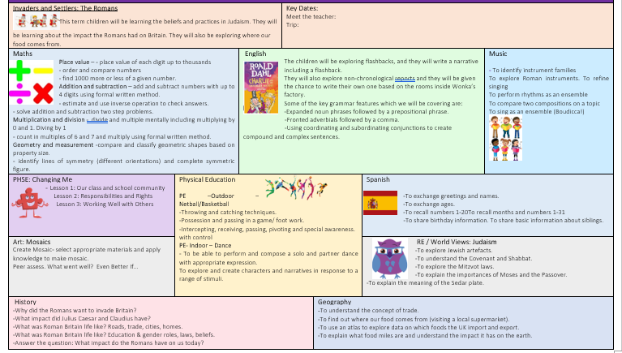
Curriculum
Autumn: Romans
- History
- Geography
- Art
- RE
Trips:
Local visit around our area – 24/09/25
Local visit to Tesco – 01/10/25
Verulamium museum – 9th/ 21st/23 October
Parent volunteers
9

Slide 10

Arbor
Download the Arbor App!
Check your emails for your username, this will have a link to click on.
Best way to receive communication from the school.
Trips, Clubs, Closures etc.
10

Slide 11

Home Learning
Daily: Reading for at least 30 minutes. Playing times table rockstars for at least 20 minutes.
Weekly: Maths OR English will be set on a Friday and due on Tuesday.
Weekly Spellings and Timetables practice.
Half- termly: project work will be set at the beginning of every half term and due by the end of the half term.
Home learning is designed to be enjoyable, and each task should not take any longer than 30-40 minutes.
Chrome books, headphones and internet dongles are available from the school office.
No paper homework will be available.
11

Slide 12


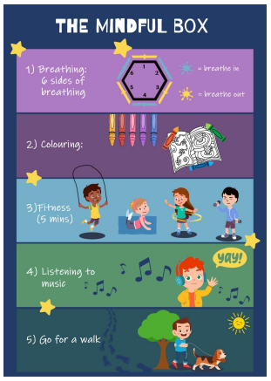

Promoting Healthy Relationships with Tender
Tender:
A charity that supports children in understanding what healthy, respectful relationships look like.
September 2020: Statutory for all schools to teach relationships education.
Links with Relationships and Sex Education (RSE) & PSHE curriculum
Provides children with the skills to identify and maintain healthy relationships.
Skills learnt can support children in transitioning into adulthood.
How you can help:
Talk about their friendships
Talk about their emotions (recognise what makes them feel good and bad in their friendships at school and in life).
Encourage the use of the ‘Healthy Relationships Toolkit’ created by our school council.
“Stop it, I don’t like it,” ‘ Breathing exercises’ ‘ Top tips from children’

Slide 13



Slide 14


