Slide 1


Welcome to
Reception
2025/26

Slide 2
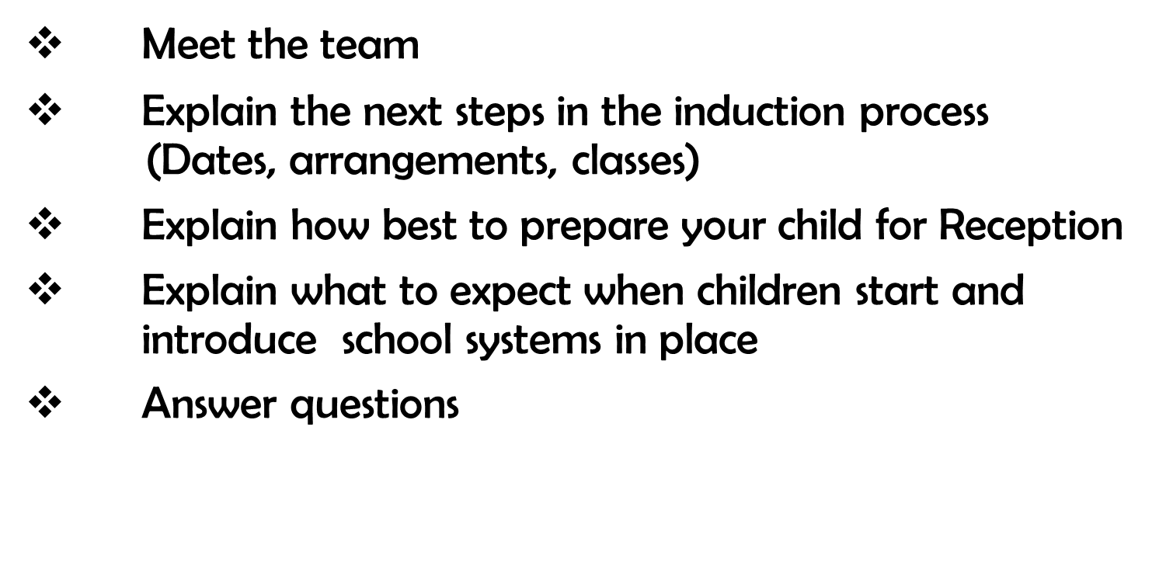
Aims of this session:
2

Slide 3
Staff?
Hazel Class
Class Teacher: Rochanne Davis
TA : Becky Cooper
Holly Class
Class Teacher: Polly Janata
TA: Saima Ahmed
Willow Class
Class Teacher: Karima Telmoune
TA: Elida Brucaj
Head Teacher: Nicky Ross
Deputy Head Teachers:
Rosanna Ojosipe, Amy Donovan, Sharon Monaghan
Assistant Head Teacher for EY: Hatice Mehmet
Reception Team Leader:
Polly Janata
3

Slide 4
Induction Process:
Key dates and Information for Reception 2025
Tuesday 8th July 2025 9:00 – 11:00am | Transition from Nursery Children from our Nursery will have Stay and Play (without parents) opportunity during their time at school as part of our transition from Nursery to Reception.
Wednesday 9th July 2025 9.15-10am- Holly Class 10.30-11.15am- Willow Class 1.30-2.15pm-Hazel Class | Stay & Play New Children to Woodpecker This session is for Reception children who are new to our school and have not attended our Nursery.
Thursday 10th & Friday 11th July 2025 | Home Visits (New to Woodpecker) This is for Reception children who are new to our school and have not attended our Nursery.
4

Slide 5
Induction Process:
Key dates and Information for Reception 2025
Thursday 4th - Monday 8th September 2025 | Settling In Days First day – 8:45-11:15am - No lunch: Parents/carers are NOT expected to attend this session. Children are not staying for lunch. Second day – 8:45-12:30pm - with lunch: Parents/carers are NOT expected to attend this session. Children are staying for lunch. If your child will NOT be having school dinners, please provide them with a healthy packed lunch. Full day: Your child will be in school full time. Please ensure your child is in school from 8.45am. Pick-up time is at 3.25pm; please don’t be late.
Tuesday 9th September 2025 | All children will have started Reception full time by this date (*unless extremely unsettled)
5

Slide 6
All children will be full-time on the third day unless we feel that they need longer to settle.
Your child may need a personalised introduction to school that will help them to settle more easily.
6

Slide 7
Outline of a Day in Reception 8.45-8:55 Children come into class; children start learning at 8.45. 11.30-12.30 Lunch. 3.25 End of day; pick up is at the door. (new collection time) 1 x PE session weekly. 1 x Music session once a week. 1x Spanish session weekly. Our day consists of learning in both the indoor and outdoor environment. If you would like to speak to the teacher, please arrange a time for the end of the day.
Keeping Healthy and independent Healthy diet. Oral health very important; brushing teeth with an adult twice a day. 10-13 hours sleep every night; early bed-time is very important. Limited screentime before bed to help them sleep. Independence dressing/undressing and eating. Following instructions. Express emotions clearly.
7

Slide 8









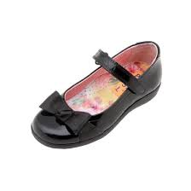
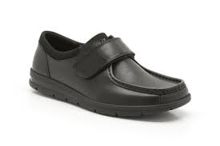
School Uniform
Uniform will be compulsory.
It can be bought from Uniform 4 Kids.
Come to school in PE kit on PE day.
White shirt (long or short sleeved) School tie V-neck purple jumper or cardigan (school logo) Grey trousers Grey Skirt Grey Pinafore White, grey or black tights/socks Purple gingham dress (Summer) Black shoes (*preferably shoes with no laces for Reception children)
PE Kits Indoor PE: Navy shorts White T-shirt Black plimsolls Outdoor PE: Navy jogging bottoms Navy zip up jumper White T-shirt Trainers | PE Timetable - We will know allocated times in September, and we will tell you when the children start fulltime.
School Uniform
Please label all items with your child’s name and class including shoes.
8

Slide 9
School Day on Arrival
Please keep to the dropping off and collecting times. Children arriving late or being collected late can become distressed. Always phone us if you are running late so that we can reassure your child that you are on your way.
Children must be collected by a known adult or senior school age child, not a primary aged child. If for any reason a different person is collecting your child, please let the class teacher or a member of the office staff know. You will need to set a password for your child, and this will be used if a different person is to collect them.
9

Slide 10




Fruit / Water
Children are provided with a piece of fruit or vegetable every morning as part of the National Fruit Scheme, to support healthy eating.
We actively encourage children to drink water throughout the day to keep them hydrated. Please send your child in with their own water bottle everyday and make sure it is labelled with their name.
10

Slide 11
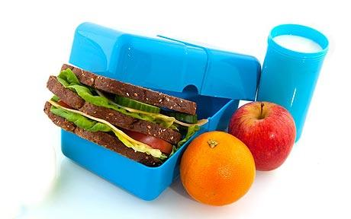


Lunchtime
Your child can either have a school dinner or bring in a packed lunch. All children of Primary school age are entitled to a Universal Free School Meal and no payment is required.
The office must be informed of any change to dinner preferences ½ termly.
Fizzy drinks and sweets/chocolates are not allowed in packed lunch boxes.
Woodpecker Hall Academy is a NUT & FISH FREE school. Please do not include any items in lunch boxes that contain nuts or fish , such as ‘Nutella’, peanut butter sandwiches, tuna sandwiches or other nut/fish items.
11

Slide 12
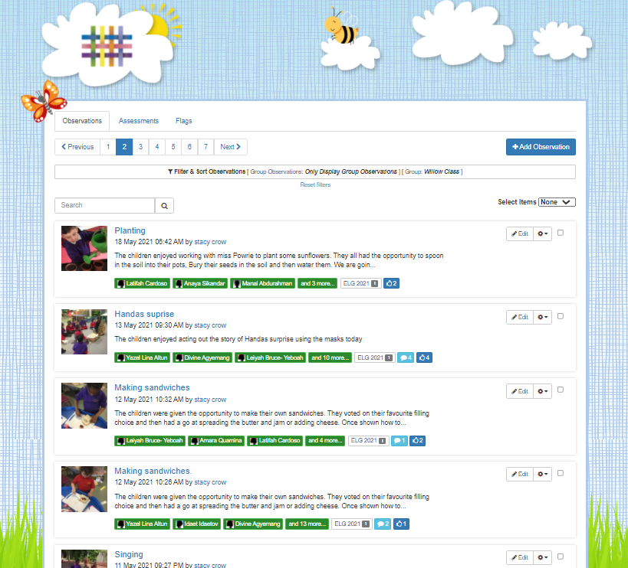
TAPESTRY
Online Learning Journal system where staff record your child’s progress and activities using tablet devices (iPads) and PCs.
Parents and carers can view their own child’s journal on mobile devices and on their home computers and can make observations of their own using a secure login system.
It creates a two-way communication between us (the EYFS team), and you (the parents and carers).
We will hold an information meeting dedicated to Tapestry by the end
of September (Date tbc).
12

Slide 13
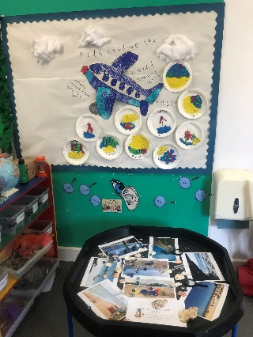
Curriculum
Three Prime Areas of learning & development: | Four Specific Areas of learning and development:
Communication & Language - Listening, Attention and Understanding - Speaking Physical Development - Gross Motor Skills - Fine Motor Skills Personal, Social & Emotional Development - Self-Regulation - Managing Self - Building Relationship | Literacy - Comprehension - Word Reading - Writing Mathematics - Number - Numerical patterns Understanding of the World - Past and Present - People, Culture and Communities - The Natural World Expressive Arts & Design - Creating with Materials - Being Imaginative and Expressive
The Early Years Foundation Stage (EYFS) curriculum is play-orientated and based on the premise that children learn from quality first hand experiences -Indoors and Outdoors
Learning is further enhanced through ‘Focus Group’ work with Class Teachers and Teaching Assistants (TAs).
Woodpecker Hall Academy follows the Read Write Inc. scheme of work to teach phonics.
​
Useful website for parents & carers: www.ruthmiskin.com​
13

Slide 14
Medical Needs
We need to know if your child has a medical need or allergies which might affect them in school.
If your child uses an inhaler, we can supervise its use during the school day.
Please note that medication is not administered by staff unless it is part of an emergency care plan which has been agreed by the Headteacher.
Please make sure that we have an up-to-date contact number in case we need to get hold of you.
14

Slide 15
First Aid
Whilst we do everything we can to make sure that children are safe, they do fall over and get the occasional bruise.
Our staff are trained to attend to the children and will treat all bumps and bruises.
If a child has bumped their head, you will receive a note, via email, and you will receive a call from a member of staff to make you aware.
The children in YN-Y2 will also wear a green coloured
wrist band as a visual reminder that they have been to the medical room.
15

Slide 16
How to Support?
Read with or to your child every day and complete the orange reading record.
Talk to your child about their school day. Discuss things that they see around them and extend their vocabulary.
Make a commitment to attend Parents’ Evenings and Open Days, coffee mornings and workshops.
16

Slide 17
How to Support?
Work with the school if you have any concerns. We are all here for your child.
Make sure your child has good attendance and punctuality by establishing good routines at home e.g. bedtimes.
Homework: Complete all weekly homework.
Please see the Reception Information Booklet for a more detailed list of things you can do to support your child’s learning.
17

Slide 18
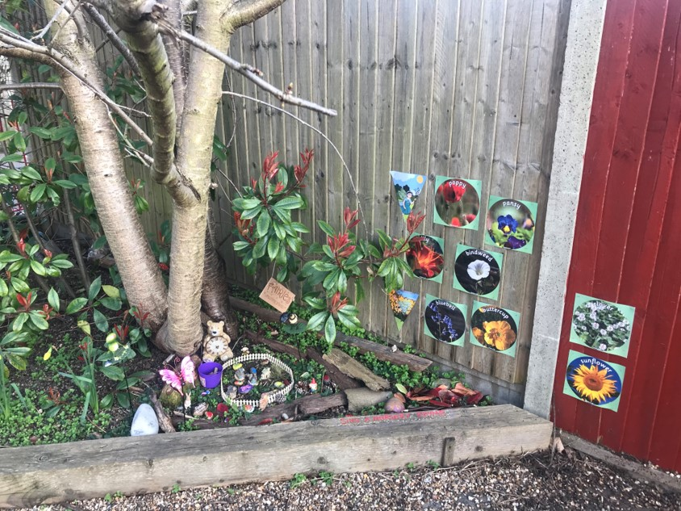
Website
You will find all the relevant information about Reception Curriculum on our website.
www.woodpeckeracademy.org.uk
18

Slide 19



Friends of Woody
All parents are part of the Parent Teacher Association (PTA).
Friends of Woody.
Each class has x2 representatives (encourage parents to get involved).
All ideas welcome.
No organising of events just helping get things set up/helping at events.
Events only happen with your support.
19

Slide 20
Any Questions?
20

Slide 21
Thank you

