Slide 1


Meet the Team
Year 6

Slide 2
Year 6 Team
Teachers
Miss Anderson-Ikpa (6B, RE, PSHE and P4C Lead)
Miss Forbes (6O, Year Group Leader)
Mr. Griffiths (6E, Computing & Geography Lead)
Miss Hiley (6M, Maths Lead, AAH)
Mr. Roberts (6M, English Lead, AAH)
Teaching Assistants
Mrs. Banjaw
2

Slide 3


Reading
Expectation of 40 minutes home reading being completed every day
This is essential as it affects their fluency and reading speed.
Filling in reading record – using the suggested comments to support.
Please support by reading with your children and questioning their understanding.
Aim: Foster a love of reading.
3

Slide 4
Writing
Poetry
Narrative writing
Non-fiction pieces
Daily lessons with a focus on GPS, composition and editing.
Spelling and handwriting lessons
4

Slide 5
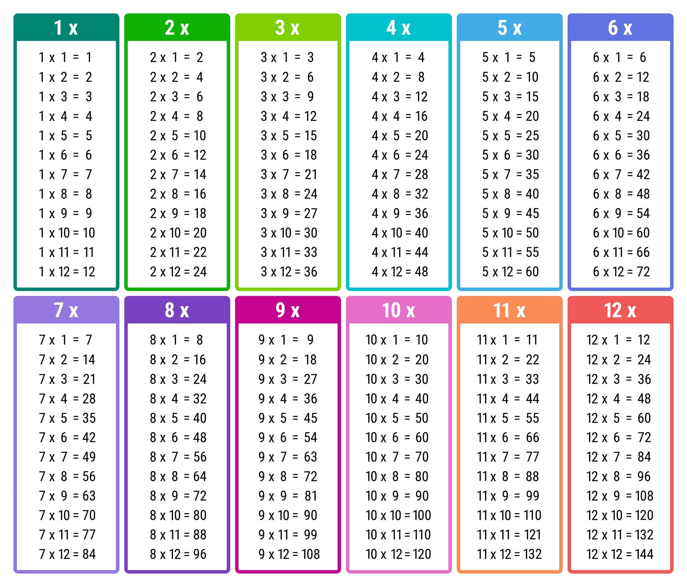

Maths
A big focus on basic arithmetic skills and ensuring the foundations of place value, addition, subtraction, multiplication and division are in place and built upon throughout the year.
Problem solving and reasoning skills.
Home learning should involve revision around these subjects, including an emphasis on mental arithmetic (i.e. times tables and related division facts).
5

Slide 6
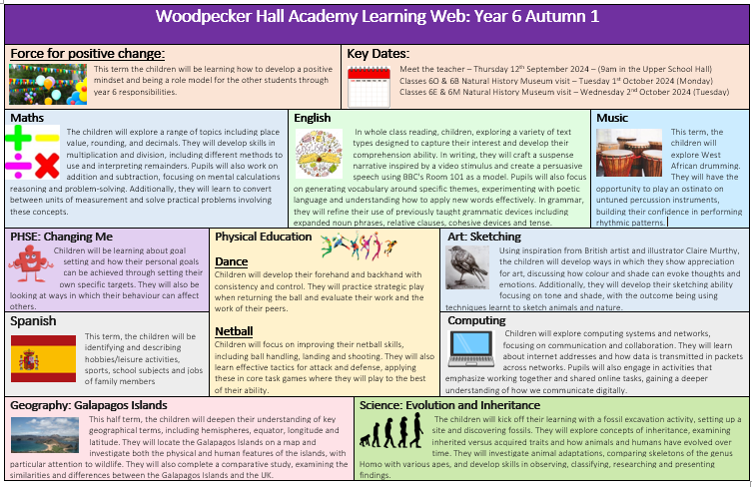
Learning Journey
Half termly projects sent out every half term.
Autumn 1: Evolution and Inheritance
- Science
Geography
Art
6

Slide 7
Trips and celebrations this academic year
A voluntary contribution may be requested for some trips.
Parent helpers required to support with trips.
Autumn 1 | Autumn 2 | Spring 1 | Spring 2 | Summer 1 | Summer 2
Evolution & Inheritance | CSI Investigates | WW2 | WW2 | Empire & Enfield | Fit & Fabolous
Natural History Museum | National Gallery | HMS Belfast | Imperial War Museum | Redstart financial education Y6 Trip week* | Y6 Production Y6 Disco Leavers
*Trip week will take place week beginning 18th– 22nd May 2026 and includes a range of activities
Further details to follow
7

Slide 8

Home Learning
Reading Records: Reading records (40 minutes daily)
Spellings: Statutory spelling list for Year 5 & 6 words practised daily
Maths: Basic math skills to be practised daily and times tables up to 12 to be practised daily
Daily TTRS (times tables rockstar) practice
Weekly Maths and English home learning will be set on Google classroom
Half-termly project work will be sent home at the beginning of each half-term
Additional handwriting practice
Chrome books, headphones and internet dongles are available from the school office.
8

Slide 9
Additional Support
We will be offering further clubs to support various children across the year group in the form of morning breakfast clubs, after school interventions and Saturday school. These will be based around reading, writing and mathematics.
We kindly request your support with ensuring your child attends every session, should they be selected for these.
These clubs will provide light refreshments for the children. With the morning clubs offering breakfast; the after school sessions and Saturday school will be offering a light snack.
SAT’s week – 11th -14th May 2026
9

Slide 10
Attendance
Good attendance is essential for your child’s success in Year 6
This is a crucial year as pupils prepare for their end-of-Key-Stage assessments and begin to get ready for the transition to secondary school.
Regular attendance helps children keep up with learning, build confidence and stay connected with their class.
Even missing a day or two can mean gaps in understanding, especially in subjects like maths and English where lessons build on previous learning.
We encourage all families to aim for excellent attendance so that every child can reach their full potential.
Attendance is also incentivised through half termly attendance prizes and trips.
10

Slide 11


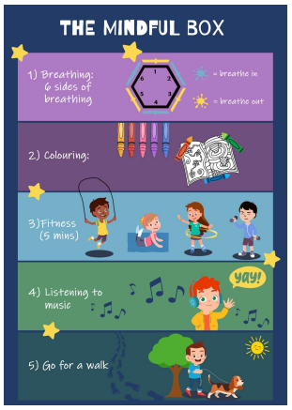

Promoting Healthy Relationships with Tender
Tender:
A charity that supports children in understanding what healthy, respectful relationships look like.
September 2020: Statutory for all schools to teach relationships education.
Links with Relationships and Sex Education (RSE) & PSHE curriculum
Provides children with the skills to identify and maintain healthy relationships.
Skills learnt can support children in transitioning into adulthood.
How you can help:
Talk about their friendships
Talk about their emotions (recognise what makes them feel good and bad in their friendships at school and in life).
Encourage the use of the ‘Healthy Relationships Toolkit’ created by our school council.
“Stop it, I don’t like it,” ‘ Breathing exercises’ ‘ Top tips from children’

Slide 12



Slide 13
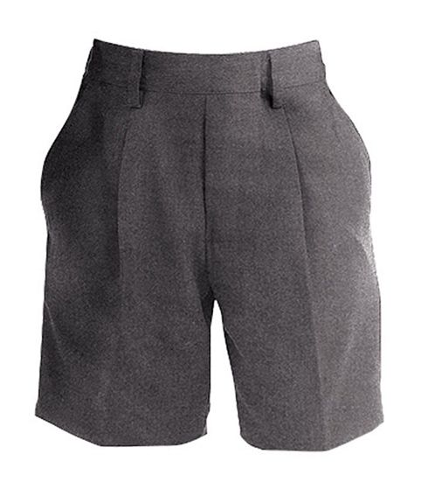
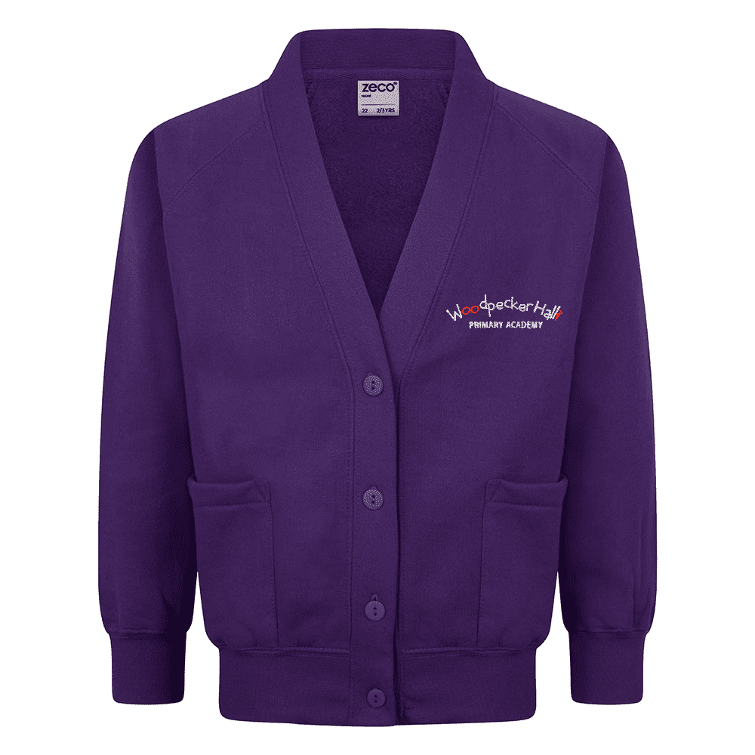


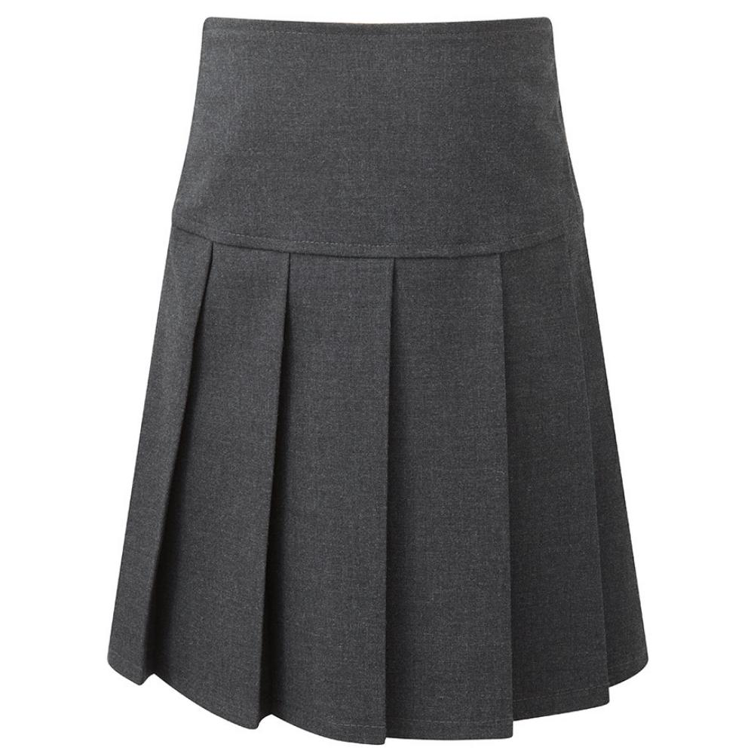
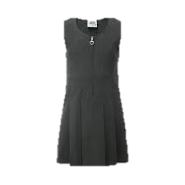
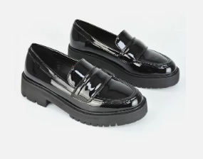


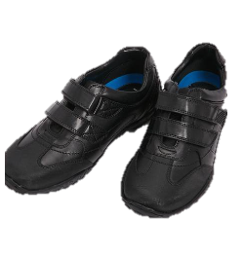

Uniform
Other than PE days and planned events, children should be in full school uniform.
Label! Label! Label!
13

Slide 14



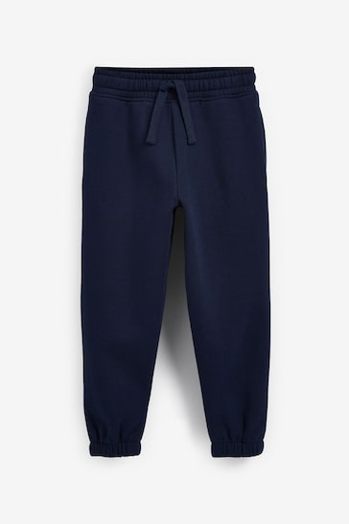



PE Days
Class | INDOOR PE | OUTDOOR PE
6O | Tuesday | Thursday
6B | Wednesday | Thursday
6E | Wednesday | Thursday
6M | Tuesday | Thursday
14

Slide 15

Communication
Download the Arbor App!
Check your emails for your username, this will have a link to click on.
Best way to receive communication from the school.
Trips, Clubs, Closures etc.
15

Slide 16




FRIENDS OF
WOODPECKER
CALLING ALL PARENTS & CARERS!
WE NEED YOUR HELP!
Are you interested in becoming a Class Rep?
We need you to help spread the word and drum up support for the events run by our Parent Teacher Association throughout the year.
Let your class teacher know if you would like to volunteer!

