Slide 1

Welcome to
Woodpecker Hall Academy Nursery
2025/26

Slide 2
Aims of this session:
Meet the team
Next steps in the induction process
(Dates, arrangements, classes)
How best to prepare your child for Nursery
What to expect when children start
Answer questions
2

Slide 3
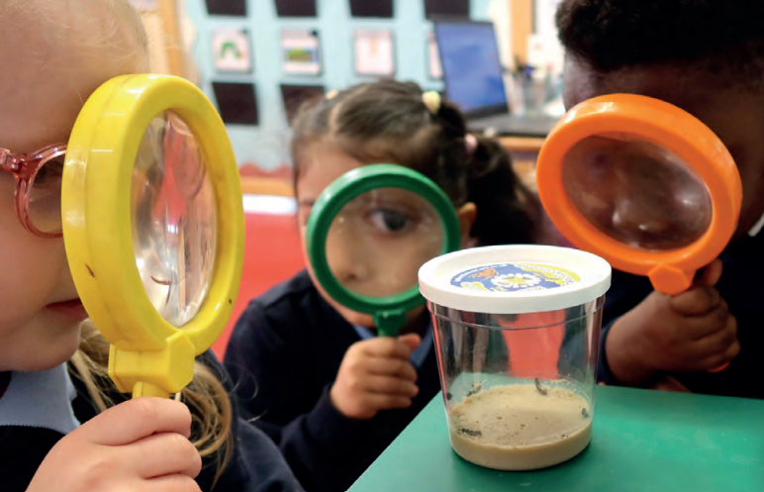
Who is who?
Headteacher: Nicky Ross
Assistant Headteacher for Early Years:
Hatice Mehmet
Year Leads:
James Mansfield/Selma Hassan
Full Time Class Teacher: James Mansfield
Nursery Part Time Class Teachers: Selma Hassan & Sevda Atakli
Early Years Practitioners:
Marta Cichocka, Afshan Hussein, Alida Culaj and Kirsty Daines
3

Slide 4
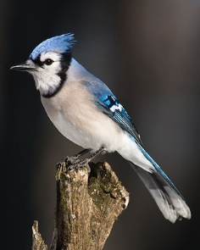
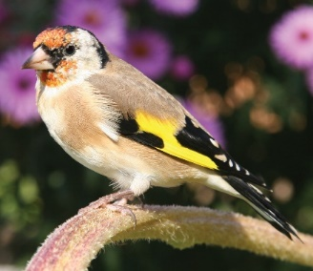
Nursery Classes
Finches
3 year old class
*Morning class
8.30-11.30am
*Afternoon class
12.15-3.15pm
Blue Jays
3 year olds class
* Full Time
8.30-3.15pm
4

Slide 5


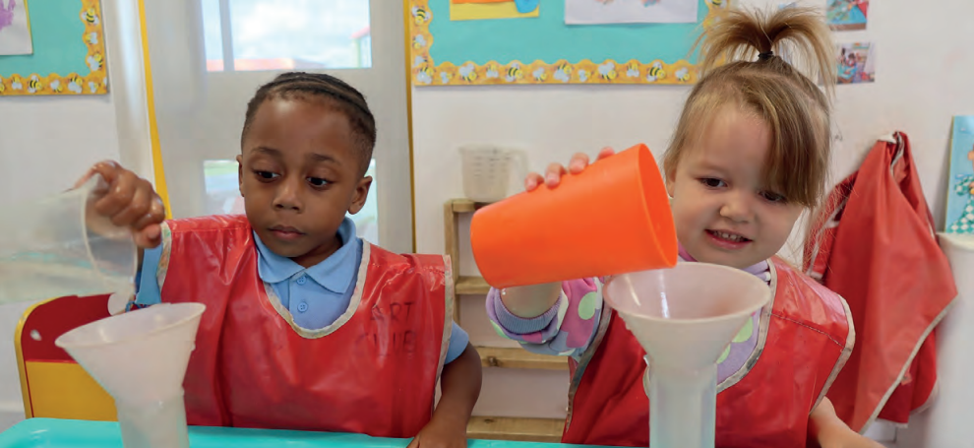
Wraparound Care
Breakfast Club
8:00-8:30pm
We offer the children cereal, toast, fruit and water.
After Nursery Care
3.15-6.15pm
Children staying in After Nursery Care will be provided with a light meal.
(See the Wrap Around Care menu)
5

Slide 6

Food
Fruit and Milk -Children are provided with a piece of fruit/vegetable and a carton of milk each day. We require the children to bring their own named water bottle.
Blue Jays – Bring packed lunch from home. (NO NUTS & FISH)
Lunch time is at 11.30am.
6

Slide 7


Packed Lunches
If your child is staying with us full time, please ensure they bring in a packed lunch. Please note that fizzy drinks, chocolate spreads and sweets/chocolates are not allowed to be brought in children’s lunch boxes.
Woodpecker Hall Academy is NUT and FISH FREE at all times. Please do not include any items in lunch boxes that contain fish/seafood, such as tuna and nuts, such as ‘Nutella’ and other chocolate spreads, peanut butter sandwiches or other nut items.
Children are encouraged to eat as much as they can. If your child experiences problems at lunchtime, we will let you know.
Anything not eaten will be left in the lunchbox.

Slide 8
Induction
Key dates and Information for Nursery 3-4 2025
Wednesday 2nd July 2025 9.00 am/Upper school Hall WHA | Information Meeting for parents and careers Letter about stay & play, staggered starts and home visits to be given with the information pack
Tuesday 15th July & Wednesday 16th July 2025 | Home visits This is for children who are new to our school and have not attended our Nursery provision before.
Thursday 4th September 2025 | Stay & Play session for Nursery children who are new to our school and have not attended our Nursery. (Parents are required to stay on site for this visit).
8

Slide 9
Induction
Key dates and Information for Nursery 3-4 2025
Friday 5th- 9th September 2025 | All information is in your letter. *Please note that if your child is unsettled, we will work with you to set up personalised settling-in process and times to support your child.
Monday 8th September 2025 (PT) Tuesday 9th September 2025 (FT) | All children will have started Nursery for their full allocated time. (*unless extremely unsettled)
9

Slide 10
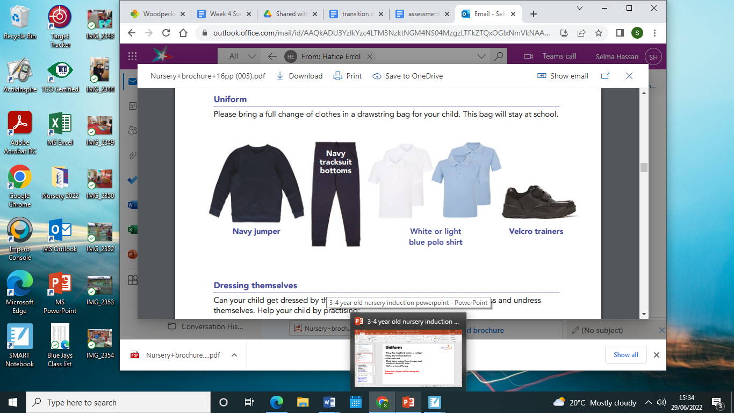
Uniform
Navy Blue sweatshirt, jumper or cardigan
Navy Blue tracksuit bottoms
White or light blue polo shirt
Black velcro trainers/shoes (no open-toed sandals or shoes with laces)
Wellies to stay at Nursery for Forest Garden.
Please label all your child’s clothing and footwear.
10
Notes:
Coat
Sun hat depending on weather

Slide 11


Bookbags
Reading is one of the most important things you can do to support your child’s education.
Each nursery child will be given a zippy wallet with a book and a reading record.
Please return this at least ONCE PER WEEK so we can change the book.
11
Notes:
Coat
Sun hat depending on weather

Slide 12
Be Ready for Nursery
It would really help your child to settle into Nursery if they can:
Dress and undress themselves (Coats and trousers when using the toilet)
Put on own shoes using two hands.
Use the toilet by themselves.
Use a cup to drink from/ be independent to eat a snack.
Sit down to listen to a story (concentration).
Have a regular and early bedtime routine.
Talk is key to learning (daily experiences).
It is also important that you talk to your child about their day at Nursery and encourage them to talk to us about their needs.
12

Slide 13
What to expect when your child starts…
-Even if your child has had a previous experience of nursery or playgroups, starting in a new environment might be unsettling (separation anxiety, tears, clinginess).
-Some children might be more tearful than others which unsettles those around them.
-We will encourage you to leave after a while, so that we can settle them in but we will always call you if needed.
13

Slide 14
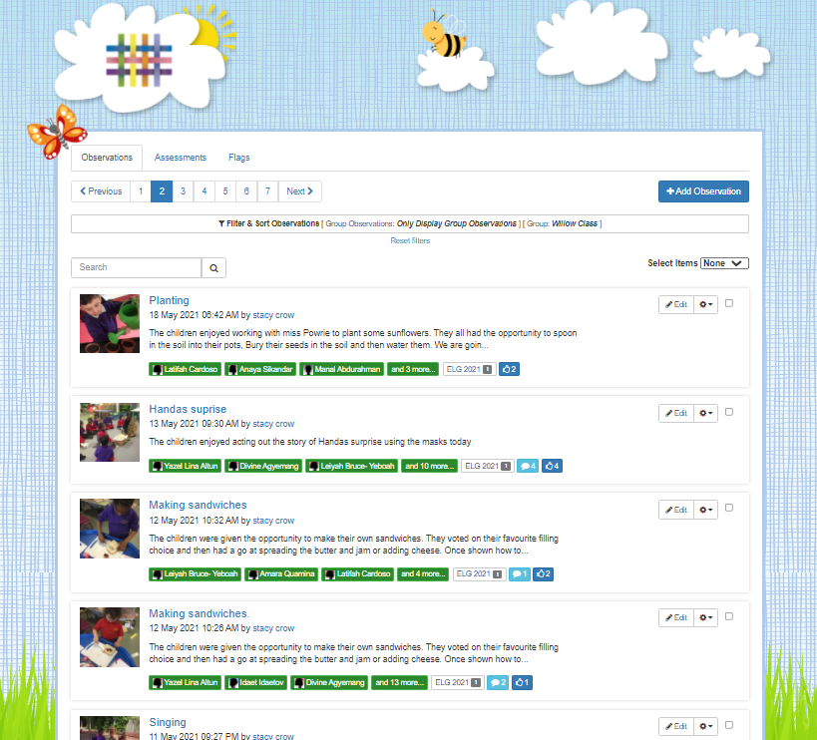
Tapestry
An Online Learning Journal system where staff record children's progress and activities, using tablet devices (iPads) and PCs.
Parents can view their child’s journal on mobile devices and on their home computers and can make observations of their own using a secure login system.
It creates a two-way communication between home and school.
In September, you will be set you up on Arbor.
We will also hold an information meeting dedicated to Tapestry by the end of September (Date tbc).
14

Slide 15
Woodpecker Hall Academy Website- Nursery
https://www.woodpeckerhallacademy.org.uk
Our Nursery page is updated regularly with information about what we will have been learning and how you can help your child at home.
All other information is in your information pack.
15

Slide 16


Friends of Woody
All parents are part of the Parent Teacher Association (PTA).
Friends of Woody.
Each class has x2 representatives (encourage parents to get involved).
All ideas welcome.
No organising of events just helping get things set up/helping at events.
Events only happen with your support.
16

Slide 17

Any questions?
17

