Slide 1

Welcome to
Woodpecker Hall Nursery
Puffins
2024/2025

Slide 2
Aims of this session:
Meet the team
The induction process
How best to prepare your child for Nursery
What to expect when your child starts
Answer questions
2

Slide 3

Staffing
Puffins (2 Year Old Room) Team:
Miss Angus
Ms Johnson
Mrs Ulasan
Miss Matondo
Mrs Acar
Head Teacher: Nicky Ross
Assistant Head Teacher for EYFS: Hati Mehmet
Nursery Team Leaders:
James Mansfield & Selma Hassan
3

Slide 4

Sessions
Puffins
2 year old class
*Morning class
8.30am-11.30am
*Afternoon class
12.15pm-3.15pm
*Full time
8.30am-3.15pm
*Wrap Around Care
3.15-6.15
4

Slide 5
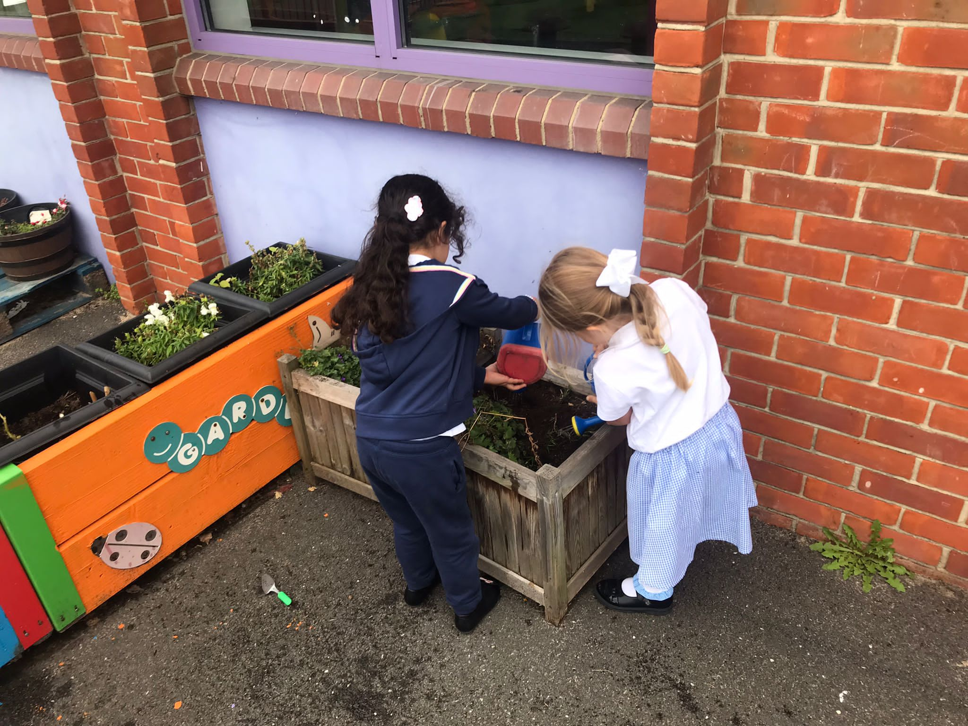
Curriculum
In the Early Years curriculum children under 3 focus on developing the Prime Areas of Learning:
    Personal, Social and Emotional Development
    Communication and Language
    Physical Development
Learning activities are planned in both the indoor
and outdoor environments.
The activities planned are influenced by the
children’s interests and observations made by
the practitioners.

Slide 6



Food
Fruit and Milk
Children are provided with a piece of fruit or vegetable every morning and a carton of milk.
Water Bottles
We encourage the children to bring their own named water bottle.
Full-time Puffins– Bring packed lunch from home.
Lunch time is at 11.30am.
Fizzy drinks and sweets/chocolates are not allowed in packed lunch boxes.
6

Slide 7

Sleep
Children are entitled to a sleep during the day if they wish to have one.
Sleep mats and blankets are provided in the quiet room.
Children in the sleep room are regularly monitored.
7

Slide 8
Toileting
All children are welcome to our setting; those who are toilet trained and those who may be wearing nappies or equivalent. We aim to work in partnership with parents towards toilet training children.
Parents/carers provide their own nappies and creams which are placed in the child’s individual box. Unless your child is in the process of toilet training, please provide regular nappies, not pull-ups.
Parents/carers also need to provide at least 2 changes of clothing (all items labelled with your child’s name).
Any soiled clothes will be returned home at the end of the session to be washed.
When your child is ready, we will support them, and you, with potty training.

Slide 9
Induction
‘Stay and Play’ sessions and staggered start for children.
To support your child’s settling into Nursery, we start children in small groups. This enables children to begin to form positive relationships with our practitioners, feel comfortable and happy in their new class and really support a positive start to Nursery.
9

Slide 10
Induction to Nursery
Home Visit – Thursday 4th September
Stay and Play – Friday 5th September
Settling In – Monday 8th and Tuesday 9th September
Start Nursery – Wednesday 10th September
You will receive a letter today regarding staggered starts and home visit times.
10

Slide 11
All children will start their allocated time once they are ready and settled.
Your child may need a personalised introduction to school that will help them to settle more easily.
11

Slide 12
Working in Partnership with Parents
Parents and carers are children’s first educators. We aim to work together with all our families and strive to achieve high standards of care and education.
Working in partnership with parents and carers will ensure that each child’s introduction to the nursery is managed with care and sensitivity.
We operate an ‘Open Door’ policy. Our parents and carers are welcome to view our settling and inquire about our policies.

Slide 13
Getting Ready for Nursery
It would really help your child to settle into Nursery if they can:
Help themselves with dressing and undressing.
Say when they have had a wee or poo in their nappy.
(In English or in their home language.)
Use a cup to drink from/ be independent to eat a snack.
Have a regular and early bedtime routine.
Talk is key to learning (daily experiences), it is important that you talk to your child about the world around them.

Slide 14
What to Expect …
-Even if your child has had a previous experience of playgroups, starting in a new place might be unsettling (separation anxiety, tears, clinginess).
-Some children might be more tearful than others which unsettles those around them.
-We will encourage you to leave after a while so that we can settle them in, but we will always call you if needed.
14

Slide 15
Key-Person System
On entering our setting, each child will be allocated a Key-Person (nursery practitioners) to bond with.
A Key-Person will be responsible for recording the progress each child makes and for communicating with parents/carers on a daily basis.
The adult to children ratio in our Puffins room is 1:5 at all times.

Slide 16
Clothes
Children must wear comfortable clothes in Puffins room (no uniform) and have at least two changes of clothing.
In order to help identify clothes, we request all garments, particularly outdoor garments, such as, sun hats and wellies are labelled or marked with the child’s name.
Footwear should be velcro and no shoelaces.
NO CROCS, NO SHOELACES AND OPEN-TOED SHOES PLEASE!

Slide 17

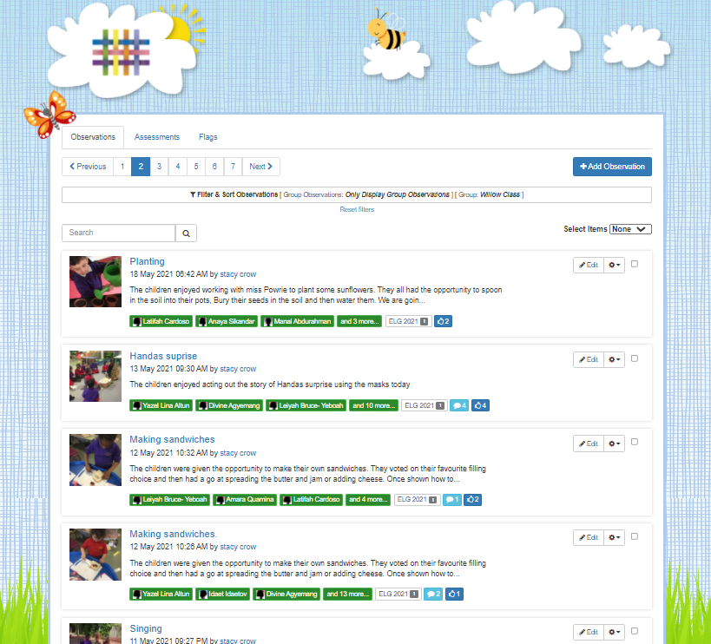
Tapestry
An Online Learning Journal system where staff record children's progress and activities using tablet devices (iPads) and PCs.
Parents can view their child’s journal on mobile devices and on their home computers and can make observations of their own, using a secure login system.
It creates a two-way communication between home and school.
In September, your class teacher will set you up on Arbor.
We will also hold an information meeting dedicated to Tapestry by the end of September (Date tbc).
17

Slide 18

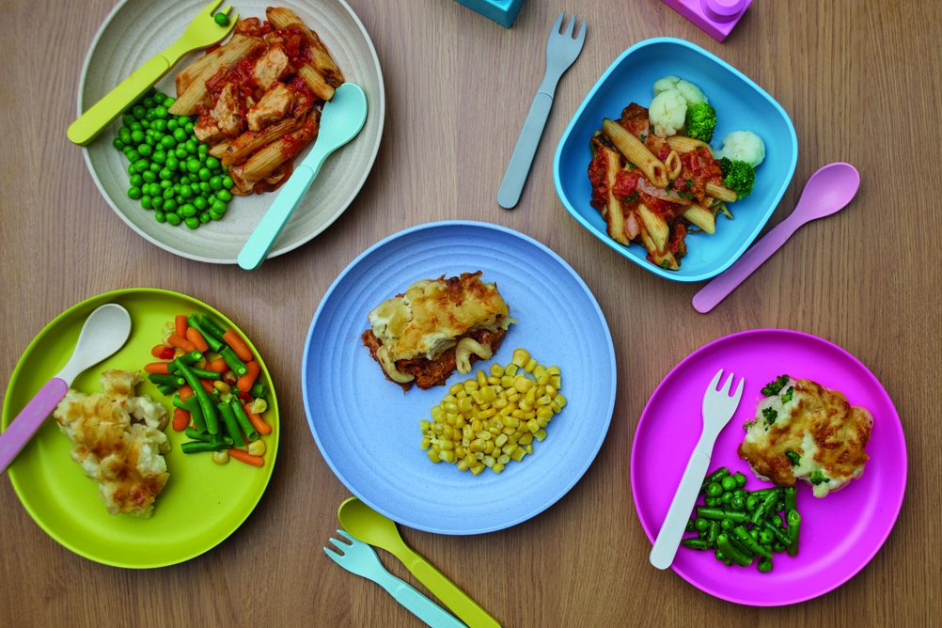
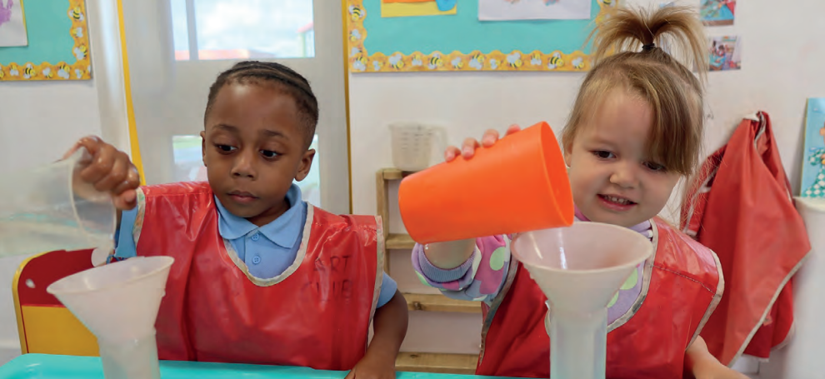
Wraparound Care
Breakfast Club
8:00-8:30pm
We offer the children cereal, toast, fruit and water.
After Nursery Care
3.15-6.15pm
Children staying in After Nursery Care will be provided with a light meal.
(See the Wrap Around Care menu)
18

Slide 19


Friends of Woody
All parents are part of the Parent Teacher Association (PTA).
Friends of Woody.
Each class to have x2 representatives (encourage parents to get involved).
All ideas welcome.
No organising of events just helping get things set up/helping at events.
Events only happen with your support.
19

Slide 20
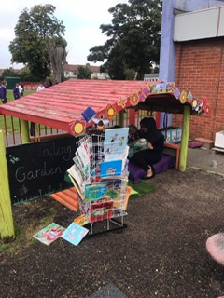
Nursery information on our website https://www.woodpeckerhallacademy.org.uk

Slide 21

Any questions?
21

